Slide 1
How does the Beer Distribution Game help us to understand Humanitarian Supply Chains?
David G Duddy Doctoral Researcher
Dr Damian Stantchev Supervisor
Dr Miles Weaver Supervisor
Notes:
This research seeks to establish the effects of variations in material flow under Push and Pull inventory strategies in the humanitarian supply chain and how the Bullwhip Effect impacts upon a humanitarian supply chain.
My motivation for undertaking this research was to gain a better academic understanding of my professional experiences and I appreciate that, in drawing on my own experience for some of this work, bias cannot be ruled out.

Slide 2
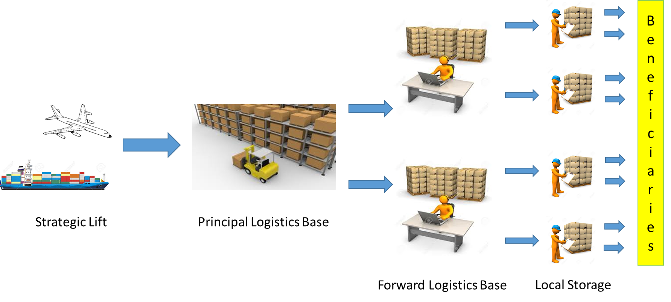
The Challenge
The Elements of the Beer Distribution Game. Adapted from Forrester (1958).
Humanitarian Supply Chain (simplified).
Notes:
Until recently, humanitarian logistics was not necessarily recognised as a specific, niche discipline; instead, it was viewed by many as an application of commercial, or even military logistic thinking to a humanitarian relief operation. Overstreet, et al recognise that humanitarian logistics, and the design of humanitarian supply chains in particular are fundamentally different from those of commerce.
The majority of humanitarian practitioners are schooled in commercial logistics: a situation acknowledged by the World Food Programme (WFP) Logistic Cluster in their 2016-2018 Strategy paper. The importance of coordination and the need for efficient passage of information is highlighted by both Akhtar, et al and Tomasini and Van Wassenhove.
For example, an aspect of inventory strategy which is more important in the humanitarian supply chain than in the commercial world is that of Push and Pull logistics; Oloruntoba and Kovacs look at this in some detail.
In coming to understand commercial supply chains, we benefit from the existence of several accepted reference models, probably the most famous being Forrester’s Beer Distribution Game. This research sets out to map this model across to a typical humanitarian supply chain to ascertain how might a humanitarian version of the Beer Game model look and what challenges are thrown up.

Slide 3
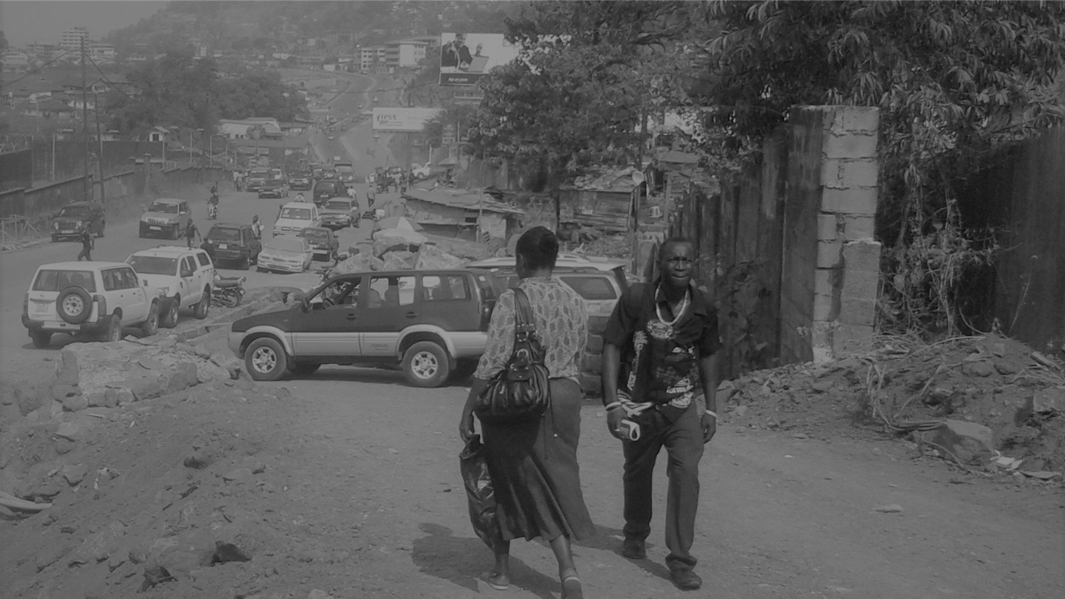
Methodology
Case Study: Ebola Crisis, Sierra Leone, 2014 – 15
Primary resources
Observation
Interviews (WFP and MSF)
Evaluation reports (WFP and WHO)
Secondary resources
E.g. Journal of Humanitarian Supply Chain Management International Journal of Physical Distribution and Logistics;
Conference papers
Books / publications
Notes:
The basis of this research is the Emergency Intervention in Sierra Leone in response to the 2014/15 Ebola Crisis. Through observational study of this case, augmented by interviews and the review of post-operational evaluation reports, it has been possible to map the supply chain which delivered emergency supplies to this emergency effort.
The literature which has contributed to this research is drawn from a wide range of sources. The literature has also offered some conflicting views, particularly in the definition of the customer, and confirmed some rather uncomfortable truths regarding supply chain ownership and control, the role and influence of donor organisations and the flow of materials and information.

Slide 4
The Research
Definition of ‘The Customer’
The [Intelligent] Customer and The Beneficiary
Commodity Control Interface
The Collaboration Envelope
Customer / Consumer Interface
Where the demand is generated
Humanitarian Supply Chain Management
Chain or network?
Bullwhip Effect
The effect of Push Logistics, Pull Logistics and Local Procurement
Notes:
The first step in developing this model is to analyse and define who the customer is, what role they play and how much influence they have on the humanitarian supply chain. The Beer Game relies on the Lysons and Farrington definition of the customer as ‘simply the recipient of the goods or services that result from all the processes and activities of the supply chain’ because the customer is the consumer; however, this is not necessarily the case in the humanitarian context. The consumer will be the family left without shelter after the earthquake, the baby suffering from malnutrition or the young man who has contracted Ebola. But these individuals cannot be the customers in the humanitarian version of the Beer Game because while they place a demand on the supply chain, sometimes without knowing it, they cannot influence the meeting of that demand.
Taking the logic of Nienhaus, the customer is the individual that places a demand for a specific item, therefore in the humanitarian logistics paradigm the customer must actually be an appropriately experienced or qualified Subject Matter Expert. This is the person on the ground, closest to the disaster, who has oversight of the local needs.
Specifically, this research looks at these five key areas.

Slide 5
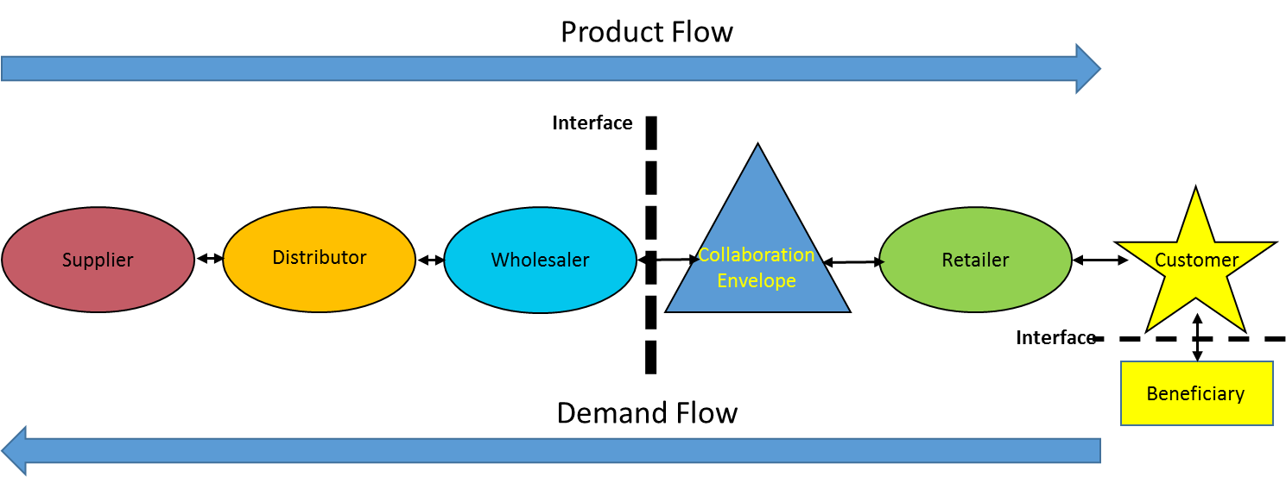
The Commodity Control Interface and the Collaborative Envelope.
Notes:
Humanitarian supply chains become increasingly complex once commodities have crossed the international interface to enter a country receiving aid assistance. When more than one aid agency is involved, a number of individual supply chains are often established, catering for the needs of each specific NGO. MSF’s 2016 Review shows that this was the case during the Ebola Crisis.
Here, the Logistic Cluster coordination begins and collaborative working starts. It is also the point where in-country NGOs come to appreciate the holistic priorities of the aid programme in addition to the priorities of their specific project. In classic PRINCE2 terms, this is the point where project management is superseded by programme management, with the Logistics Cluster acting in a similar manner to a Programme Board. The interface between the individual NGOs and the collaborative envelope of the Logistics Cluster is where NGOs are most likely to relinquish control over commodities to address priorities outside their sphere of influence.
Even in a simple humanitarian supply chain where there is only one NGO providing all the aid, the customer will be the SME and the consumer, the beneficiary. The consumer’s simple needs of medical aid, food, water and shelter are translated into a complex demand for commodities. These demands inform the supply chain of the exact nature of commodities required by the consumer and these are passed along the supply chain to the entity acting as the ‘retailer’. Between the retailer and warehouse sits the collaborative envelope: a logistics services and supply brokerage where NGOs and other aid agencies come together to coordinate disparate supply chains and collaborate in the resolving of Issues for the many potential beneficiaries across the programme.
However, a pre-requisite for such a complex supply chain to work efficiently as well as effectively, there must be an effective flow of information along the entire supply chain and a supporting flow of information and guidance up to and down from individual NGO and governmental strategic decision makers.

Slide 6
Humanitarian Supply Chain Complexity and Role of Local Procurement
Notes:
In variance to the Beer Game’s simple supply chain, a single humanitarian supply chain sees more than one commodity being supplied in a shared, operationally focused chain, where often, a single, identical commodity type may be supplied by more than one donor. The humanitarian supply chain sees distinctly different actors and different flows, and relationships and interfaces are also significantly different from commercial supply chains where profit is a key driver.
To ensure that a demand surge does not always adversely impact on other operational priorities, the humanitarian supply chain has the advantage of local procurement: the utilisation of financial resources in the theatre of operations to buy in materials, equipment or services. This can also be used to relieve pressure on the supply chain in the event of delays or losses. However, as Willets-King and Harvey observe, local procurement can bring its own problems, from profiteering and corruption and bribery.

Slide 7
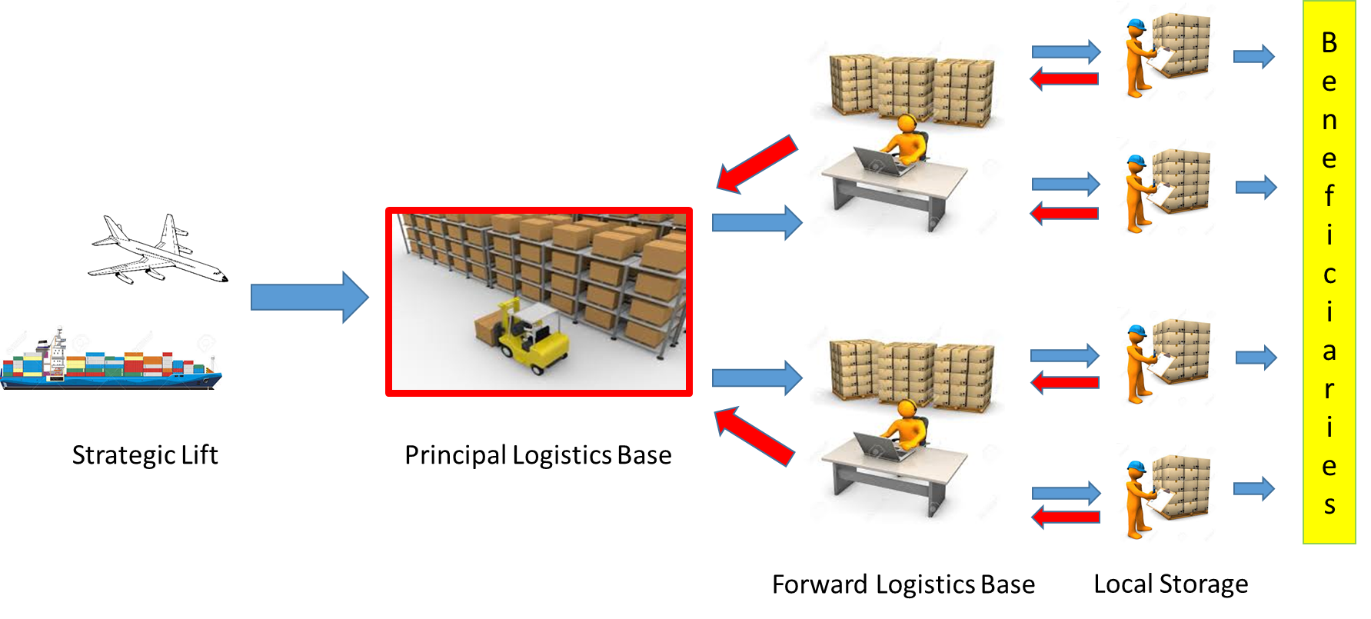
Flow of materials including the reverse supply chain
Notes:
Push logistics as a humanitarian supply chain strategy differs profoundly from the commercial world in that there is no anticipation of demand based on long-term forecasting and inherent uncertainty. Push strategies tend to be employed early in humanitarian operations to ensure a sufficient volume of urgently required specific material is delivered to the point of need. Push tends to give way to Pull once effective supply chains have been established. The effectiveness of such supply chains is determined by the flow of information. In the case of the Ebola Response in Sierra Leone, commodities were sent forward from the logistic base at Port Loko to district storage facilities where bulk was broken down before being forwarded to points of need. Where items were delivered as part of multi-commodity packs, some commodities were needed and others not. Due to the frenetic work involved in forwarding materials, items which were not required were held in storage by local NGOs ‘Just in Case’ rather than being immediately back-loaded for redistribution. Some storage facilities began to fill with unnecessary items but the Logistics Cluster was in a position to instigate a reverse supply chain to relief the pressure on these facilities.
Due to the nature of Push logistics, commodities managed this way tend to flow relatively freely along the humanitarian supply chain. Blockages do occur where:
Air consignments are being consolidated;
At international frontiers due to customs delays;
Breaking bulk occurs at principal logistics bases in preparation for onward distribution;
Where delays caused by transport issues and lack of infrastructure arise;
Where bureaucratic challenges arise, including corruption and other losses to the supply chain.
However, because the flow is determined and controlled at a point close to the donor, and the supply chain support infrastructure of national ports of entry, warehousing and bulk cargo transportation is managed by the in-country NGO or Logistics Cluster, despite administrative delays intimated above, there is little evidence of the Bullwhip Effect.
At the point when the inventory management mode switches from Push to Pull logistics, an effect similar to the Bullwhip Effect is generated which affects only part of the supply chain. In humanitarian logistics, this switch creates a log-jam at the principal logistic base because commodities being pulled forward tend to move more slowly and in smaller volumes than when they are pushed. At the same time, the reverse supply chain becomes more effective for the redistribution of items required elsewhere, but all the while, donations still arrive in country. This all requires significantly larger ‘rear area’ storage facilities near the point of entry and a management system to coordinate the arrival of new materials, the redistribution of reserve supply chain commodities and the effective reaction to demands from frontline local agencies. At this point, the ability of the Logistics Cluster to inform strategic planners is critical to influencing the stream of donations.

Slide 8
Conclusions
Bullwhip Effect in Push and Pull Logistics
Customer v Beneficiary
Contribution to knowledge
Implication of this research
Notes:
During the initial, Push logistics phase of an emergency operation, material flows to the point of need as fast as possible, and often the demand will outstrip supply, as any demand placed by the customer will only be satisfied if it is available and can be transported to the point of need. So, the humanitarian Push inventory supply chain will rarely result in the initiation of the Bullwhip Effect.
During the subsequent Pull phase, any Bullwhip Effect can be mitigated by routing commodities efficiently from other donors to the Logistics Cluster, from where they can be directed on to beneficiaries. This, together with the use of local procurement requires an effective and proactive collaboration envelope, capable of maintaining information flow vertically between logistic practitioners in-country and strategic logistic planners in NGO and IGO global HQs.
In the Beer Game, the customer is a decision maker who discerns whether they want the item and what they are prepared to pay for the item. The beneficiary of emergency aid performs neither of these functions; rather, it is the local subject matter expert that makes these decisions on behalf of all beneficiaries with his/her sphere of influence.
This research contributes to knowledge by mapping the complexities of the humanitarian supply chain and identifying the difference between the customer of a commercial supply chain and that of a humanitarian supply chain. This is turn draws attention to the level of understanding of humanitarian supply chains by commercial logistics practitioners and strategic planners. The implication therefore is that humanitarian supply chains need to be better understood and that the creation of a conceptual framework which encapsulates the workings of the humanitarian supply discipline would benefit Humanitarian Emergency Operations stakeholders.

Slide 9
What Next?
Humanitarian Supply Chain or Supply System
How do the skill sets of humanitarian logisticians differ from those of commercial logisticians?
Does formal governance exist in humanitarian supply chains and if not, does it need to?
How could a conceptual framework combining skill sets and governance benefit the development of humanitarian supply chain management?
Notes:
Quick flash – 5 seconds

Slide 10
References
Akhtar, P., Marr, N. and Gamevska, E. (2012), ‘Coordination in Humanitarian Relief Chains: Chain Coordinators’. Journal of Humanitarian Logistics and Supply Chain Management, Vol 2(1), pp.5-14.
Forrester, J. W. (1958), ‘System Dynamics: A major breakthrough for decision makers’. Harvard Business Review, 36(4), pp.37-66.
Lysons, K. and Farrington, B. (2006), ‘Purchasing and Supply Chain Management’. 7th Ed. Harlow, Pearson Education Ltd.
MSF (2016), ‘OCB Review 2016’. Operational Centre Brussels, Médecin Sans Frontières, Supply Annex and Logistic Annex. Available at: http://evaluation.msf.org/evaluation-report/ocb-ebola-review-2016 [Accessed 2 Jun 17].
Nienhaus, J. (2002), ‘What is the Bullwhip Effect Caused By?’ Supply Chain World Europe 2002 Conference, 28-30 October 2002, Amsterdam.
Oloruntoba, R. and Kovacs, G. (2015), ‘A commentary on agility in humanitarian aid supply chains’. Supply Chain Management: An International Journal, Vol 20(6), pp.708-716.
Overstreet, R.E., Hall, D., Hanna, J.B. and Kelly Rainer Jr, R. (2011), ‘Research in Humanitarian Logistics’. Journal of Humanitarian Logistics and Supply Chain Management, Vol 1(2), pp.114-131.
Tomasini, R. and Van Wassenhove, L. (2009), ‘Humanitarian Logistics’. Basingstoke, Palgrave MacMillan.
WFP (2017) Summary Evaluation Report of WFP’s Ebola Crisis Response: Guinea, Liberia and Sierra Leone. Rome, WFP Executive Board Report WFP/EB.1/2017/6-B dated 17 Jan 17. Available at: http://documents.wfp.org/stellent/groups/public/documents/eb/wfp289348.pdf [Accessed 22 May 17].
Willetts-King, B. and Harvey, P. (2005), ‘Managing the Risks in Humanitarian Relief Operations’. Final Report. Humanitarian Policy Group, Overseas Development Instiute, DfID.

Slide 11
Questions
David G Duddy david.duddy@napier.ac.uk

