Slide 1
Community OR:
Creating a ‘Shared Space’ to build value between business and communities
Miles Weaver
Associate Professor,
International Centre for Management & Governance Research,
Edinburgh Napier University Business School
m.weaver@napier.ac.uk @weavermiles
Also contributing:
Crossan, K., McCallum, L., Paxton, S., and Tan, H.
Notes:
Creating
Approaches to Building “Value” between Responsible Businesses and Communities:
Creating “Shared Spaces”
to Build “Value” between Responsible Businesses and Communities
Using a Systems Approach to Help Responsible Businesses and Communities to Build Value
Creating “Shared Spaces” to Unlock Business Resources into Communities and Evaluate “Value”
Within this relationship is conflict … difference in language way one dresses

Slide 2
Outline
Current projects/interests using “Systems Thinking” to address “grand challenges”
  between business, the third sector, power and the active citizen
KTP Project with VAF: Using a systems approach to unlock business resources into communities
Three key concepts emerging from understanding different perspectives & embedded in the ‘Connect’ model
  Fostering ‘open space’ to invest in social capital
  Co-creation of business-community value
  Role of a conduit to unlock & prepare a ‘shared space’
‘Boundary Idea’ in creating a ‘Shared Space’ to build value between business and communities

Slide 3
United Nations (Accessed: 15.03.17)
Notes:
SD goals: economic growth (8) & partnerships for the goals (17)

Slide 4
The Sustainable Business challenge:
To reconnect business and societal goals
Trends and calls to reconnect business and societal goals, going beyond CSR as a firm’s only moral obligation (e.g. Porter and Kramer, 2011; Bansal & DesJardine, 2014; Scagnelli and Cisi, 2014).
Need for business to rearticulate its place in society and develop long-term sustainable business models (Lacy et al., 2012) that address societal priorities.

Slide 5
Releasing business resources into communities: Role for COR?
In the context of Midgley and Ochoa-Arias (1999) call to Community OR practitioners, we seek to understand:
How best to unlock and release the resources held by the for-profit sector (as part of responsible business practice) into communities?
Resource allocation
How can these communities themselves, represented by third sector organisations help to evaluate the impact of this resource allocation?
Evaluation services

Slide 6
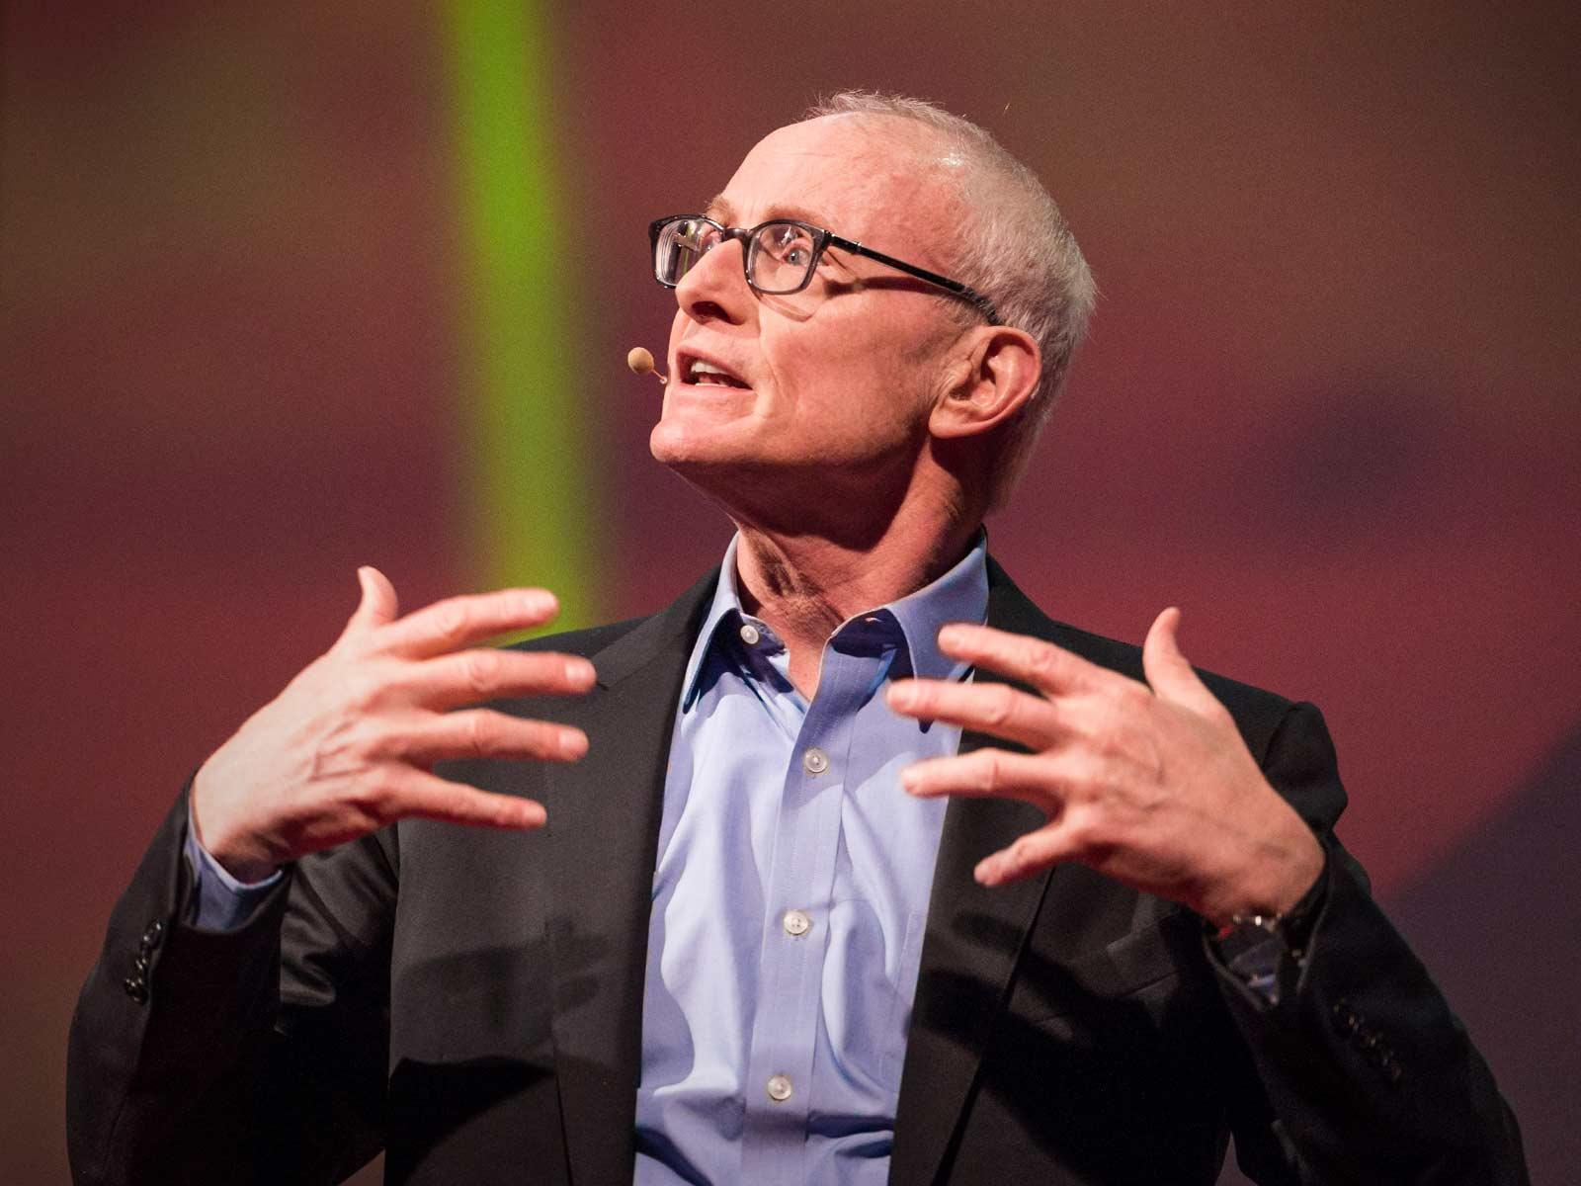
Michael Porter puts forward the case for “letting business solve societal problem” … thoughts?
“I think if we can get business seeing itself differently, and if we can get others seeing business differently, we can change the world”
(Porter, 2013)
https://www.ted.com/talks/michael_porter_why_business_can_be_good_at_solving_social_problems/
(Accessed: 09/01/16)
Porter and Kramer (2011) proposes the concept of shared value: addressing a social issue with a business model
“There's a fundamental opportunity for business today to impact and address these social problems, and this opportunity is the largest business opportunity we see in business” (Porter, 2013)
Notes:
Porter and Kramer (2011) proposes the concept of shared value: addressing a social issue with a business model and argue:
“Capitalism is under siege ... Diminished trust in business is causing political leaders to set policies that sap economic growth .... Business is caught in a vicious circle ... The purpose of the corporation must be redefined around SHARED VALUE”
“There's a fundamental opportunity for business today to impact and address these social problems, and this opportunity is the largest business opportunity we see in business” (Porter, 2013)
Three opportunities for companies to CSV (Porter and Kramer, 2013):
1. By reconceiving products and markets
2. By redefining productivity in the value chain
3. By enabling local cluster development

Slide 7
John Mackey: three legged stool of society
“Tear down the conceptual wall around motivation”
“for-profits and non-profits should act like colleagues … allies … should be working together”
“so much in common … rather than differences”
“non-profits can do what for-profits cannot do”
“for-profits bring capital and skills”
“One difference: Non-profits have ’donors’ expects a return on donation but not on capital”
“both need to become more conscious”
(Mackay, 2016)
“More than just about money”
Reconnect with the ‘higher purpose’?
Both based on
‘voluntary exchange’
VALUE
+
+
SCALE
VALUES
+
+
ASSET-BASED
Governments
Play Umpire
+
Do what ‘non-profits’ & ‘for-profits’ cannot do
BUT
Selfishness & greed?
For-profit
Not for-profit

Slide 8

Connecting with the ‘higher purpose’: Profit + Purpose
Recognition that business create resources (most of them); they do this when they can meet a need and make a profit (Porter, 2013)
Business part of the solution
  myth: business part of the ‘problem’?
  NOT ALL societal problems can be solved through shared value solutions (Porter, 2011)
Growing consensus: “Doing well by doing good”
  the ‘conscious’ capitalist
  Creating Shared Value
  Creating Sustainable Value
Notes:
“Most wealth in business … only business can create resources … when it can meet a need … when it makes a profit ….”
Position that is good for business AND society
Need for business to rearticulate the place they hold in society, comply with community standards and to develop long-term healthy business models (Lacy, Haines and Hayward, 2012; Porter, 2011)
Key Enablers include (Lazlo, 2005; Laszlo and Zhexembayeva, 2011; Zadek and Radovich, 2006; Porter, 2011): innovation, learning and partnerships
Companies pursuing ‘product stewardship’ strategies: integrating stakeholder views into business processes. Drivers: civil society, transparency and connectivity (Hart, 2005; 2008).
Shaped by ever changing customer perception and legal requirements (Banerjee, 2001)

Slide 9
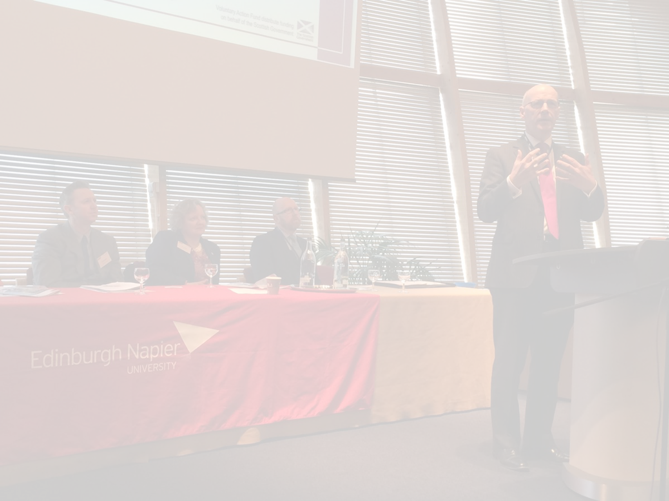

Initial conversation with the Client
The questions posed by VAF:-
How can VAF bring about more resources (e.g. people/skills, physical assets and money) into communities?
  But … Where is this resource pool?
  In a Scottish context, the third sector attracts £4.9 billion in funding from various sources, using SCVO statistics 34% (£1,686m) comes in from the public sector (includes local, devolved and national governments) when only 1.5% (73m) comes from the private sector (Weaver, Crossan, Tan & Paxton, forthcoming).
  Median donation by FTSE 100 companies have trebled from £1m in 2007 to £3 million in 2012 (CAF Bank, 2014)
What business models can VAF adopt to tap this resource pool?
To release existing and potential resources within communities by investing money, increasing capacity and building relationships
(VAF Mission Statement, 2015-2018)
Notes:
How can ‘we’ bring about more resources (people, skills and money) into communities?
But … Where is this resource pool? How can it be tapped?
What are the challenges and opportunities facing each sector in connecting and aligning ?
Third sector
Business
Government(s)
Public

Slide 10
Workshops held to form a multitude of perspectives over three cycles of SSM
Cycle | Category | No. of RP Workshops | No. of Participants
 |  |  | Cycle 1 |  | Cycle 2 | Cycle 3
1 | VAF trustees | 2 | 10
 | VAF managers | 1 | 6
 | VAF staff | 2 | 11
2 | Third Sector VAF funded organisations | 2 |  |  | 12
 | Third Sector non-funded organisations | 3 |  |  | 19
 | Other Grant-makers and umbrella bodies | 1 |  |  | 5
3 | Local Government | 2 |  |  |  | 17
 | Scottish Government and their agencies | 2 |  |  |  | 10
 | Public Sector bodies | 2 |  |  |  | 13
 | Total number of workshops/participants | 17 | 27 |  | 36 | 40
 |  | Survey responses (funded organisations) |  |  | 26
 |  | Regular dialogue with key stakeholder |  | 8
 |  | Critical friend interviews |  | 2 | 4 | 2
Note: Cycle 4 involved Scottish Businesses. Data collected but outside of the scope of this presentation.
Notes:
Workshops held for each cycle to express the problem situation from a multitude of perspectives

Slide 11
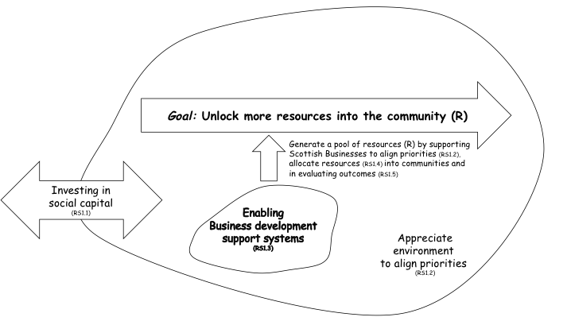
The ‘VAF Connect’ emblematic model

Slide 12
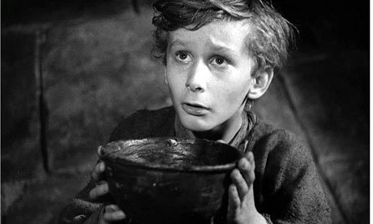
Issues/challenges facing third sector organisations in Scotland
Funding & funding cycles
Setting priorities
Skills and assets (human resources, skills and physical assets)
Relationships between and within the public, third & private sectors
Operating environment and climate
Notes:
Stage 1: Finding out about a problem situation
Stage 2: Formulating some relevant purposeful activity models
“Square holes for circle problems”
“Sometimes what you get offered is maybe not what you need, you don’t need a day with 100 volunteers coming up to do a community garden, actually what you need is real capacity building, in a way that might be to support, IT support, not necessarily covering head office costs but core sustainability funding and I think, corporates are starting to get that”
(Third Sector workshop participant)
Castle with high walls between sectors
“the private sector does one thing … the government another … and the third sector doing a third thing” (Cycle 2 Participant)
“these were all very inter-connected and the relationships going backwards and forwards were central to everything that happens”
(Cycle 2 Group)
the “big squeeze” (operating environment & climate)
“less of CSR tick-boxing exercise … and tokenistic partnerships [with TSOs]”
“right communities resources targeted with the most appropriate resources”
the “ball and chain”
(Constraints imposed on TS & outcomes that funder expects)
Reinforced by a critical friend (a grant-maker):
“business do not really know how the modern charity works”
“Some relationships are good … some very superficial”
“a lot of businesses don’t know how to engage”
the perceived “begging bowl”
the “begging bowl” – a constant ask in the absence of sustainable change - a transactional relationship)
Cogs:
”funding is peripheral although essential to making things happen, the work carries on even if we don’t have these two things”
Cog’s keep turning because “third sector people make them work, might take longer but we keep going”
“third sector are closest to communities and people … we continue to address ‘circle problems’ even when hindered to do so … we commit a lot of resources to applying for funding that distracts us from addressing real issues”
Fish:
Within this relationship is conflict … difference in language way one dresses

Slide 13
Bottom-up movements for social change
Critical friends noted that “Islands of good practice exist” but struggled to think of any examples of joint working
Many examples could be offered of people, self-organising, coming together around a cause
“people are at the heart of communities, you also find the same people holding positions in different sectors … there are no barriers … actually no such thing as sectors” (Cycle 2 participant, supported by Scottish Government, Policy Manager)
“Businesses are part of these communities already … particularly seen in SMEs”
(Critical friend, grant-maker)

Slide 14
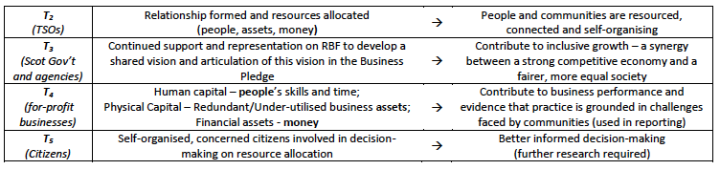
Multiple 'Ts' from different perspectives
Root Definition for the refined ‘Connect’ model:
A system, organised by VAF people to bring about a transformation in the relationship between aligned responsible business and third sector aspirations and open ‘shared spaces’ for these relationships to allocate resources (i.e. people, assets, money) and evaluate outcomes on joint value created.

Slide 15
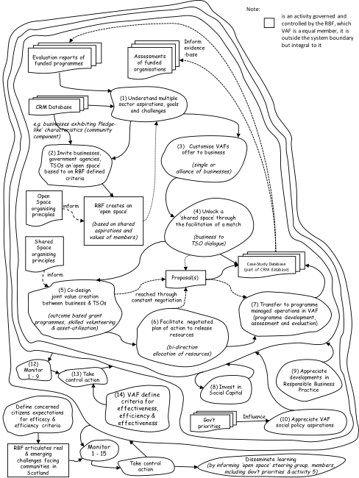
Root Definition for the refined ‘Connect’ model:
A system, organised by VAF people to bring about a transformation in the relationship between aligned responsible business and third sector aspirations and open ‘shared spaces’ for these relationships to allocate resources (i.e. people, assets, money) and evaluate outcomes on joint value created

Slide 16
Three key concepts embedded into the refined connect model
Fostering ‘open space’ to invest in social capital
  Boundary and governance arrangements
  Shared aspirations and values between participants
  Continuously debate diversity of sectors participating in open system
  Reciprocity in the relationships and borrowing ideas from the ‘common good’
Co-creation of business-community value
  Shared dialogical space between the market, state & third sector
  Shift from “them and us” to “what can we do for each other”?
  Communities and themselves are best placed to describe and address challenges
Role of a conduit to unlock and prepare a ‘shared space’
  Capacity to develop power & political agency
  Prepare the ground prior to unlocking the ‘shared space’ (the “ask” becomes part of the co-created solution)
  Shared understanding, use best practice, build social capital
  Bring together coalitions of interested parties (e.g. SMEs)

Slide 17
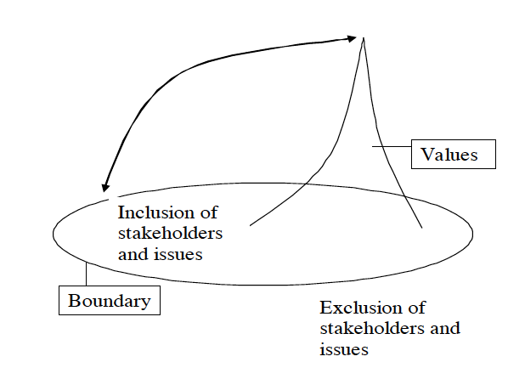
The Boundary Idea
(See Midgley, 2016)

Slide 18

‘Boundary Idea’ in creating ‘shared space’ (I)
Initial guiding principles for a conduit that unlocks and prepares a ‘shared space’:
Understand ‘issues’ (’open spaces’ provide a listening opportunity)
Better channel stakeholders “haves” & “wants” (particularly, the TSO “ask”)
Minimise potential conflict by preparing the ground & level playing field
Identify potential ‘fit’ between partners ’values’

Slide 19
‘Boundary Idea’ in creating ‘shared space’ (II)
Initial guiding principles for a conduit that unlocks and prepares a ‘shard space’:
Utilise & share good practice
Build social capital (the ‘relationship’)
Potential to pool resources by bringing together coalitions of interested parties (e.g. SMEs) around ‘shared values’
Primary activity once a suitable match has been made: Facilitate the co-creation of solutions, efficient allocation of resources and evaluation

Slide 20
(1) Prepare the groundwork for each ‘shared space’ by Identifying each VISION
V Values | List the values detailed by cause/location and Worldview of donor/benefactor
I Issues | What Issues are each of the stakeholders passionate about/areas to make a difference?
S relevant Stakeholders | Who are the relevant stakeholders (e.g. beneficiaries, donors, TSO, Gov’t actors and concerned citizens) who will participate in the shared space?
O Ownership | How should the shared space be governed, power appropriately distributed, marginalised views best represented and who takes a governance leadership role with the support of the conduit to address conflict as it arises?
N Network (social capital) | How are the issues and combined social capital of participants bounded? What relationships currently exist that can be engaged and built upon to deliver impact?

Slide 21
(2) In a ‘Shared Space’ debate what MATTERS to realise each VISION
M Money | funds that can be made available
A Assets | both redundant resources & physical resources that can be offered
T Time | human capital measured in time & skills
T Transformation | the purposeful activity expressed as a transformation of input (M, A, T & R) to output (desired impact)
E Environment | the key constraints outside the system boundary that are significant to the system
R Relationships | Existing relationships formed with and between stakeholders, Who might have a stake in evidencing the impact

Slide 22
Addressing different ‘perspectives’?

Slide 23

Summary & further work
Opportunity exists to better allocate resources from “for-profit” organisations into communities, recognising that the third sector and communities themselves best understand real and emerging issues/challenges and should help to evaluate impact
Further work to integrate the ‘Boundary Idea’ into a process framework that offers guidelines to unlock and prepare a ‘shared space’
  supporting the co-creation of business-community value &
  allocating resources to make this happen and evaluation
  …. a clear role for COR?

