Slide 1


A Systems Thinking Approach to Connecting and Aligning CSR Responses to Social Need in Scotland
* Miles Weaver, Steven Paxton,
Anne-Marie Reilly, Hock Tan,
Kenny Crossan
* m.weaver@napier.ac.uk
@DrMilesWeaver /
@VolActionFund
Notes:
Are we adopting the right approach?
Lead to methodological considerations
Our contribution to knowledge is around extending SSM with multiple cases and other data points in areas that the ‘problem situation’ requires further depth (i.e. reporting content analysis, survey of funded organisations)
How we will use the approach to provide an evidence base for building social capital and lead role for VAF in decision making (this includes how the RPDs underpin the CMs to be developed from different perspectives).
Miles Weaver, Steven Paxton, Hock Tan, Kenny Crossan, Anne-Marie Reilly
The session aims to present a conceptual model of the governance is- sues in connecting and aligning the CSR activities of Scottish Busi- nesses and the real and emerging needs in Scotland and the third sec- tor. This forms part of a KTP funded project to design and establish a grant-making platform for the Voluntary Action Fund that encourages the engagement in volunteering and social action in a Scottish context.
The session explores how a ’systems thinking’ approach may pro- vide an interesting avenue to explore governance issues to embed sustainability in organisations and across supply chains. Particularly, sustainability-responses that focus on transparent and stakeholder en- gagement.

Slide 2
Session Outline
Presentation Aim: To identify the themes in connecting and aligning CSR/Sustainability responses to the real and emerging challenges in Scotland and methodological concerns in the KTP project
Rationale for Knowledge Transfer Partnership (KTP) project with the Voluntary Action Fund (Scotland)
Adopting a soft systems methodology approach to the KTP
Emerging themes of the problem from the pilot study with VAF employees and trustees
Towards building a conceptual system model(s)
Future directions and research agenda
Notes:
Miles
Miles Weaver, Steven Paxton, Hock Tan, Kenny Crossan, Anne-Marie Reilly
The session aims to present a conceptual model of the governance is- sues in connecting and aligning the CSR activities of Scottish Busi- nesses and the real and emerging needs in Scotland and the third sec- tor. This forms part of a KTP funded project to design and establish a grant-making platform for the Voluntary Action Fund that encourages the engagement in volunteering and social action in a Scottish context.
The session explores how a ’systems thinking’ approach may pro- vide an interesting avenue to explore governance issues to embed sustainability in organisations and across supply chains. Particularly, sustainability-responses that focus on transparent and stakeholder en- gagement.

Slide 3
Session Outline
Presentation Aim: To identify the themes in connecting and aligning CSR/Sustainability responses to the real and emerging challenges in Scotland and methodological concerns in the KTP project
Rationale for Knowledge Transfer Partnership (KTP) project with the Voluntary Action Fund (Scotland)
Adopting a soft systems methodology approach to the KTP
Emerging themes of the problem from the pilot study with VAF employees and trustees
Towards building a conceptual system model(s)
Future directions and research agenda
Notes:
Miles
Miles Weaver, Steven Paxton, Hock Tan, Kenny Crossan, Anne-Marie Reilly
The session aims to present a conceptual model of the governance is- sues in connecting and aligning the CSR activities of Scottish Busi- nesses and the real and emerging needs in Scotland and the third sec- tor. This forms part of a KTP funded project to design and establish a grant-making platform for the Voluntary Action Fund that encourages the engagement in volunteering and social action in a Scottish context.
The session explores how a ’systems thinking’ approach may pro- vide an interesting avenue to explore governance issues to embed sustainability in organisations and across supply chains. Particularly, sustainability-responses that focus on transparent and stakeholder en- gagement.

Slide 4

Violence Against Women
Fund
£11M
Grant programmes
2014-15
Total Funds Distributed £19.9M
VAF’s Vision
That people and communities are thriving, active, self-organising, resourceful, and connected.
VAF’s Mission
To release existing and potential resources within communities by investing money, increasing capacity and building relationships.
Community Safety Grant
£4.1M
Volunteering
Grants
£1M
Equality Grants
£2.7M
Glasgow Transformation Fund
£1M
Community Grants
£40K
Notes:
AMR
Managed Grant Programmes
VAF manages a number of programmes on behalf of the Scottish Government. These are:
Violence Against Women and Girls Fund
Equality Fund
Community Safety Fund
Volunteering Support Fund.

Slide 5
Rationale for KTP
KTP Overall Aim: “To design and establish a grant-making and development support platform that connects and aligns the CSR activities of Scottish Businesses and the real and emerging challenges in Scotland.”
VAF’s Strategic Plan 2014 – 18:
  To develop and manage innovative programmes that invest in communities to achieve social change
  To diversify its funding sources to supports its mission (i.e. not just funding from central and local government, develop partnerships with businesses aligned to CSR/Sustainability activities)
Notes:
AMR
we need a clear picture of the challenge;
- our project will deliver a service to corporates to help them refine their Sustainability /CSR in light of real and emerging needs in Scotland and to help then deliver the Business Pledge launched by the FM at the end of May;
- our project will help VAF have first mover advantage to channel the grant making and development support activities of corporates to communities in Scotland;
Our project will shift the paradigm for CSR/Sustainability in Scotland and set the standard for the rest of UK.
VAF’s Strategic Plan 2014 – 18
To develop and manage innovative programmes that invest in communities to achieve social change
To diversify its funding sources to supports its mission (i.e. not just funding from central and local government, develop partnerships with businesses aligned to CSR activities)
How can VAF forge and establish relationships with Scottish businesses to better align CSR to emerging and real challenges in Scotland (i.e. skilled volunteer time, shared resources and funds)?

Slide 6
CSR/Sustainability in Context
CSR/Sustainability is ever changing area for research and practice
Host of definitions and perspectives on Corporate Social Responsibility (CSR)
  Social, economic, environmental, stakeholder, voluntariness dimensions (Dahlsrud, 2008)
Triple Bottom Line (TBL) approach to sustainability (Elkington, 1997)
  Critics question whether it delivers true sustainability (e.g. Pagell and Wu, 2009; Nunes et al., 2014; Porter, 2011; Porter and Kramer, 2011)
Embedding Sustainability with a goal of creating Sustainable Value (Laszlo and Zhexembayeva, 2011)
“Doing well by doing good” – distinguishing the right from the good DesJardin (2014)
Notes:
State of flux
MW
Over the last decade there could be seen a shift from Philanthropy towards Corporate Social Responsibility (CSR) and sustainability. Beyond giving back, firms increasingly realized the need to rearticulate the place they hold in society, comply with community standards and to develop long-term healthy business models (Lacy, Haines and Hayward, 2012; Porter, 2011).
ES discuss the need to Embed sustainability into the core of its business and throughout the entire value chain
However more recent literature suggests that bottom line thinking is not delivering true sustainability, as environmental sustainability is the all encompassing pre-requirement for all other activities and that social sustainability relies on it (Pagell and Wu, 2009; Nunes et al., 2014). Also economic sustainability cannot be seen as an independent bottom line as it depends on the wider sustainable development of society (Porter, 2011; Porter and Kramer, 2011).
Over the last decade there could be seen a shift from Philanthropy towards Corporate Social Responsibility (CSR) and sustainability. Beyond giving back, firms increasingly realized the need to rearticulate the place they hold in society, comply with community standards and to develop long-term healthy business models (Lacy, Haines and Hayward, 2012; Porter, 2011).
However more recent literature suggests that bottom line thinking is not delivering true sustainability, as environmental sustainability is the all encompassing pre-requirement for all other activities and that social sustainability relies on it (Pagell and Wu, 2009; Nunes et al., 2014). Also economic sustainability cannot be seen as an independent bottom line as it depends on the wider sustainable development of society (Porter, 2011; Porter and Kramer, 2011).
Paradigm/shift from citizenship, philanthropy and sustainability to joint company and community value creation (Porter and Kramer, 2011)
Need for business to rearticulate the place they hold in society, comply with community standards and to develop long-term healthy business models (Lacy, Haines and Hayward, 2012; Porter, 2011)
Triple Bottom Line (TBL) approach to sustainability (Elkington, 1997) and its critics that question whether it delivers true sustainability (e.g. Pagell and Wu, 2009; Nunes et al., 2014; Porter, 2011; Porter and Kramer, 2011)
Paradigm/shift from citizenship, philanthropy and sustainability to joint company and community value creation (Porter and Kramer, 2011)
Need for business to rearticulate the place they hold in society, comply with community standards and to develop long-term healthy business models (Lacy, Haines and Hayward, 2012; Porter, 2011)
Triple Bottom Line (TBL) approach to sustainability (Elkington, 1997) and its critics that question whether it delivers true sustainability (e.g. Pagell and Wu, 2009; Nunes et al., 2014; Porter, 2011; Porter and Kramer, 2011)
LOOK UP
SYSTEMIC
COLLABORATIVE
DYNAMIC
M Grazia Speranza – Trends in transportation and logistics
Systemic focus
Constant need to define a ‘problem’
A systemic focus has many problems faciltiy location, production scheduling, inventory management, supply chain network management …
THEY ARE INTERCONNECTED

Slide 7
CSR Vs. Shared Value (Porter and Kramer, 2011)
Creating shared value CSV enhances social and economic conditions in the community, which then simultaneously enhances the company’s competitiveness
  = Businesses should reconnect business goals with societal goals, and go beyond CSR efforts (Porter and Kramer, 2011; Scagnelli and Cisi, 2014)
CSR | Shared Value
Value: doing good | Value: economic and societal benefits relative to cost
Citizenship, philanthropy, sustainability | Joint company and community value creation
Discretionary or in response to external pressure | Integral to competing
Separate from profit maximisation | Integral to profit maximisation
Agenda is determined by external reporting and personal preferences | Agenda is company specific and internally generated
Impact limited by corporate footprint and CSR budget | Realigns the entire company budget
Notes:
Kramer, 2011; Scagnelli and Cisi, 2014) (see table 2.1).

Slide 8
Shift towards new business models
Need for business to rearticulate the place they hold in society, comply with community standards and to develop long-term healthy business models (Lacy, Haines and Hayward, 2012; Porter, 2011)
Key Enablers include (Lazlo, 2005; Laszlo and Zhexembayeva, 2011; Zadek and Radovich, 2006; Porter, 2011): innovation, learning and partnerships
Companies pursuing ‘product stewardship’ strategies: integrating stakeholder views into business processes. Drivers: civil society, transparency and connectivity (Hart, 2005; 2008).
Shaped by ever changing customer perception and legal requirements (Banerjee, 2001)
Notes:
nnovation, also learning and partnerships are stated as key enablers (Lazlo, 2005; Laszlo and Zhexembayeva, 2011; Zadek and Radovich, 2006; Porter, 2011)

Slide 9
Threat or Opportunity for VAF?
VAF seek to address:
  How can VAF bring more resources into communities?
Clear picture of the challenges and opportunities
Develop services to support Scottish Businesses in:
  Defining and setting CSR/Sustainability priorities
  Developing purposeful CSR/Sustainability responses that address real and emerging need in Scotland
Gain first-mover advantage
Influence the debate & channel CSR/Sustainability in Scotland to societal need
Notes:
Where does VAF fit into this?
How can VAF forge and establish relationships with Scottish businesses to better align CSR to emerging and real challenges in Scotland (i.e. skilled volunteer time, shared resources and funds)?
Identify a clear picture of the challenges and opportunities
Deliver a service to Scottish Businesses to support then in defining and setting priorities and developing CSR/Sustainability responses that address real and emerging need in Scotland
First mover advantage to channel grant-making and development support activities to corporates to communities' in Scotland
Ambitiously shift the paradigm for CSR/Sustainability in Scotland set the standard for the rest of UK.
channel grant-making and development support activities to corporates to communities' in Scotland
Ambitiously shift the paradigm for CSR/Sustainability in Scotland set the standard for the rest of UK.

Slide 10

Forging greater connectivity between the key players to address “Grand Challenges”
Scottish Government
Local Government
Business in the Community
Grant-makers and funding bodies
Universities
Individuals/Citizens
Scottish Businesses CSR responses
?
Scotland’s
Third sector

Slide 11
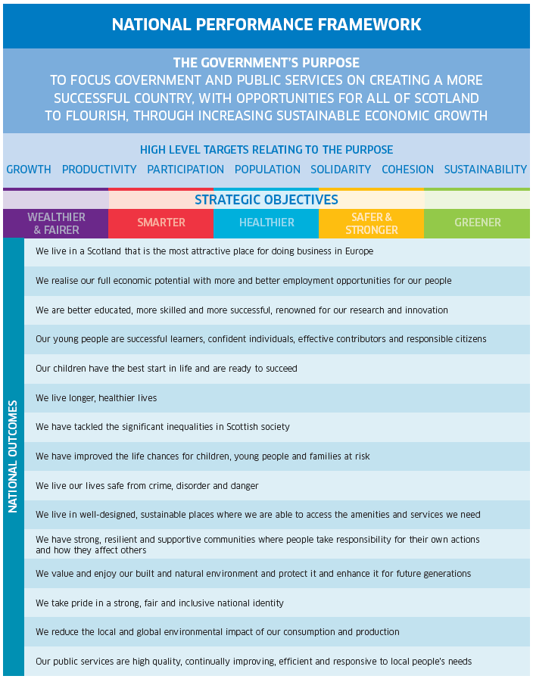
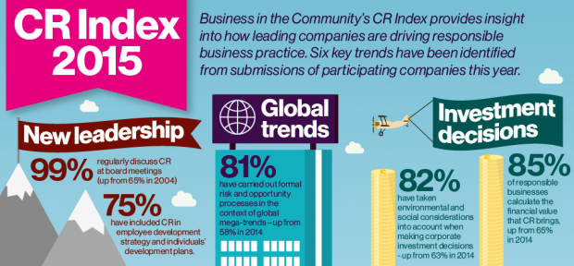

Alignment of CSR responses to real and emerging need
?
Scottish Businesses CSR responses
Scotland’s
Third sector
plus
Partnerships
Notes:
The ‘commodification’ of CSR/Sustainability Responses to real and emerging challenges in Scotland
Partnerships are good examples of shared value

Slide 12
National Aspirations and the
Policy Framework
Scotland’s fifteen National Outcomes: The purpose of Government;
The Scottish Business Pledge:
Living Wage
Zero Hours Contracts
Workforce Engagement
Invest in Youth
Balanced Workforce
Innovation
Internationalisation
Community
Prompt Payment
50/50 by 2030: Working for Diversity in the Board Room;
Creating a Fairer Scotland: What Matters to you

Slide 13
Session Outline
Presentation Aim: To identify the themes in connecting and aligning CSR/Sustainability responses to the real and emerging challenges in Scotland and methodological concerns in the KTP project
Rationale for Knowledge Transfer Partnership (KTP) project with the Voluntary Action Fund (Scotland)
Adopting a soft systems methodology approach to the KTP
Emerging themes of the problem from the pilot study with VAF employees and trustees
Towards building a conceptual system model(s)
Future directions and research agenda
Notes:
Miles
Miles Weaver, Steven Paxton, Hock Tan, Kenny Crossan, Anne-Marie Reilly
The session aims to present a conceptual model of the governance is- sues in connecting and aligning the CSR activities of Scottish Busi- nesses and the real and emerging needs in Scotland and the third sec- tor. This forms part of a KTP funded project to design and establish a grant-making platform for the Voluntary Action Fund that encourages the engagement in volunteering and social action in a Scottish context.
The session explores how a ’systems thinking’ approach may pro- vide an interesting avenue to explore governance issues to embed sustainability in organisations and across supply chains. Particularly, sustainability-responses that focus on transparent and stakeholder en- gagement.

Slide 14
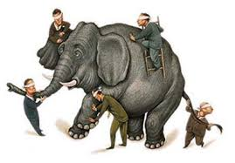
Why mess around with SSM?
‘The blind men and the Elephant’
John Godfrey Saxe (1816-1887)
Notes:
VAF wish to identify new opportunities to diversify its funding base and support activities to third sector organisations.
Raises many questions!
Is there a business opportunity?
Is this what our stakeholders want? Will we gain their support?
Connecting and aligning CSR responses to the real and emerging need in Scotland
Who? What? Which? How? Lost!
Complex and messy
We want to see how these wheel turn
The elephant in the room

Slide 15
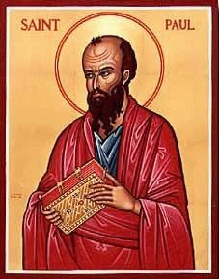
The companies perspective:
In a Glass Darkly…..
“SSM helps us [VAF] see in the glass less darkly!”
“now I know in part”…..
Notes:
Saint Paul said this quote.
Lets me see things more fully

Slide 16
7. Take action to improve the problem
1. Summary of problem situation:
unstructured
6. Debate possible changes which are both systematically desirable & culturally feasible
2. Identification of alternative potential views or themes of the problem
5. Compare conceptual model (in 4) with real-world actions (as in 1 & 2)
real world
Iterate
systems thinking
about real world
3. Formulate a root definition for each theme or view using CATWOE
4. Build a conceptual system model for each root definition
Checkland (1981)

Slide 17
7. Take action to improve the problem
1. Summary of problem situation:
unstructured
6. Debate possible changes which are both systematically desirable & culturally feasible
2. Identification of alternative potential views or themes of the problem
5. Compare conceptual model (in 4) with real-world actions (as in 1 & 2)
real world
Iterate
systems thinking
about real world
3. Formulate a root definition for each theme or view using CATWOE
4. Build a conceptual system model for each root definition
Adapted from Checkland (1981)
Notes:
‘Finding out’ how we can support one another
KTP bidding process
Dark bit

Slide 18
7. Take action to improve the problem
1. Summary of problem situation:
unstructured
Grounded Theory Methodology (GTM), case study approach and SSM. Development of RPD to model case studies in ongoing research project (following Sutrisna and Barrett, 2007)
At least eight case-studies:
VAF employees and trustees
VAF funded organisations
Other grant-makers
Sector leadership groups
Scottish Government (multiple department)
Scottish local authority
Business development agencies and Umbrella groups
*Scottish Businesses (inc. SMEs)
* Supplemented of CSR/Sustainability reporting in Scotland
Methodological consideration:
  How do we reach ‘population saturation’ / Use GTM approach with other data sources?
6. Debate possible changes which are both systematically desirable & culturally feasible
2. Identification of alternative potential views or themes of the problem
5. Compare conceptual model (in 4) with real-world actions (as in 1 & 2)
real world
Iterate
systems thinking
about real world
3. Formulate a root definition for each theme or view using CATWOE
4. Build a conceptual system model for each root definition
Adapted from Checkland (1981)
Notes:
SNOW BALLING
GTM is a general methodology to develop theory that is grounded in systematically gathered and analysed data (Crotty, 1998; Strauss and Corbin, 1998; Groat and Wang, 2002; Sutrisna and Barrett, 2007. A RELATIONSHIP WITH DATA
GTM aims to develop theory through the continuous interplay between analysis and data collection (Sutrisna and Barrett, 2007)
ITERATATIVE TRIANGULATION – GROUNDED IN LITERATURE, ANALYSIS AND DATA – this was in the original bid.
Monty Sutrisna and Peter Barrett
Checkland, P. B. (1995) Model validation in soft systems practice. Systems Research. Vol.12. No.1. pp.47-54.
The rich picture diagram (RPD) technique within the SSM is defined as a pictorial summary of the actual situation in the “systems world” based on inquiries or observations of the “real world” (Patching, 1990)
underlying concepts of the GTM, case study approach, and the soft system methodology (SSM) from which the RPD was originally derived. Based on the identified agreement between and consistency of both methodologies, the development of RPD to model case studies in an ongoing research project (using the GTM) is explained. The subsequent cross-case analysis procedure is also discussed, leading to conclusions
Snowballing method
Reach population saturation
Content analysis of CSR reports of Scottish businesses
Take into account more of the richness and complexity of the real world to produce broad “roughly right” theoretical framework (Barrett and Barrett (2003)
The rich picture diagram (RPD) technique within the SSM is defined as a pictorial summary of the actual situation in the “systems world” based on inquiries or observations of the “real world” (Patching, 1990)
RPD has been found superior to the narrative text in presenting the case study storyline (Barrett et al., 2006)
RPD is subject to continuous change to the point of saturation (further data collection fails to add or change anything within the diagram). Thus, from the SSM point of view, the RPD will continue to be “drawn” throughout as new information becomes available (Checkland and Scholes, 2005).

Slide 19
Grounded theory methodology and rich picture diagrams
Take into account more of the richness and complexity of the real world to produce broad “roughly right” theoretical framework (Barrett and Barrett, 2003)
The rich picture diagram (RPD) technique within the SSM is defined as a pictorial summary of the actual situation in the “systems world” based on inquiries or observations of the “real world” (Patching, 1990)
RPD has been found superior to the narrative text in presenting the case study storyline (Barrett et al., 2006)
RPD is subject to continuous change to the point of saturation (further data collection fails to add or change anything within the diagram). Thus, from the SSM point of view, the RPD will continue to be “drawn” throughout as new information becomes available (Checkland and Scholes, 2005).
Notes:
Snowballing technique
Population saturation
Data saturation
What we propose to do is to reach a ‘population saturation’
Analysiing them using Bell and Morse
Following the research typology advocated by Barrett and Barrett (2003), both the GTM and soft system methodology (SSM) can be considered as lying within the telescopic approach, in which the researchers take into account more of the richness and complexity of the real world to produce broad, “roughly right” theoretical frameworks.
RPD normally present descriptions of local problem situations without explicit theoretical underpinning or modelling logic (Rose, 1997). Hence the RPD is not a methodology, but rather a tool that can be used to support the subsequent analysis leading to theory building.
GTM principles, the resultant RPD is subject to continuous change to the point of saturation (further data collection fails to add or change anything within the diagram). Thus, from the SSM point of view, the RPD will continue to be “drawn” throughout as new information becomes available (Checkland and Scholes, 2005).
Theory development using the GTM is facilitated through a gradual distillation of the data through theoretical sampling (in which the earlier investigations indicate avenues of further investigation leading to further “cycles” of data collection and analysis) and identification of concepts, followed by further individuals, situations and places to be incorporated to strengthen the findings to the point of saturation.
Thus different case studies represent these “cycles”, while the point of saturation is achieved when the constant comparison within and among the case studies ceases to provide new information. Hence, the use of a multiple case study approach was found to be in agreement with the principles of GTM on the methodological level, i.e. relying on multiple sources and constant comparison, for the purpose of theory building.
GTM principles, the resultant RPD is subject to continuous change to the point of saturation (further data collection fails to add or change anything within the diagram). Thus, from the SSM point of view, the RPD will continue to be “drawn” throughout as new information becomes available (Checkland and Scholes, 2005).

Slide 20
“Rich Pictures” refined by focus groups
Focal question for RPD
Focus groups themes
Encapsulating the problem situation in a Scottish context
Perceptions and Understanding of CSR/Sustainability in a Scottish context
Alignment and connectivity of business priorities and objectives to address the real and emerging challenges in Scotland
Stewardship, social capital and agents for change
“There are many social, economic, environmental, stakeholder, voluntariness issues and challenges facing Scotland today”. How joined up are the Government, the Private & Civil Society [third sector] in addressing these challenges and issues?
Notes:
Alignment & connectivity of Businesses RESPONSES to the real & emerging challenges in a Scottish context

Slide 21
Session Outline
Presentation Aim: To identify the themes in connecting and aligning CSR/Sustainability responses to the real and emerging challenges in Scotland and methodological concerns in the KTP project
Rationale for Knowledge Transfer Partnership (KTP) project with the Voluntary Action Fund (Scotland)
Adopting a soft systems methodology approach to the KTP
Emerging themes of the problem from the pilot study with VAF employees and trustees
Towards building a conceptual system model(s)
Future directions and research agenda
Notes:
Miles
Miles Weaver, Steven Paxton, Hock Tan, Kenny Crossan, Anne-Marie Reilly
The session aims to present a conceptual model of the governance is- sues in connecting and aligning the CSR activities of Scottish Busi- nesses and the real and emerging needs in Scotland and the third sec- tor. This forms part of a KTP funded project to design and establish a grant-making platform for the Voluntary Action Fund that encourages the engagement in volunteering and social action in a Scottish context.
The session explores how a ’systems thinking’ approach may pro- vide an interesting avenue to explore governance issues to embed sustainability in organisations and across supply chains. Particularly, sustainability-responses that focus on transparent and stakeholder en- gagement.

Slide 22
Formulate a root definition for each theme or view using CATWOE (Smyth, 1975) for each case-study grouping with a representative sample.
Methodological considerations:
Verify with a representative sample of existing population OR
New population (i.e. industry representatives)
** Departure from Sutrisna and Barrett (2007)
7. Take action to improve the problem
1. Summary of problem situation:
unstructured
6. Debate possible changes which are both systematically desirable & culturally feasible
2. Identification of alternative potential views or themes of the problem
5. Compare conceptual model (in 4) with real-world actions (as in 1 & 2)
real world
Iterate
systems thinking
about real world
3. Formulate a root definition for each theme or view using CATWOE
4. Build a conceptual system model for each root definition
Adapted from Checkland (1981)
Notes:
‘Finding out’ how we can support one another
KTP bidding process
Dark bit

Slide 23
Research team builds a conceptual system model for each root definition within each case-study group
Verified by advisory group of representatives inc. KTP Advisor, government, third sector (including VAF trustees and funded organisations), business community
Methodological considerations:
Clustering themes and perspectives around each CSM for each root definition
Will this move us towards the “whole”?
** Departure from Sutrisna and Barrett (2007)
7. Take action to improve the problem
1. Summary of problem situation:
unstructured
6. Debate possible changes which are both systematically desirable & culturally feasible
2. Identification of alternative potential views or themes of the problem
5. Compare conceptual model (in 4) with real-world actions (as in 1 & 2)
real world
Iterate
systems thinking
about real world
3. Formulate a root definition for each theme or view using CATWOE
4. Build a conceptual system model for each root definition
Adapted from Checkland (1981)
Notes:
‘Finding out’ how we can support one another
KTP bidding process
Dark bit
Building on shoulders of giants

Slide 24
7. Take action to improve the problem
1. Summary of problem situation:
unstructured
6. Debate possible changes which are both systematically desirable & culturally feasible
2. Identification of alternative potential views or themes of the problem
5. Compare conceptual model (in 4) with real-world actions (as in 1 & 2)
real world
Iterate
systems thinking
about real world
3. Formulate a root definition for each theme or view using CATWOE
4. Build a conceptual system model for each root definition
Checkland (1981)

Slide 25
Session Outline
Presentation Aim: To identify the themes in connecting and aligning CSR/Sustainability responses to the real and emerging challenges in Scotland and methodological concerns in the KTP project
Rationale for Knowledge Transfer Partnership (KTP) project with the Voluntary Action Fund (Scotland)
Adopting a soft systems methodology approach to the KTP
Towards building a conceptual system model(s)
Emerging themes of the problem from the pilot study with VAF employees and trustees
Future directions and research agenda
Notes:
Miles
Miles Weaver, Steven Paxton, Hock Tan, Kenny Crossan, Anne-Marie Reilly
The session aims to present a conceptual model of the governance is- sues in connecting and aligning the CSR activities of Scottish Busi- nesses and the real and emerging needs in Scotland and the third sec- tor. This forms part of a KTP funded project to design and establish a grant-making platform for the Voluntary Action Fund that encourages the engagement in volunteering and social action in a Scottish context.
The session explores how a ’systems thinking’ approach may pro- vide an interesting avenue to explore governance issues to embed sustainability in organisations and across supply chains. Particularly, sustainability-responses that focus on transparent and stakeholder en- gagement.

Slide 26

Emerging themes from “Rich Pictures”
One participant on the problem situation:
“It’s a broken jig saw – I feel very little is joined up”
“sectors have different priorities … not on same wave length”
[Arm’s folded]
Notes:
“It’s a broken jig saw – I feel very little is joined up” – complicated problem?
“sectors have different priorities … not on same wave length” – so how do you tune?
Sid folded arms

Slide 27
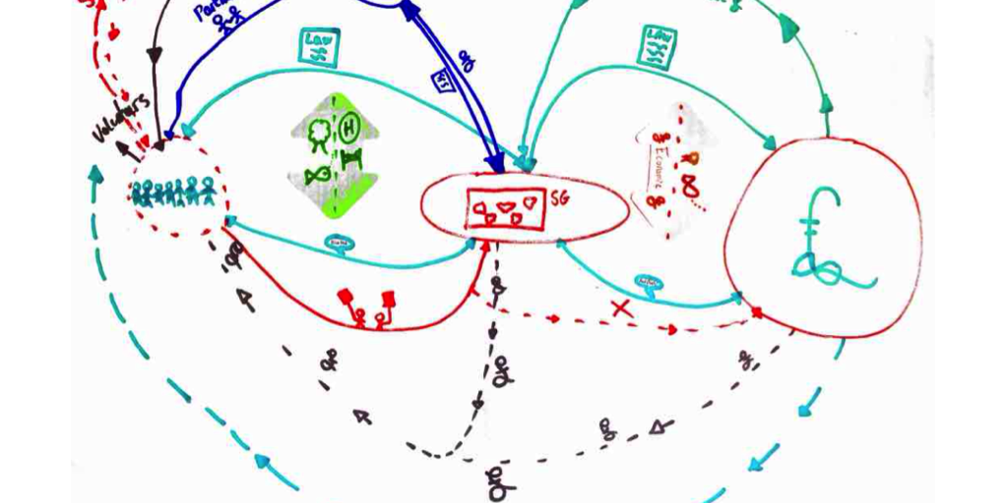
RPD: VAF Staff

Slide 28
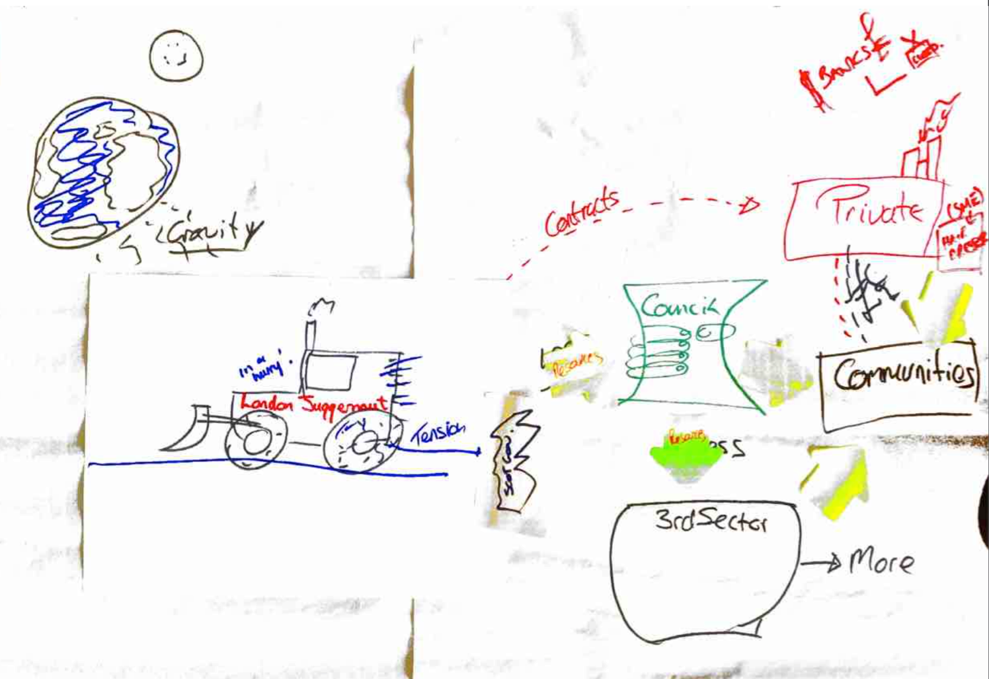
RPD: VAF Managers

Slide 29
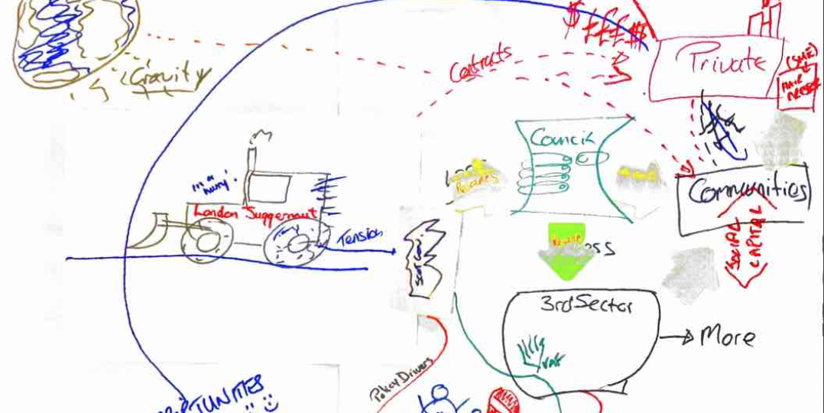
RPD: VAF Trustees

Slide 30
Emerging themes from “Rich Pictures”
Government sets priorities; so do Businesses and the third sector are ‘expected’ to align. Both Government and Business hold the money, time and resources. What are the appropriate priorities and whom should set them?
The group drew out the private sector and discussed the idea that the private corporations were there first and foremost to make a profit and that some used CSR as a tick box process although through discussion the group agreed that the private sector plays a very important role in society

Slide 31
Emerging themes from “Rich Pictures”
There are competing priorities and lack of “anchor points” that identify real and emerging need. What mechanisms are required to reconcile competing priorities so that the third sector can align its programmes?
One group drew leaders of the Scottish Parliament and discussed how the third sector felt that they expressed and input emerging needs to the Government but sometimes the information through political interference fell into a black hole

Slide 32
Emerging themes from “Rich Pictures”
Weak connectivity. What connections are strong, weak and/or missing given the various worldviews of stakeholders?
One group drew hands not touching between sectors and ‘no’ to gadgets, mobile phones, media devices, indicating that people should talk face to face. Another group drew mountain peaks each sector at the top unable to communicate and connect across the chasm.

Slide 33
Emerging themes from “Rich Pictures”
Communicating priorities and listening to those that understand need. What communication channels exist to influence decision-making [with whom that holds the power] in setting the priorities?
The group made reference to the third sectors use of evidence and case studies to show needs and a line lead from the black hole (that occurs when feeding information in to the government) out to the word ‘opportunities’ the group then connected this line with the private sector

Slide 34
Emerging themes from the Rich Pictures
The “Big Squeeze” – “Doing more with less”. What is the nature of the way in which the third sector is changing and in adapting to its environment?
One group drew the council being squeezed and discussed the pressures on all areas to do more with less money

Slide 35

Emerging themes from the Rich Pictures
Central theme: Leadership and governance of the processes involved is a central theme in the problem situation. What is the nature of the leadership & the ‘governance of networks’ issues?
  holistic governance of networks (Nikoloyuk et al., 2010; Pirson and Turnbull, 2011; Zadek and Radovich, 2006)
  Stewardship theory - governing assets responsibly and in the best interest of the company and other stakeholders, including the environment (Pirson and Turnbull, 2011)
Notes:
Get an arrow
Power of the relationships
Mechanistic relationship
Partnership governance
The term Partnership or Collaborative Governance has gained momentum over the last years. It is a partnership based governance system that involves a number of corporate and social actors and therefore looks at holistic governance of networks (Nikoloyuk et al., 2010; Pirson and Turnbull, 2011; Zadek and Radovich, 2006). This goes hand in hand with Stewardship Theory in terms of governing assets responsibly and in the best interest of the company and other stakeholders, including the environment (Pirson and Turnbull, 2011).
The next section will look again the framework of Carter and Rogers (2008) in order to see how partnership governance relates to each of the four surrounding dimensions.

Slide 36
Summary
VAF seek to identify the themes in connecting and aligning CSR/Sustainability responses to the real and emerging challenges (Note: not ‘need’) in Scotland so that VAF can bring more resources into communities
Adopted a grounded theory methodology (GTM), case study approach and SSM approach. RPD being central to model the case studies in ongoing research project. Adapting Sutrisna and Barrett (2007).
Methodological consideration(s):
  How do we reach ‘population saturation’ / Use GTM approach with other data sources?
  Build root definitions with representative sample of existing population or new?
  Clustering themes and perspectives around each CSM for each root definition
  How do we see the whole (i.e. holistic governance of networks)?
Follow the SSM framework (back to the ‘real world’)
Notes:
SSM approach adopted to understand the richness and complexity of the real world
Formulate a root definition for each theme or view using CATWOE (Smyth, 1975) for each case-study grouping with a representatives sample.
Point us in the direction of approaches to cluster themes and perspectives from CSM
Discussion:
Verify with a representative sample of existing population OR
New population (i.e. industry representatives)
** Departure from Sutrisna and Barrett (2007)
Research team builds a conceptual system model for each root definition within each case-study group
Verified by advisory group of representatives from KTP Advisor, government, third sector (including VAF trustees and funded organisations), business community
Discussion:
Clustering themes and perspectives around each CSM for each root definition
Will this move this towards a “Big picture”?
** Departure from Sutrisna and Barrett (2007)

