Slide 1
Applications of “Systems Thinking” to co-create business-community value
Miles Weaver
International Centre for Management & Governance Research,
Edinburgh Napier University Business School
m.weaver@napier.ac.uk @weavermiles
Notes:
Creating
Approaches to Building “Value” between Responsible Businesses and Communities:
Creating “Shared Spaces”
to Build “Value” between Responsible Businesses and Communities
Using a Systems Approach to Help Responsible Businesses and Communities to Build Value
Creating “Shared Spaces” to Unlock Business Resources into Communities and Evaluate “Value”
Within this relationship is conflict … difference in language way one dresses

Slide 2
Outline
Current projects/interests using “Systems Thinking” to address “grand challenges”
  between business, the third sector, power and the active citizen
  In Edinburgh, Scotland and beyond
KTP Project with VAF: Using a systems approach to unlock business resources into communities
Three key concepts emerging from understanding different perspectives & embedded in the ‘Connect’ model
  Fostering ‘open space’ to invest in social capital
  Co-creation of business-community value
  Role of a conduit to unlock & prepare a ‘shared space’

Slide 3
O.R. Contribution to addressing “Grand Challenges”
United Nations (Accessed: 15.03.17)

Slide 4
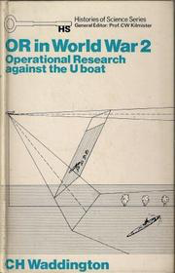

Current projects/interests
Making an Impact with O.R. to address “Grand Challenges”
  Annual event at ORS Conference with local key stakeholders acting as potential O.R. beneficiaries (e.g. Pro Bono project, local student projects, Funding call/knowledge exchange with local University)
  SD goals: Issues/challenges locally determined
Nurturing a Talent Pipeline of ‘Young Professionals on Boards’
  The ‘Get on Board’ Young Professionals framework
  Professional Development Certificate in Leadership in Board Governance
  SD goals: Reduce inequalities (10), gender equality (5) & strong institutions (16)
Taking Action to Unlock Business Resources Into Communities using SSM
  Funded Knowledge Transfer Partnership with a Scottish Grant Maker
  SD goals: economic growth (8) & partnerships for the goals (17)
Notes:
Founded in WW2
used to protect Britain
helped to liberate Europe
Post-war
New ‘hard’ OR methods developed
to improve efficiency of new nationalised industries
but operational level, not high-level issues
More recently
Soft OR methods developed
to help with strategic planning in complex situations
To understand & address ‘wicked problems’
In this session we shall seek to discuss:
What “Grand Challenges” face us today and into the future, in Portsmouth, in the UK and beyond?
What contribution can the O.R. community have to address these challenges?
We intend to follow-up 1 – 2 projects ideas in the following ways:
Pro Bono project
Funding call/opportunity
Local student project
Gender Balance in the Board Room
Lord Davies of Abersoch, CBE
Women on Boards (February 2011)
70 years
(at current rate of change)
Average age of a Trustee
57

Slide 5
The Responsible Business challenge:
To reconnect business and societal goals
Trends and calls to reconnect business and societal goals, going beyond CSR as a firm’s only moral obligation (e.g. Porter and Kramer, 2011; Bansal & DesJardine, 2014; Scagnelli and Cisi, 2014).
Need for business to rearticulate its place in society and develop long-term sustainable business models (Lacy et al., 2012) that address societal priorities.

Slide 6
Releasing business resources into communities: Role for CBOR?
In the context of Midgley and Ochoa-Arias (1999) call to Community-Based O.R. practitioners, we seek to understand:
How best to unlock and release the resources held by the for-profit sector (as part of responsible business practice) into communities?
Resource allocation
How can these communities themselves, represented by third sector organisations help to evaluate the impact of this resource allocation?
Evaluation services

Slide 7
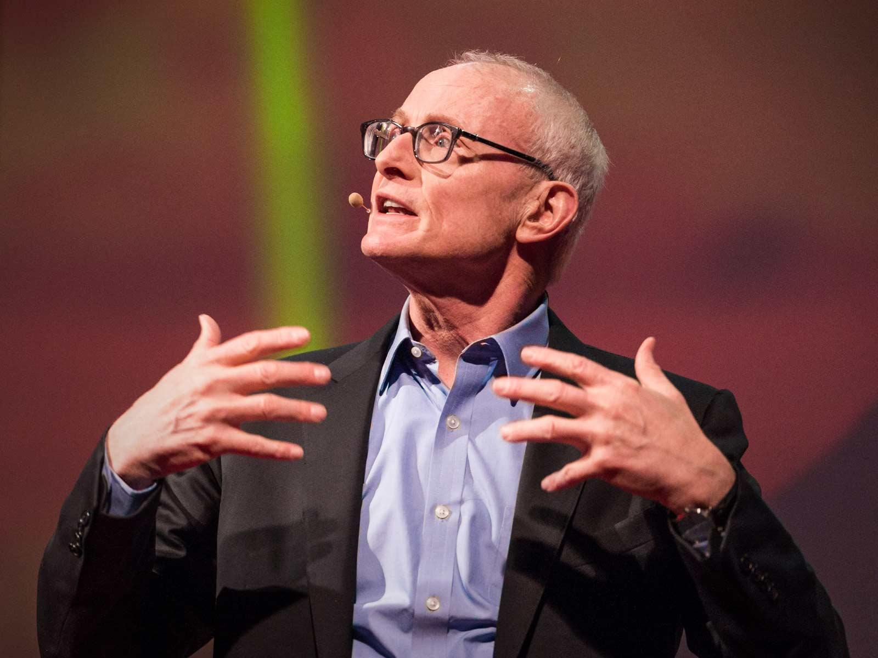
Michael Porter puts forward the case for “letting business solve societal problem” … thoughts?
“I think if we can get business seeing itself differently, and if we can get others seeing business differently, we can change the world”
(Porter, 2013)
https://www.ted.com/talks/michael_porter_why_business_can_be_good_at_solving_social_problems/
(Accessed: 09/01/16)
Porter and Kramer (2011) proposes the concept of shared value: addressing a social issue with a business model
“There's a fundamental opportunity for business today to impact and address these social problems, and this opportunity is the largest business opportunity we see in business” (Porter, 2013)
Notes:
Porter and Kramer (2011) proposes the concept of shared value: addressing a social issue with a business model and argue:
“Capitalism is under siege ... Diminished trust in business is causing political leaders to set policies that sap economic growth .... Business is caught in a vicious circle ... The purpose of the corporation must be redefined around SHARED VALUE”
“There's a fundamental opportunity for business today to impact and address these social problems, and this opportunity is the largest business opportunity we see in business” (Porter, 2013)
Three opportunities for companies to CSV (Porter and Kramer, 2013):
1. By reconceiving products and markets
2. By redefining productivity in the value chain
3. By enabling local cluster development

Slide 8
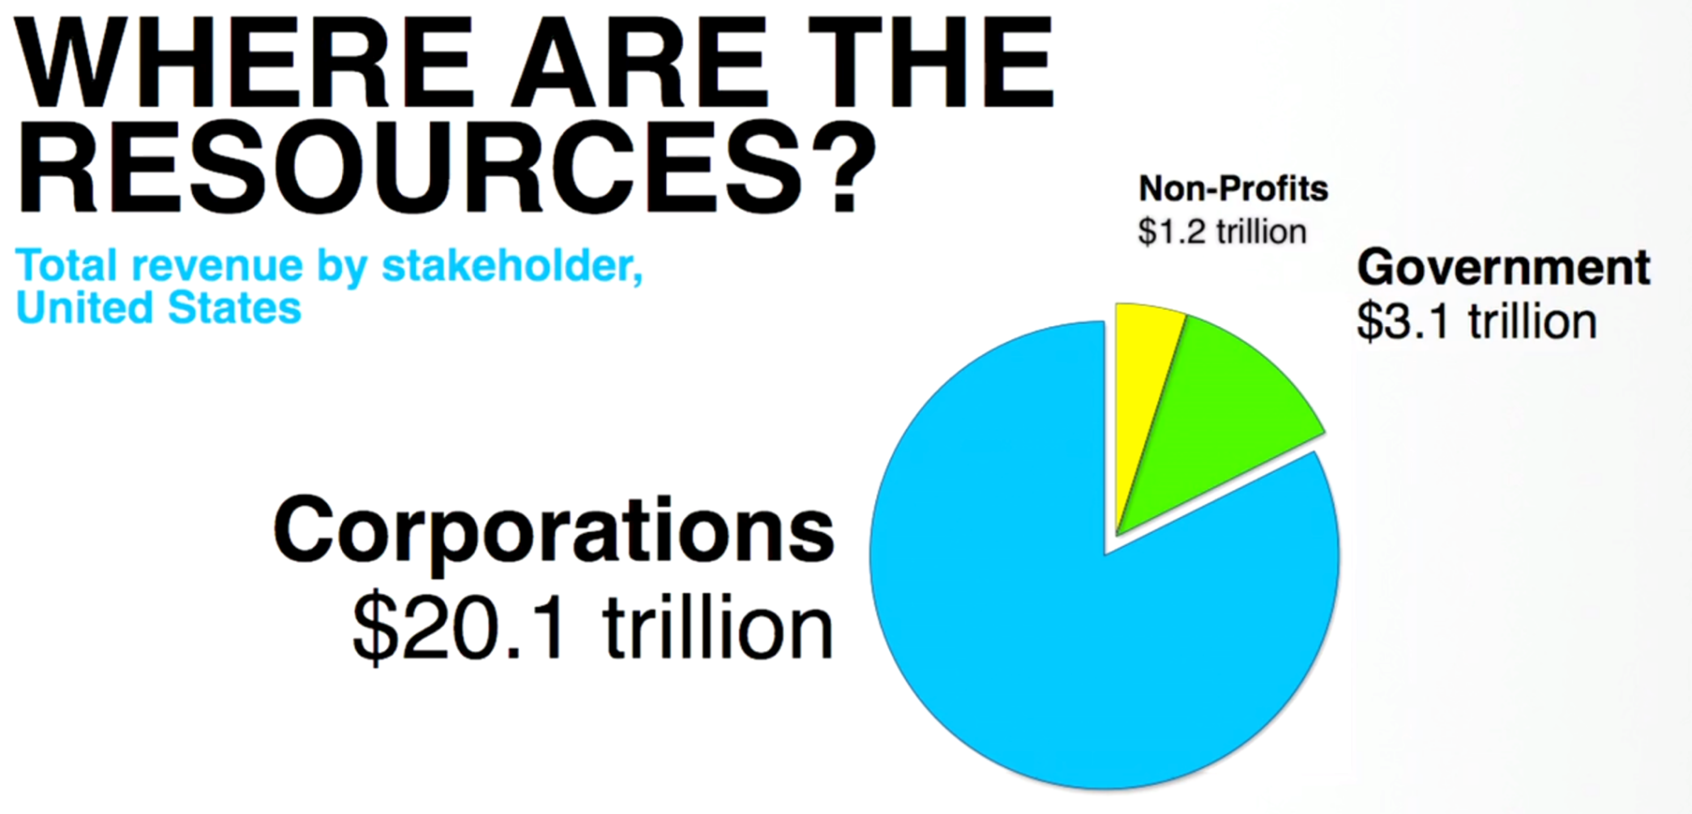
(Porter, TEDGlobal, 2013)
In a Scottish context, the third sector attracts £4.9 billion in funding from various sources, using SCVO statistics 34% (£1,686m) comes in from the public sector (includes local, devolved and national governments) when only 1.5% (73m) comes from the private sector (Weaver, Crossan, Tan & Paxton, forthcoming).
Median donation by FTSE 100 companies have trebled from £1m in 2007 to £3 million in 2012 (CAF Bank, 2014)
Notes:
Most wealth in business … only business can create resources … when it can meet a need … when it makes a profit ….
How do we tap into this?
How do we tap into this? It’s the ‘profit’ that makes it scalable

Slide 9
John Mackey: three legged stool of society
“Tear down the conceptual wall around motivation”
“for-profits and non-profits should act like colleagues … allies … should be working together”
“so much in common … rather than differences”
“non-profits can do what for-profits cannot do”
“for-profits bring capital and skills”
“One difference: Non-profits have ’donors’ expects a return on donation but not on capital”
“both need to become more conscious”
(Mackay, 2016)
“More than just about money”
Reconnect with the ‘higher purpose’?
Both based on
‘voluntary exchange’
VALUE
+
+
SCALE
VALUES
+
+
ASSET-BASED
Governments
Play Umpire
+
Do what ‘non-profits’ & ‘for-profits’ cannot do
BUT
Selfishness & greed?
For-profit
Not for-profit

Slide 10

Connecting with the ‘higher purpose’: Profit + Purpose
Recognition that business create resources (most of them); they do this when they can meet a need and make a profit (Porter, 2013)
Business part of the solution
  myth: business part of the ‘problem’?
  NOT ALL societal problems can be solved through shared value solutions (Porter, 2011)
Growing consensus: “Doing well by doing good”
  the ‘conscious’ capitalist
  Creating Shared Value
  Creating Sustainable Value
Notes:
“Most wealth in business … only business can create resources … when it can meet a need … when it makes a profit ….”
Position that is good for business AND society
Need for business to rearticulate the place they hold in society, comply with community standards and to develop long-term healthy business models (Lacy, Haines and Hayward, 2012; Porter, 2011)
Key Enablers include (Lazlo, 2005; Laszlo and Zhexembayeva, 2011; Zadek and Radovich, 2006; Porter, 2011): innovation, learning and partnerships
Companies pursuing ‘product stewardship’ strategies: integrating stakeholder views into business processes. Drivers: civil society, transparency and connectivity (Hart, 2005; 2008).
Shaped by ever changing customer perception and legal requirements (Banerjee, 2001)

Slide 11
Application of systems thinking to co-create business-community value

Slide 12

Our client, VAFs goal and directions
Over the last 35 years, VAF has distributed £127 million of public funding across Scotland supporting over 5,000 projects. VAF also works with businesses and individual donors to invest in communities.
Violence Against Women
Fund
£11M
VAF’s Vision
That people and communities are thriving, active, self-organising, resourceful, and connected.
VAF’s Mission
To release existing and potential resources within communities by investing money, increasing capacity and building relationships.
Community Safety Grant
£4.1M
Grant programmes
2014-15
Volunteering
Grants
£1M
Equality Grants
£2.7M
Glasgow Transformation Fund
£1M
Community Grants
£40K
Notes:
AMR
Managed Grant Programmes
VAF manages a number of programmes on behalf of the Scottish Government. These are:
Violence Against Women and Girls Fund
Equality Fund
Community Safety Fund
Volunteering Support Fund.

Slide 13
Initial conversation: VAF taking action to bring about more resources into communities
How can VAF bring about more resources (e.g. people/skills, physical assets and money) into communities?
But … Where is this resource pool?
What business models can VAF adopt to tap this resource pool?
Boundary
Relationship
System
Perspective
Approaches for developing viable and highly responsive organisations at multiple levels (global to local)
Emphases of different systems approaches
(Midgley adapted from Cabrera et al., 2008)
Notes:
How can ‘we’ bring about more resources (people, skills and money) into communities?
But … Where is this resource pool? How can it be tapped?
What are the challenges and opportunities facing each sector in connecting and aligning ?
Third sector
Business
Government(s)
Public

Slide 14
Understanding various stakeholder perspectives using “Rich Pictures”
  “There are many grand challenges facing Scotland today”. What are your views and perspectives on how joined up are the Government[s], the Private, Public & Third Sector in addressing these challenges?
Boundary
Relationship
System
Perspective
Approaches for addressing conflict; exploring multiple perspectives; developing mutual understanding; and agreeing solutions that people are willing to implement
Emphases of Different Systems Approaches
(Midgley adapted from Cabrera et al., 2008)
Notes:
What are the challenges and opportunities facing each sector in connecting and aligning between and within sectors to address the challenges being faced by communities?
“There are many Grand Challenges facing Scotland today”. What are your views and perspectives on how joined up are the Government[s], the Private, Public & Third Sectors in addressing these challenges?
Lack of connectivity and alignment between and within sectors to address the challenges being faced by communities, represented by third sector organisations (TSOs)
between and within sectors to address the challenges being faced by communities, represented by third sector organisations (TSOs)
How can ‘we’ bring about more resources (people, skills and money) into communities?
But … Where is this resource pool? How can it be tapped?
What are the challenges and opportunities facing each sector in connecting and aligning ?
Third sector
Business
Government(s)
Public

Slide 15
Workshops held to form a multitude of perspectives over three cycles of SSM
Cycle | Category | No. of RP Workshops | No. of Participants
 |  |  | Cycle 1 |  | Cycle 2 | Cycle 3
1 | VAF trustees | 2 | 10
 | VAF managers | 1 | 6
 | VAF staff | 2 | 11
2 | Third Sector VAF funded organisations | 2 |  |  | 12
 | Third Sector non-funded organisations | 3 |  |  | 19
 | Other Grant-makers and umbrella bodies | 1 |  |  | 5
3 | Local Government | 2 |  |  |  | 17
 | Scottish Government and their agencies | 2 |  |  |  | 10
 | Public Sector bodies | 2 |  |  |  | 13
 | Total number of workshops/participants | 17 | 27 |  | 36 | 40
 |  | Survey responses (funded organisations) |  |  | 26
 |  | Regular dialogue with key stakeholder |  | 8
 |  | Critical friend interviews |  | 2 | 4 | 2
Note: Cycle 4 involved Scottish Businesses. Data collected but outside of the scope of this presentation.
Notes:
Workshops held for each cycle to express the problem situation from a multitude of perspectives

Slide 16
SSM cycle 1: Finding out about the problem situation from the perspective of the client (a ‘grant-maker’)
PS1.1 What are the appropriate priorities and whom should set them?
PS1.2 What mechanisms are required to reconcile competing priorities so that the third sector can align its programmes?
PS1.3 What connections are strong, weak and/or are missing given the various perspectives of stakeholders and understanding of community assets?
PS1.4 What communication channels exist to influence decision-making [with whom holds the power] in setting the priorities?
PS1.5 What is the nature in which the third sector is changing and is adapting to its environment?
PS1.6 Who (or what) holds responsibility for governing the system and forging the relationships between sectors?
Notes:
SSM cycle 1: Questions identified from RP workshops to facilitate debate
Stage 1:
Questions identified from RP workshops to facilitate debate with the client (the grant-maker perspective)

Slide 17
Stage 2: Formulating some relevant purposeful activity models (Client’s perspective)
Relevant system identified in cycle 1 |  | System Name | Problem situations identified in Cycle 1
 |  |  | PS1.1 | PS1.2 | PS1.3 | PS1.4 | PS1.5 | PS1.6
RS1.1 | A system to invest in social capital with new and current stakeholders | Investing in social capital |  |  | • |  |  | •
RS1.2 | A environment-scanning system to identify and align private sector responsible business priorities to VAFs social policy passions | Aligning priorities | • | • |  | • | • | •
RS1.3 | A system to develop a proposal articulating VAFs offer to business to invest in community programmes, which align to societal goals through effective matching of third sector organisations with business | Developing VAFs offer to business | • | • | • |  |  | •
RS1.4 | A system that identifies alternative sources of people, assets and money that can be allocated to communities in Scotland within an evolving public space | Resource allocation to communities |  |  |  |  | • | •
RS1.5 | A system for reporting and evaluating outcomes that can be used by business clients to demonstrate responsible business practice and Third Sector clients to demonstrate greater leverage of resources released into communities | Evaluation services |  |  |  |  | • | •

Slide 18
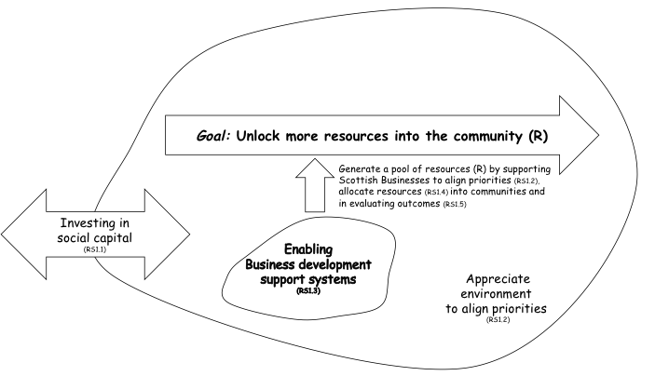
The ‘VAF Connect’ emblematic model

Slide 19
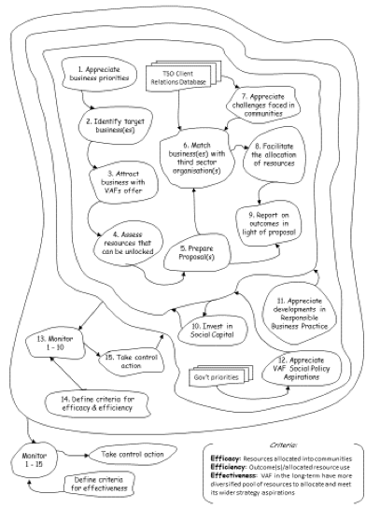
Notes:
Formal root definition &
the ‘connect’ model

Slide 20
Stage 3: Debating the situation, using the models &
Stage 4: Taking action in the situation to bring about improvement
Approaches for understanding complex causality; feedback; vicious and virtuous circles; and the possible consequences of intervention
Boundary
Relationship
System
Perspective
RS1.1: Investing in Social Capital
Emphases of Different Systems Approaches
(Midgley adapted from Cabrera et al., 2008)

Slide 21
Issues/challenges facing third sector organisations in Scotland
Moving to Cycle 2:

Slide 22
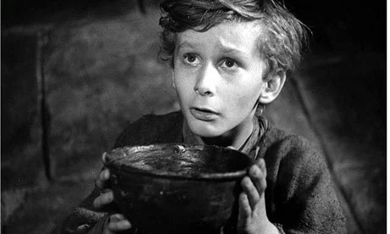
Issues/challenges facing third sector organisations in Scotland (stage 1)
Funding & funding cycles
Setting priorities
Skills and assets (human resources, skills and physical assets)
Relationships between and within the public, third & private sectors
Operating environment and climate
Notes:
Stage 1: Finding out about a problem situation
Stage 2: Formulating some relevant purposeful activity models
“Square holes for circle problems”
“Sometimes what you get offered is maybe not what you need, you don’t need a day with 100 volunteers coming up to do a community garden, actually what you need is real capacity building, in a way that might be to support, IT support, not necessarily covering head office costs but core sustainability funding and I think, corporates are starting to get that”
(Third Sector workshop participant)
Castle with high walls between sectors
“the private sector does one thing … the government another … and the third sector doing a third thing” (Cycle 2 Participant)
“these were all very inter-connected and the relationships going backwards and forwards were central to everything that happens”
(Cycle 2 Group)
the “big squeeze” (operating environment & climate)
“less of CSR tick-boxing exercise … and tokenistic partnerships [with TSOs]”
“right communities resources targeted with the most appropriate resources”
the “ball and chain”
(Constraints imposed on TS & outcomes that funder expects)
Reinforced by a critical friend (a grant-maker):
“business do not really know how the modern charity works”
“Some relationships are good … some very superficial”
“a lot of businesses don’t know how to engage”
the perceived “begging bowl”
the “begging bowl” – a constant ask in the absence of sustainable change - a transactional relationship)
Cogs:
”funding is peripheral although essential to making things happen, the work carries on even if we don’t have these two things”
Cog’s keep turning because “third sector people make them work, might take longer but we keep going”
“third sector are closest to communities and people … we continue to address ‘circle problems’ even when hindered to do so … we commit a lot of resources to applying for funding that distracts us from addressing real issues”
Fish:
Within this relationship is conflict … difference in language way one dresses

Slide 23
Bottom-up movements for social change
Critical friends noted that “Islands of good practice exist” but struggled to think of any examples of joint working
Many examples could be offered of people, self-organising, coming together around a cause
“people are at the heart of communities, you also find the same people holding positions in different sectors … there are no barriers … actually no such thing as sectors” (Cycle 2 participant, supported by Scottish Government, Policy Manager)
“Businesses are part of these communities already … particularly seen in SMEs”
(Critical friend, grant-maker)

Slide 24
Formulating some relevant purposeful activity models from a third sector perspective
Notes:
Stage 1: Finding out about a problem situation
Stage 2: Formulating some relevant purposeful activity models

Slide 25
Three key concepts embedded into the refined connect model
(see handout)

Slide 26
Three key concepts embedded into the refined connect model
Fostering ‘open space’ to invest in social capital
  Boundary and governance arrangements
  Shared aspirations and values between participants
  Continuously debate diversity of sectors participating in open system
  Reciprocity in the relationships and borrowing ideas from the ‘common good’
Co-creation of business-community value
  Shared dialogical space between the market, state & third sector
  Shift from “them and us” to “what can we do for each other”?
  Communities and themselves are best placed to describe and address challenges
Role of a conduit to unlock and prepare a ‘shared space’
  Capacity to develop power & political agency
  Prepare the ground prior to unlocking the ‘shared space’ (the “ask” becomes part of the co-created solution)
  Shared understanding, use best practice, build social capital
  Bring together coalitions of interested parties (e.g. SMEs)

Slide 27
‘Boundary Idea’ in creating ‘open spaces’
Stakeholders are active & equal members – no ’one’ owner:
Businesses
Third Sector Organisations
Government
Governance/Ownership of each ‘open space’ via representative body
Values constantly debated
  ‘Concerned Citizens’ define criteria for efficacy and efficiency of system
    Efficacy: resources allocated into communities that address issues/challenges
    Efficiency: outcome(s)/allocated resource use defined by concerned citizens
Approaches for exploring value and boundary judgements about what should be included in or excluded from analysis
Boundary
Relationship
System
Perspective
(Midgley adapted from Cabrera et al., 2008)
Notes:
What are the challenges and opportunities facing each sector in connecting and aligning between and within sectors to address the challenges being faced by communities?
“There are many Grand Challenges facing Scotland today”. What are your views and perspectives on how joined up are the Government[s], the Private, Public & Third Sectors in addressing these challenges?
Lack of connectivity and alignment between and within sectors to address the challenges being faced by communities, represented by third sector organisations (TSOs)
no one body, organisation nor sector ‘own’ the challenges being faced by communities
Propose that Government’s role is to be an active and equal member in the creation of these ‘open spaces’ and express Shared aspirations and values between participants
Stakeholders are active and equal members
Government express the shared vision and values in policy and business development activity
Concerned citizens define criteria for efficacy and efficiency of system
Efficacy: resources allocated into communities that address issues/challenges)
Efficency: outcome(s)/allocated resource use) defined by concerned citizens
between and within sectors to address the challenges being faced by communities, represented by third sector organisations (TSOs)
How can ‘we’ bring about more resources (people, skills and money) into communities?
But … Where is this resource pool? How can it be tapped?
What are the challenges and opportunities facing each sector in connecting and aligning ?
Third sector
Business
Government(s)
Public

Slide 28
‘Boundary Idea’ in creating ‘shared spaces’
A conduit unlocks and prepares a ‘shard space’:
Understand ‘issues’ (’open spaces’ provide a listening opportunity)
Better channel stakeholders “haves” & “wants” (particularly, the TSO “ask”)
Minimise potential conflict by preparing the ground & level playing field
Identify potential ‘fit’ between partners ’values’
Use good practice
Build social capital (the ‘relationship’)
Potential to pool resources by bringing together coalitions of interested parties (e.g. SMEs) around ‘shared values’
Facilitate the co-creation of solutions, efficient allocation of resources and evaluation
Approaches for exploring value and boundary judgements about what should be included in or excluded from analysis
Boundary
Relationship
System
Perspective
(Midgley adapted from Cabrera et al., 2008)
Notes:
What are the challenges and opportunities facing each sector in connecting and aligning between and within sectors to address the challenges being faced by communities?
“There are many Grand Challenges facing Scotland today”. What are your views and perspectives on how joined up are the Government[s], the Private, Public & Third Sectors in addressing these challenges?
Lack of connectivity and alignment between and within sectors to address the challenges being faced by communities, represented by third sector organisations (TSOs)
no one body, organisation nor sector ‘own’ the challenges being faced by communities
Propose that Government’s role is to be an active and equal member in the creation of these ‘open spaces’ and express Shared aspirations and values between participants
Stakeholders are active and equal members
Government express the shared vision and values in policy and business development activity
Concerned citizens define criteria for efficacy and efficiency of system
Efficacy: resources allocated into communities that address issues/challenges)
Efficency: outcome(s)/allocated resource use) defined by concerned citizens
between and within sectors to address the challenges being faced by communities, represented by third sector organisations (TSOs)
How can ‘we’ bring about more resources (people, skills and money) into communities?
But … Where is this resource pool? How can it be tapped?
What are the challenges and opportunities facing each sector in connecting and aligning ?
Third sector
Business
Government(s)
Public

Slide 29
Addressing different ‘perspectives’?

Slide 30

Summary & further work
O.R. has a significant role to play in addressing “Grand Challenges”. We need to articulate this vision.
Opportunity exists to better allocate resources from “for-profit” organisations into communities, recognising that the third sector and communities themselves best understand real and emerging issues/challenges
Further work to integrate the ‘Boundary Idea’ into a process framework that offers guidelines to unlock and prepare a ‘shared space’, supporting the co-creation of business-community value, allocating resources to make this happen and evaluation (a clear role for O.R.)

