Slide 1
Taking Action to Unlock Business Resources Into Communities using SSM
*Miles W Weaver ^{i}, Kenny Crossan^{i},
Hock B Tan^{i} and Steven E Paxton^{ii}
^{*corresponding author}
^{i}Edinburgh Napier University Business School, Edinburgh, Scotland
^{ii}Voluntary Action Fund, Inverkeithing, Scotland
Stream: Third Sector O.R.: Modelling for a better world,
Tuesday 06 September 2016, 13:30-14:00, OR58, University of Portsmouth

Slide 2
“O wad some Power the giftie gie us, To see oursels as ithers see us!”
Robert Burns - To a Louse (1786)

Slide 3
Session Outline
Presentation Aim: To present an application of community O.R. (COR), using Soft System Methodology (SSM) to help a grant-maker to understand how to unlock and release more resources into communities
Release business resources into the community in the context of COR
VAF: the organisation, its goal and directions
Soft systems methodology (SSM) applied in VAF
The gift: To see VAF and its goal as others see it (lessons learnt for VAF)
Propose the Connect Model after refinement

Slide 4
Development of Community Based O.R.
Traced back to the 1970s
“investigating issues affecting disadvantaged stakeholders in communities” (Johnson & Smilowitz, 2012)
  Improve society (Parry and Mingers, 1991)
  Change in the community by resolving social problems (Midgley and Ochoa-Arias, 2004)
Emerging body of knowledge that uses systems-based approaches to address community issues and challenges (Midgley and Ochoa-Arias, 2004; Johnson, 2012)

Slide 5


Addressing “Grand Challenges” with O.R.
Lane (2010) suggests that O.R. has considerable advantages when dealing with strategic issues and grand challenges/high leverage interventions
O.R. has a role to play in contributing to our understanding of these challenges and to making an impact (Parkin and Weaver, 2015)

Slide 6
One path to addressing Grand Challenges?
To align and connect business and societal goals
Trends and calls to reconnect business and societal goals, going beyond CSR as a firm’s only moral obligation (e.g. Porter and Kramer, 2011; Bansal & DesJardine, 2014; Scagnelli and Cisi, 2014).
Need for business to rearticulate its place in society and develop long-term sustainable business models (Lacy et al., 2012) that address societal priorities.

Slide 7
Releasing business resources into communities: Role for COR?
In the context of Midgely and Ochoa-Arias (1999) call to COR practitioners, we seek to understand:
How best to unlock and release the resources held by the for-profit sector (as part of responsible business practice) into communities?
How can these communities themselves, represented by third sector organisations help to evaluate the impact of this resource allocation?
Resource allocation
Evaluation services

Slide 8
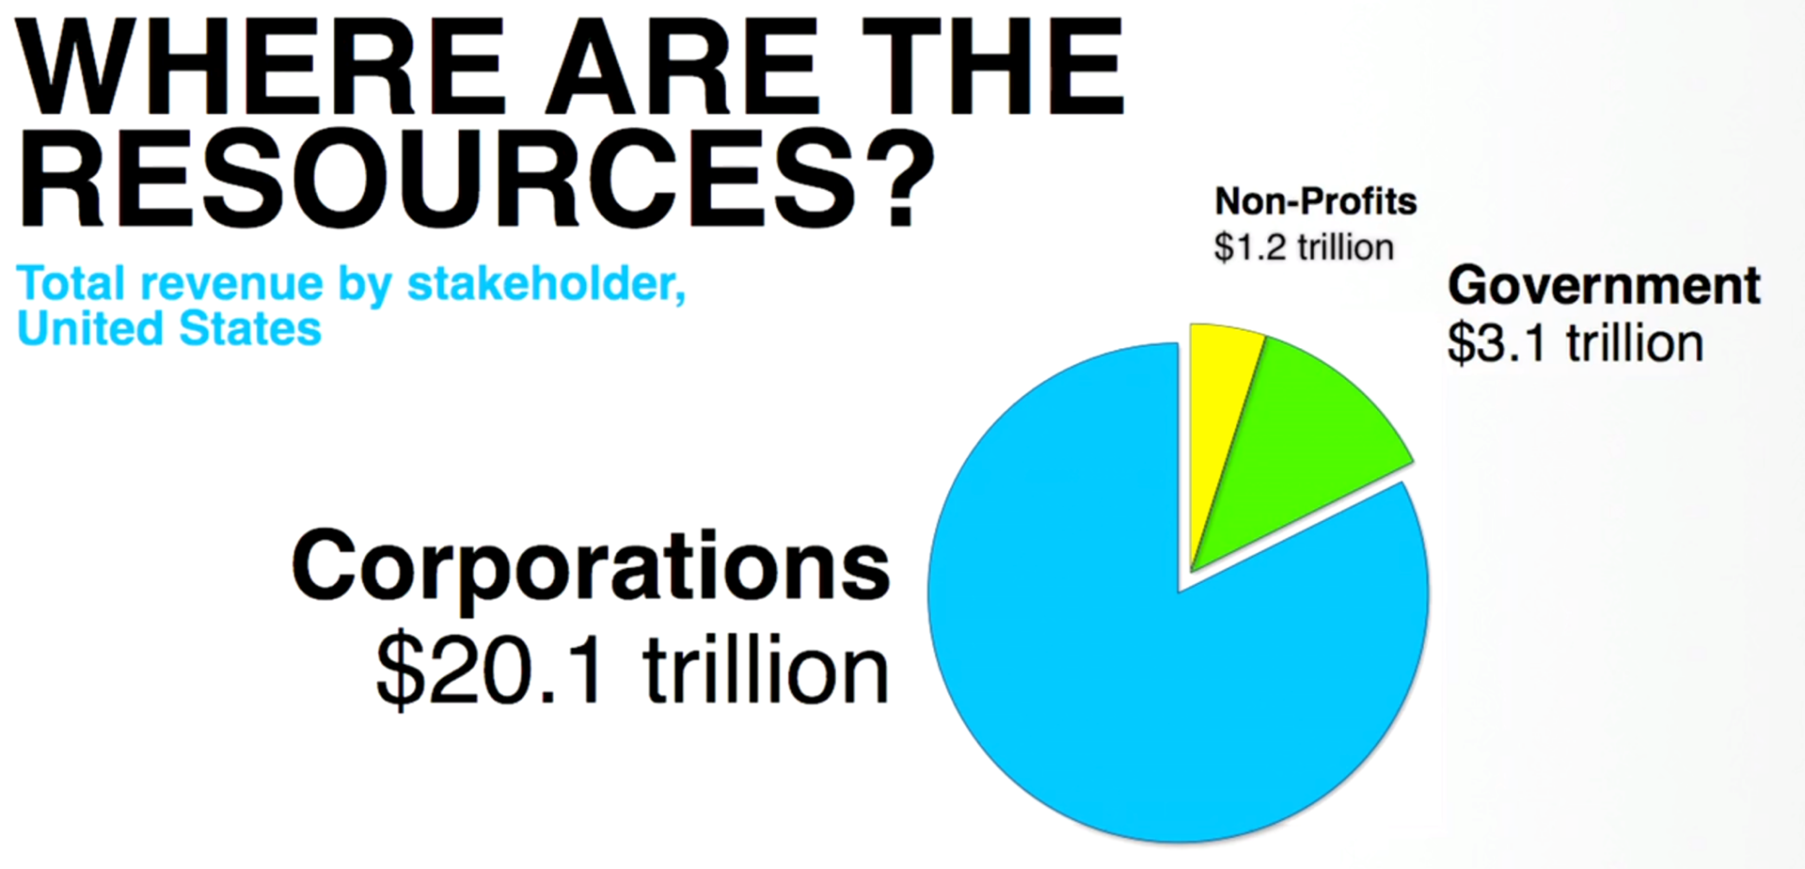
Releasing business resources into the community
‘The Case for Letting Business Solve Social Problems’ Porter (2013)
Porter & Kramer (2011) ‘Shared Value’ concept
Porter (2013) Ted Talk
In a Scottish context, the third sector attracts £4.9 billion in funding from various sources, using SCVO statistics 34% (£1,686m) comes in from the public sector (includes local, devolved and national governments) when only 1.5% (73m) comes from the private sector.
Notes:
Vast majority of resources are in the hands of business when compared to the Government and Non-Profits

Slide 9
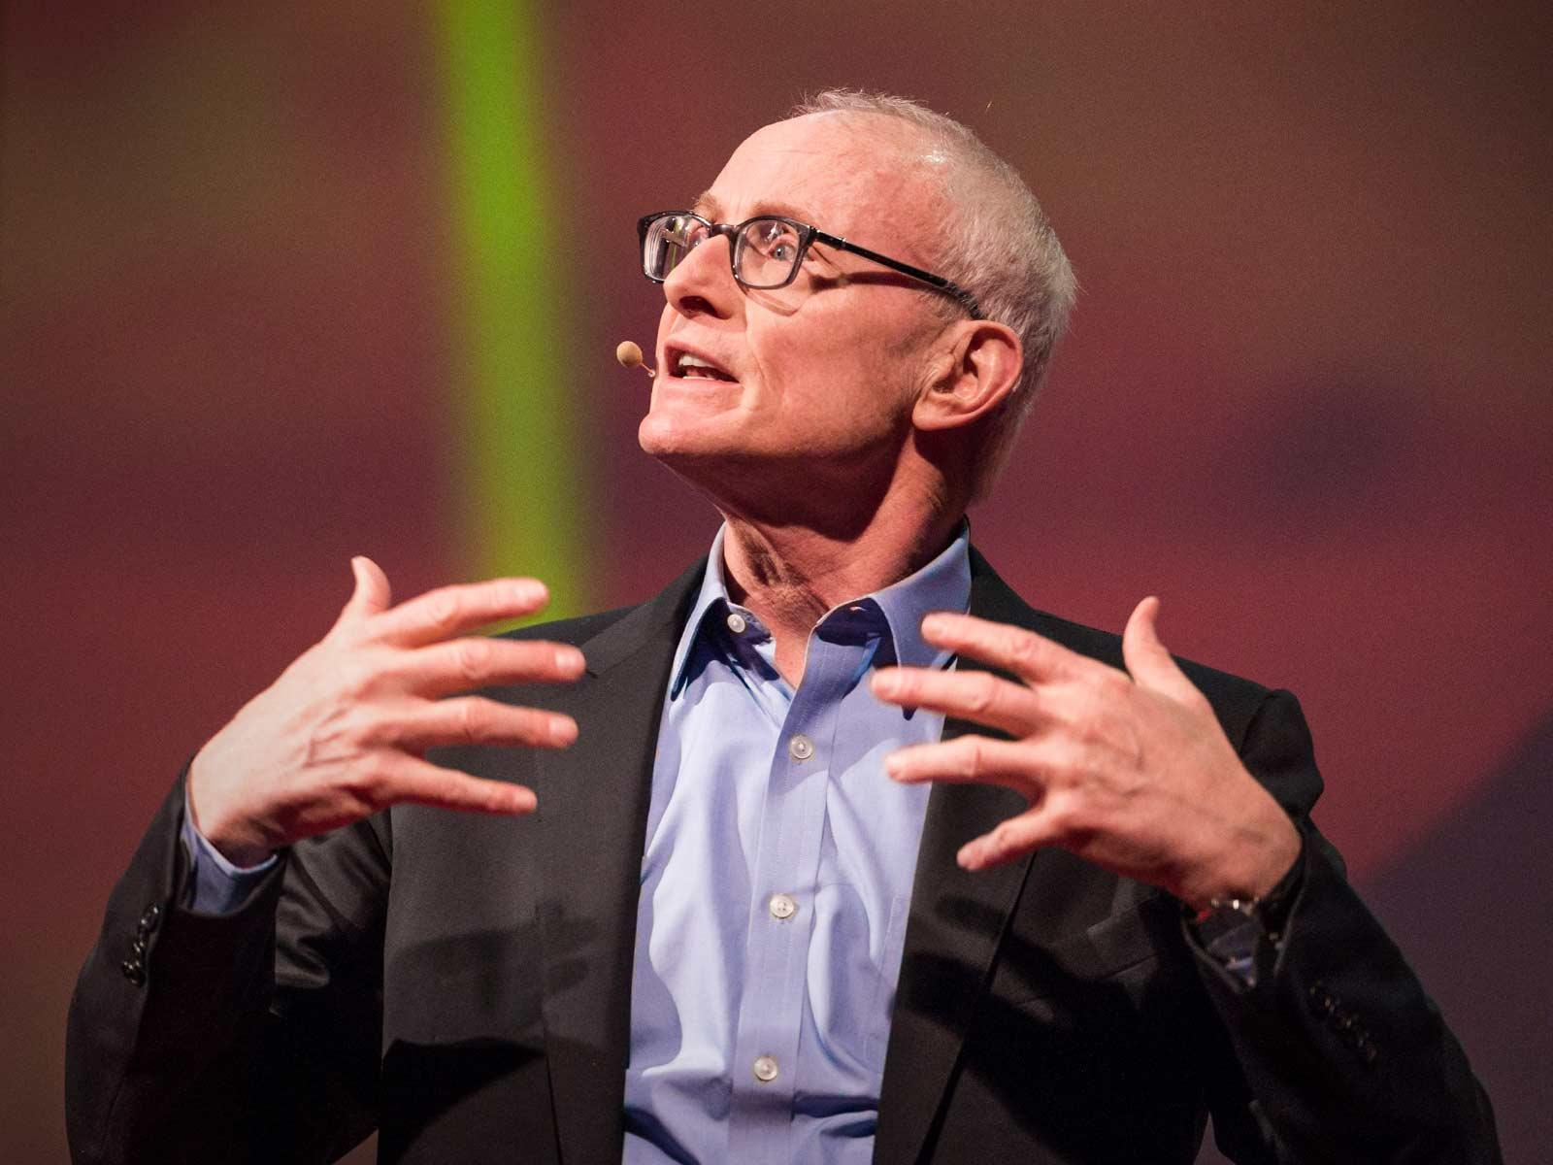
“O would some power the gift to give us to see ourselves as others see us” Robert Burns, Poem "To a Louse" - verse 8 Scottish National Poet (1759 - 1796)
“I think if we can get business seeing itself differently, and if we can get others seeing business differently, we can change the world”
(Porter, 2013)

Slide 10

the organisation, its goal and directions
Violence Against Women
Fund
£11M
Grant programmes
2014-15
Total Funds Distributed £19.9M
VAF’s Vision
That people and communities are thriving, active, self-organising, resourceful, and connected.
VAF’s Mission
To release existing and potential resources within communities by investing money, increasing capacity and building relationships.
Community Safety Grant
£4.1M
Volunteering
Grants
£1M
Equality Grants
£2.7M
Glasgow Transformation Fund
£1M
Community Grants
£40K
Notes:
AMR
Managed Grant Programmes
VAF manages a number of programmes on behalf of the Scottish Government. These are:
Violence Against Women and Girls Fund
Equality Fund
Community Safety Fund
Volunteering Support Fund.

Slide 11
VAFs perceived problem area
Lack of connectivity and alignment between and within sectors to address the challenges being faced by communities, represented by third sector organisations (TSOs)
Question for “Rich Picture” workshops: “There are many Grand Challenges facing Scotland today”. What are your views and perspectives on how joined up are the Government[s], the Private, Public & Third Sectors in addressing these challenges?

Slide 12
Soft systems methodology (SSM) applied in VAF
A systems-based approach adopted
Value of problem structuring methods to address COR/grand challenges
Interest in ‘social capital’ within human activity systems (HAS). Particularly, when considering SMEs.
Social capital integral to defining the system boundary
Desire to TAKE ACTION and bring on board key stakeholders in problem situation defining & action
SSM as a tool to invest in social capital itself?
Notes:
Mingers and White (2010) suggest this includes viewing a situation holistically, recognising that the relationships or interactions between elements are more important than the elements themselves in determining the behaviour of the system, recognising a hierarchical level of systems, mutual causality both within and between these levels and accepting, especially in social systems, that people will act in accordance with differing purposes or rationalities. This is important to this study as multiple actors exist, each holding different perspectives (e.g. aspirations and values) and conflicting interests.

Slide 13
Workshops held to form a multitude of perspectives
Cycle | Category | No. of RP Workshops | No. of Participants
 |  |  | Cycle 1 |  | Cycle 2 | Cycle 3
1 | VAF trustees | 2 | 10
 | VAF managers | 1 | 6
 | VAF staff | 2 | 11
2 | Third Sector VAF funded organisations | 2 |  |  | 12
 | Third Sector non-funded organisations | 3 |  |  | 19
 | Other Grant-makers and umbrella bodies | 1 |  |  | 5
3 | Local Government | 2 |  |  |  | 17
 | Scottish Government and their agencies | 2 |  |  |  | 10
 | Public Sector bodies | 2 |  |  |  | 13
 | Total number of workshops/participants | 17 | 27 |  | 36 | 40
 |  | Survey responses (funded organisations) |  |  | 26
 |  | Regular dialogue with key stakeholder |  | 8
 |  | Critical friend interviews |  | 2 | 4 | 2
Notes:
Workshops held for each cycle to express the problem situation from a multitude of perspectives

Slide 14
Methodological history
SSM Stage | Cycle 1 VAF Trustees & Staff
Stage 1: Finding out about a problem situation | Initial discussion around VAFs situational report & general understanding of responsible business practice; 4 workshops with VAF people identified 6 themes/problem situations, all considered relevant; Questions agreed to debate more widely
Stage 2: Formulating some relevant purposeful activity models | The ‘Connect’ model: a general emblematic model applicable to all 6 themes/problem situations and classified in terms of the 5 relevant systems;
Stage 3: Debating the situation, using the models | Comparison tables drawn up for ‘Investing in Social Capital’, debated & most significant changes defined
Stage 4: Taking action in the situation to bring about improvement | ‘Responsible Business Forum’ launched in Feb 2016; Move to cycle 2

Slide 15
Methodological history
SSM Stage | Cycle 2 TSOs Inc. GMs | Cycle 3 Government their agencies; pub PS
Stage 2: Formulating some relevant purposeful activity models | 12 relevant systems identified | 8 relevant systems identified
 | RS2.1, RS2.3, RS2.10-11, RS3.1-5 & 3.8 formed to refine the RBF model; Root definitions formed for RS2.7 – 2.9, R2.3 – RS2.6; relevant to understanding VAFs offer; VAF’s ‘W’ discussed with critical friends (other grant-makers); ‘Connect’ model is refined & proposed; Classification of the newly identified relevant systems in terms of the ‘connect’ model; Classification debated with critical friends
Stage 3: Debating the situation, using the models | Re-visited cycle 1, debate and changes made in light of new learning; Changes deemed commercially sensitive (excluded from this talk), the three emerging concepts from acquired learning
Stage 4: Taking action in the situation to bring about improvement | Move to cycle 4 – Scottish businesses (outside of scope of this talk) to refine the ‘connect’ & RBF models further as well as others deemed relevant

Slide 16

SSM Cycle 1:
Emerging themes from “Rich Pictures”
One participant on the problem situation:
“It’s a broken jig saw – I feel very little is joined up”
“sectors have different priorities … not on same wave length”
[Arm’s folded]
Notes:
“It’s a broken jig saw – I feel very little is joined up” – complicated problem?
“sectors have different priorities … not on same wave length” – so how do you tune?
Sid folded arms

Slide 17
SSM cycle 1: Questions identified from RP workshops to facilitate debate
PS1.1 What are the appropriate priorities and whom should set them?
PS1.2 What mechanisms are required to reconcile competing priorities so that the third sector can align its programmes?
PS1.3 What connections are strong, weak and/or are missing given the various perspectives of stakeholders and understanding of community assets?
PS1.4 What communication channels exist to influence decision-making [with whom holds the power] in setting the priorities?
PS1.5 What is the nature in which the third sector is changing and is adapting to its environment?
PS1.6 Who (or what) holds responsibility for governing the system and forging the relationships between sectors?

Slide 18
Relevant system identified in cycle 1
Relevant system identified in cycle 1 |  | System Name | Problem situations identified in Cycle 1
 |  |  | PS1.1 | PS1.2 | PS1.3 | PS1.4 | PS1.5 | PS1.6
RS1.1 | A system to invest in social capital with new and current stakeholders | Investing in social capital |  |  | • |  |  | •
RS1.2 | A environment-scanning system to identify and align private sector responsible business priorities to VAFs social policy passions | Aligning priorities | • | • |  | • | • | •
RS1.3 | A system to develop a proposal articulating VAFs offer to business to invest in community programmes, which align to societal goals through effective matching of third sector organisations with business | Developing VAFs offer to business | • | • | • |  |  | •
RS1.4 | A system that identifies alternative sources of people, assets and money that can be allocated to communities in Scotland within an evolving public space | Resource allocation to communities |  |  |  |  | • | •
RS1.5 | A system for reporting and evaluating outcomes that can be used by business clients to demonstrate responsible business practice and Third Sector clients to demonstrate greater leverage of resources released into communities | Evaluation services |  |  |  |  | • | •

Slide 19
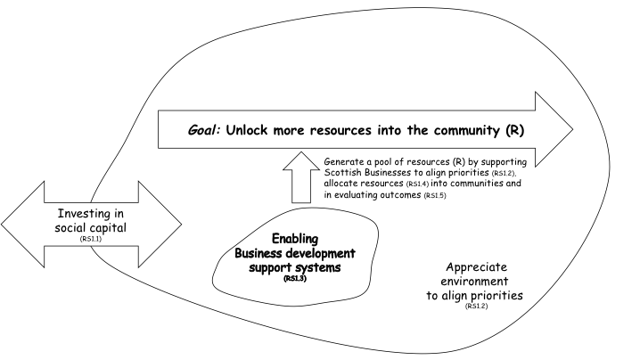
The Connect emblematic model

Slide 20
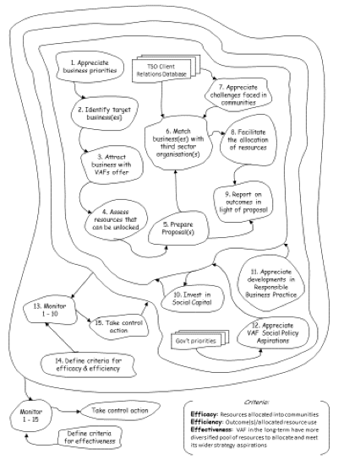
Formal root definition & the ‘connect’ model

Slide 21
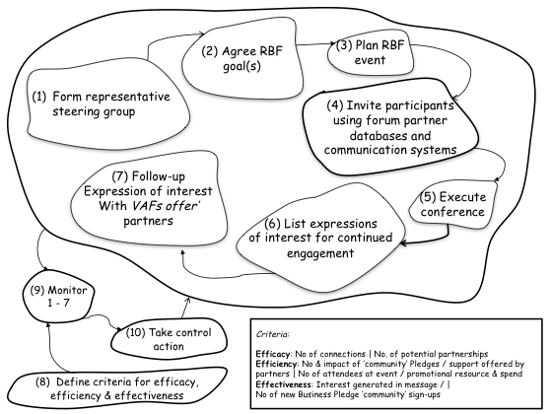
Taking action to invest in social capital
RBF Root definition: A system, organised by the Responsible Business Forum Steering Group, that seeks to forge connections between and within sectors, to promote responsible business practice and its impact on communities, supported by the Scottish Government Business Pledge and steering group member organisations who will support the implementation of community CSR/Sustainability responses

Slide 22
Comparisons between ‘Responsible Business Forum’ model and the expressions of concern (1)
No steering group exists that govern the network for cultivating responsible business
No shared vision as each actor sets their own priorities in their own interest
The Business Pledge attempts to share a vision between government and the sectors, although this is deeply ‘anchored’ in Scotland’s national priorities and language/ emphasise is business-led

Slide 23
Comparisons between ‘Responsible Business Forum’ model and the expressions of concern (2)
Sign-ups to the Business Pledge are dominated by large organisations; opportunity also exists to support SMEs (majority of Scottish businesses)
Lack of mechanisms to share good practice and listen to the views in each of the sectors (recognised that the ‘Business in the Community’ organisation, represents businesses)
Social capital already exists that can be pooled (i.e. partner databases)

Slide 24
Suggested changes to bring about the Responsible Business Forum
Form a steering group of cross-sector leaders with interest in investing in the community
Devise a mechanism for setting a shared vision amongst steering group members
Investigate ways to understand the priorities of different sectors and reconcile those with community priorities

Slide 25
Suggested changes to bring about the Responsible Business Forum
Investigate whether the Scottish Business Pledge is an appropriate mechanism for sharing a vision between sectors and ongoing role of government (as one problem solver, not the problem owner)
Consider the ways in which members should be elected to represent constituent groups, their terms of reference and length of appointment
Consider the planning and resourcing needs for RBF events

Slide 26
Suggested changes to bring about the Responsible Business Forum
Consider the intended audience of RBF events, leveraging steering group contacts
Adopt processes and practices for collating feedback from events and following up on participant’s requests (e.g. businesses and third sector organisations requiring support)

Slide 27
“That the Responsible Business Forum was the first event of its type … I’m pleased it went well” and recognised that “progression needs to be built in from the outset, I suppose, new voices, new thoughts … so that it’s capable of evolving … one of the values for this work would be if it provided us [Scottish Government] with the capacity to keep growing”
(Scottish Government, Policy Manager)

Slide 28
Issues/Challenges from TSO perspective
Emerging theme | Issues/challenges facing third sector organisations in Scotland
Funding and funding cycles | Alignment of funding resources available to organisational needs; Lack of public funding sources; Expectation to “do more for less”; Short term funding cycles; Time taken by third sector organisations to chase funding, make applications and sending them out; Lack of independent funding sources; How funding is distributed by grant makers
Setting priorities | Mismatch of funding (financial capital) to organisational need; Time pressure on planning cycles; Competing business priorities; Competing policy priorities (Grant-makers); Competing policy priorities (Scottish Government)
Skills and assets (human resources, skills and physical assets) | Long-term sustainability of skills and asset resources; Availability of resources and routes to accessing them; Mismatch/alignment of skill resources (human capital) to address challenges as a voluntary organisation; Mismatch/alignment of asset resources (physical capital) to address sector challenges
Relationships between and within the public, third & private sectors | Relationships within your sector; Relationships between the sectors; Breaking down of stereotypes that hinder collaborative working between sectors and organisations; Equality of relationships and power (real or perceived) between the sectors; Relationship between funder and recipient; Ownership of policy priorities
Operating environment and climate | Need to improve the quality of funding applications to ensure successful funding bids addressing specified criteria; Grant-makers and funders understanding of the breath and diversity the third sector in Scotland; Government official’s perception of the third sector; Grant makers and funders understanding of the environment in which they operate; Quality of communication between recipients of funds

Slide 29
“Square holes for circle problems”
“Sometimes what you get offered is maybe not what you need, you don’t need a day with 100 volunteers coming up to do a community garden, actually what you need is real capacity building, in a way that might be to support, IT support, not necessarily covering head office costs but core sustainability funding and I think, corporates are starting to get that”
(Third Sector workshop participant)
Notes:
Role for COR in the allocation of volunteers time and skills to address real & emerging challenges

Slide 30
TSOs: 12 Relevant systems

Slide 31
Government & the Public Sector:
8 relevant systems

Slide 32
Lessons learnt from SSM study (1)
1. Investing in social capital is the foundation to forming ‘spaces’ between business, third sector, government and citizens. This includes spaces to forge connections, shared understanding and to facilitate dialogue and negotiation:
  In ‘open spaces’
  In ‘shared spaces’
Notes:
In ‘open spaces’ – to learn from each other, build networks and to articulate a set of shared aspirations and values (articulated through the RBF in a Scottish context)
b. In ‘shared spaces’ - Aligned and connected business and third sector organisations enter a dialogue and negotiation around the co-creation of value, facilitated by a conduit who can match aspirations and values plus translate the ‘offer’ in terms of how value can be reciprocated through dialogue, negotiation, joint action and learning through evaluation (paving a way that counteracts a “them and us” mind-set).

Slide 33
Lessons learnt from SSM study (2)
These ‘spaces’ need to be ‘governed’ as no one body, organisation nor sector ‘own’ the challenges being faced by communities.
Government’s role is to be an active and equal member in the creation of these ‘open spaces’ and express the shared vision and values in policy and business development activity.
‘Shared spaces’ are created in a wider framework of ‘open spaces’ and are facilitated by a conduit who suggests matches and builds capacity, or can be self-organising
Notes:
These ‘spaces’ need to be ‘governed’ as no one body, organisation nor sector ‘own’ the challenges being faced by communities. Communities themselves are best placed to understand these challenges and to address them. The governance of these spaces need to consider how actors are best represented, particularly as these actors may transcend multiple sectors and that communities themselves are involved in decision-making
Government’s role is to be an active and equal member in the creation of these ‘open spaces’ and express the shared vision and values in policy and business development activity.
‘Shared spaces’ are created in a wider framework of ‘open spaces’ and are facilitated by a conduit who suggests matches and builds capacity, or can be self-organising

Slide 34
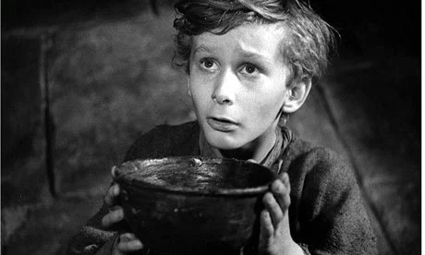
Lessons learnt from SSM study (3)
Resources can be unlocked and flow between parties in a ‘shared space’ that seeks to build joint value, recognising that assets exists to be built upon (some of which are under-utilised, redundant etc.,)
Resources can be pooled; recognising the reality that the majority of businesses in Scotland/UK are SMEs and sole traders and likewise for voluntary organisations and charities (coalitions of negotiated action)
Third sector ‘ask’ can be better channeled to suitable matched business, once a relationship has been formed –
  the “begging bowl” – a constant ask in the absence of sustainable change - a transactional relationship)

Slide 35
Lessons learnt from SSM study (3)
A conduit can support responsible businesses to understand the challenges being faced in communities, how value can be co-created through constant dialogue and joint action, support the allocation of resources and evidencing the benefit of the relationship and evaluating outcomes being achieved (as a self-denoting boundary of shared aspirations and values between business, TSOs and VAF)
Both ‘open’ and ‘shared’ spaces require governance arrangements for the network (recognising that no-one sector or organisation ‘owns’ the problem), to represent the “whole” and to ensure communities are not marginalised

Slide 36
Three key concepts embedded into the refined connect model
Fostering ‘open space’ to invest in social capital
  Boundary and governance arrangements
  Shared aspirations and values between participants
  Continuously debate diversity of sectors participating in open system
  Reciprocity in the relationships and borrowing ideas from the ‘common good’
Co-creation of business-community value
  Shared dialogical space between the market, state & third sector
  Shift from “them and us” to “what can we do for each other”?
  Communities and themselves are best placed to describe and address challenges
Role of a conduit to unlock and prepare a ‘shared space’
  Capacity to develop power & political agency
  Prepare the ground before the “ask”
  Shared understanding, use best practice, build social capital
  Bring together coalitions of interested parties (e.g. SMEs)

Slide 37
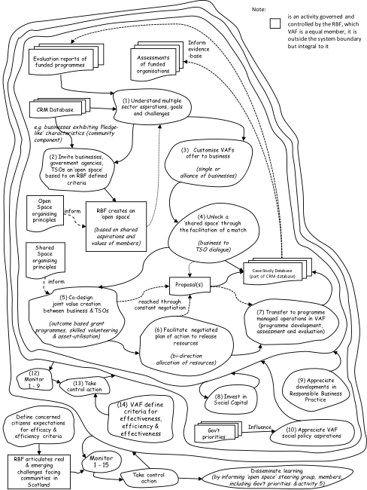

Slide 38
Further work & avenues of study
To refine the ‘connect’ model with input from business
To fully establish the RBF as an open system to develop a shared vision around addressing challenges communities face
Pilot VAFs offer to business - small number of ‘shared spaces’ with relevant actors
Develop a set of organising principles for unlocking a ‘space’ and in releasing resources into the community
Wider scope: Re-visit the concept of co-creation in the context of the call to align business & societal goals

