Slide 1
The ‘Boundary Idea’ in Sustainability & Sustainable Development
¹Miles Weaver, ²Ana Fonseca & ¹Hock Tan
¹ Edinburgh Napier University Business School
² Edinburgh Business School, Herriot-Watt University
Corresponding author: m.weaver@napier.ac.uk
Systems Thinking - Parallel 8, 12/09/2024, 12:05 – 12.30, Drama Rehearsal Room, #OR66
Notes:
Ludovico Einaudi - "Elegy for the Arctic“ (2016)
TitleThe 'Boundary Idea' for Sustainability and Sustainable DevelopmentThemeSystems ThinkingSession DetailsParallel 8 - Systems Thinking Thursday, Sep 12, 2024 11:00 AM - 12:30 PM Drama Rehearsal Room Presentation Time12:05 PM - 12:30 PMPresenting AuthorDr Miles Weaver

Slide 2
Outline
The ‘Boundary Idea’ in Sustainability & Sustainable Development
Our Approach
Practicing Systemic Sustainability
Exploring the ‘Boundary Idea’ & CSH
Towards a Systemic Sustainability
Boundary Critique
Conclusion & future directions

Slide 3
Our Approach
Multi-stakeholder value creation
Ego
With oneself;
With others;
With nature;
Truly regenerative & restorative systems
Eco
Wider impact
Where does a sense of purposefulness and value come from?
Those involved
Where is social, *ecological and legal approval assumed to reside?
Those affected
How can systems thinking help bring about meaningful engagement in co-creating multi-stakeholder value with impact?
Key Influences: Ulrich (1983; 1996); Laszlo (2011), Sharmer (2016), Porter and Kramer (2006); Midgley et al., (2017), Weaver et al., (2017; 2019, forthcoming); Raworth (2017); Ulrich and Reynolds (2020).

Slide 4
Outline
The ‘Boundary Idea’ in Sustainability & Sustainable Development
Our Approach
Practicing Systemic Sustainability
Exploring the ‘Boundary Idea’ & CSH
Towards a Systemic Sustainability
Boundary Critique
Conclusion & future directions

Slide 5
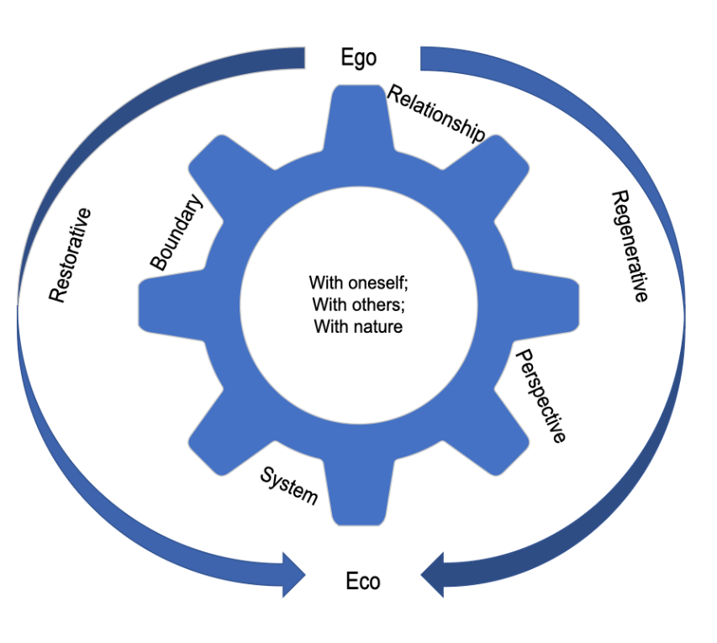
Our Approach: Practicing Systemic Sustainability
Stakeholder perspective | Stakeholder Concern (Adapted from Lazlo, 2011)
With oneself | Every little action, even how small, contributes to a sustainable future. Sustainability must always reflect one's values. It includes appreciating and understanding how to positively impact one’s carbon footprint and contribute to societal goals.
With others | Most sustainability actions are taken with others, usually within the workplace and with communities.
With nature | The third level transcends the community and interpersonal to sustainability with nature. This practice involves communing – being at one with all forms of nature by listening and acknowledging our interdependence and ultimate unity.
Truly regenerative & restorative | Embeds eco-thinking into everything we do to bring about truly regenerative and restorative systems.
Approaches for exploring value and boundary judgements about what should be included in or excluded from analysis (Midgley, 2017)

Slide 6
Outline
The ‘Boundary Idea’ in Sustainability & Sustainable Development
Our Approach
Practicing Systemic Sustainability
Exploring the ‘Boundary Idea’ & CSH
Towards a Systemic Sustainability
Boundary Critique
Conclusion & future directions

Slide 7
The ‘Boundary Idea’
(See Midgley, 2016)
Marginalisation (Midgley, 2020)

Slide 8
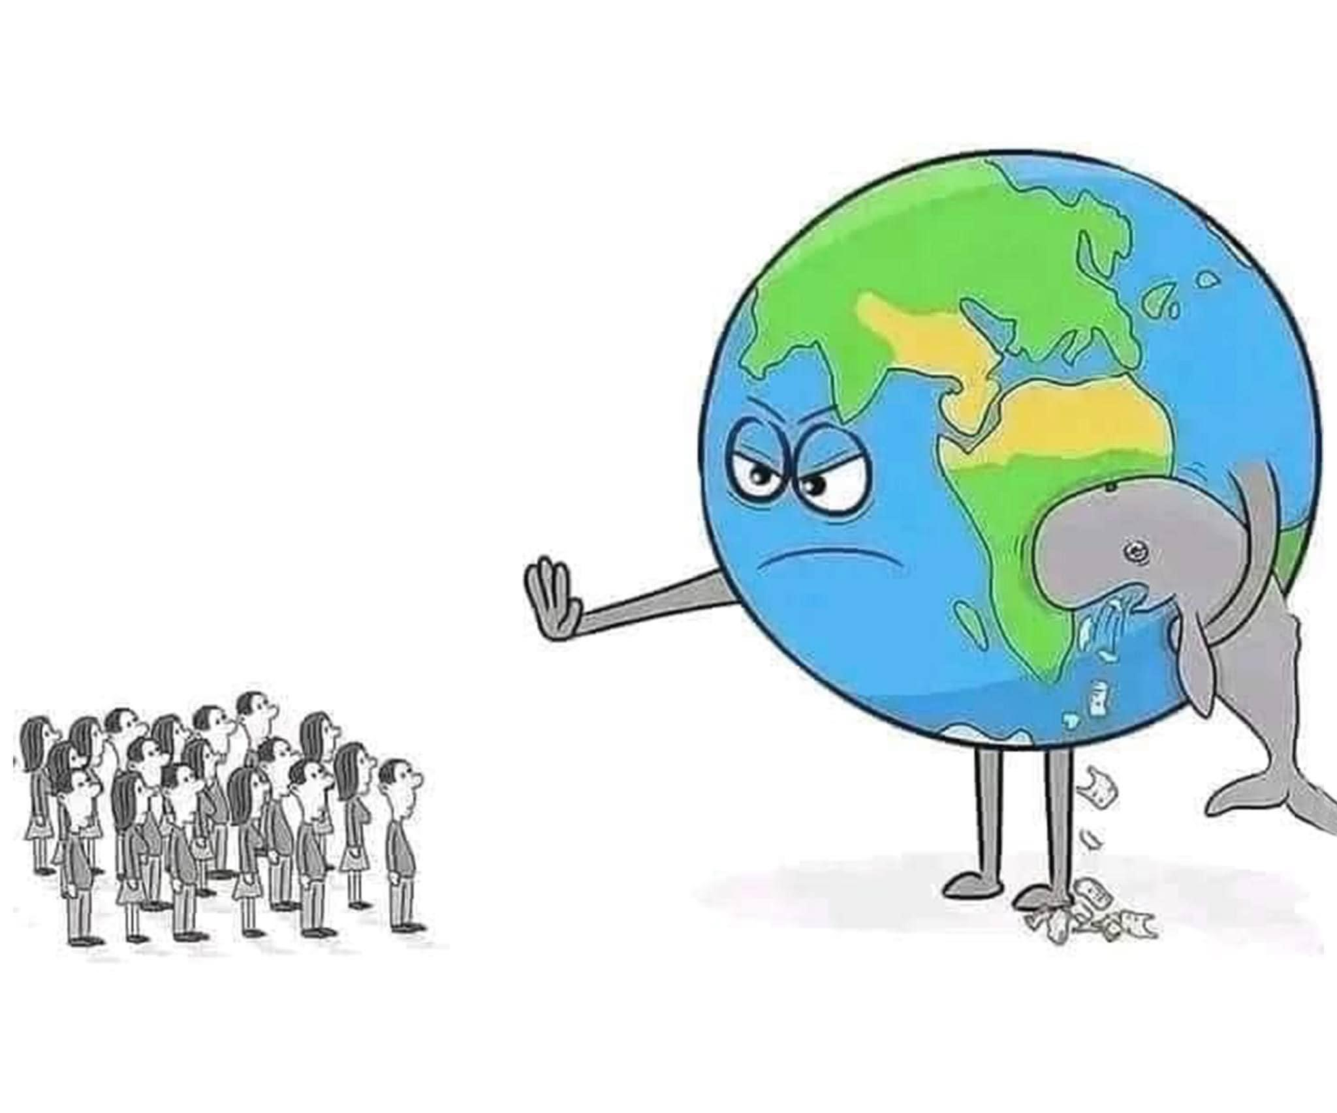
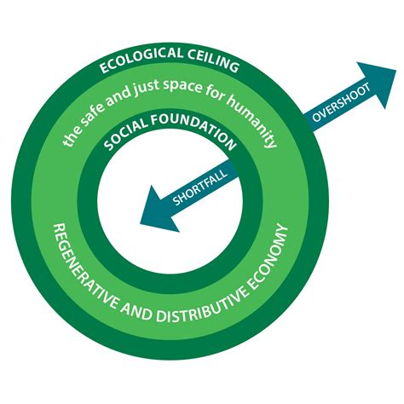
Raworth (2018) offers two critical boundaries
Impact:
OVERSHOOT
Ecological ceiling
SHORTFALL
Social foundation
Conflict:
ALIGNMENT / PERTINENT ISSUES
Sense and clashes of purposes
shared value(s) & issues between individuals & multiple actors
Marginalisation of those affected who are voiceless & clash of worldviews
i.e. future generations & nature

Slide 9
The stewardship dilemma in addressing sustainability challenges
Conflict arises from:
Deep power conflicts & marginalisation between business & communities
Difficulty reconciling a shared sense of purposes and worldview
Co-creating value with multi-actor inputs (those involved)
Measuring value created with impact towards transformation (those affected)
Stakeholder influence that can stop value and impact transformation shifts between customers and investors to future generations and nature in a circular economy (between those involved & affected)
Shared purpose
& worldview
W gives T
meaning
Marginalised voices & concerns:
Nature & future generations
O₁
O₂

Slide 10
Critical Systems Heuristics
Three reasons for using CSH (Ulrich and Reynolds, 2020):
Making sense of situations: understanding assumptions and appreciating the bigger picture
Values & motivations
Power structures
Knowledge basis
Moral basis
Unfolding multiple perspectives: promoting mutual understanding
Promoting reflective practice: analysing situations – and changing them
Where a sense of purposefulness and value comes from?
Where social and legal approval is assumed to reside?

Slide 11
Outline
The ‘Boundary Idea’ in Sustainability & Sustainable Development
Our Approach
Practicing Systemic Sustainability
Exploring the ‘Boundary Idea’ & CSH
Towards a Systemic Sustainability
Boundary Critique
Conclusion & future directions

Slide 12
Case in point
FLYING DOMESTIC:
Should I take the train or the plane?
SAVE THE NHS:
What was the right approach during Covid-19?
THE BUSINESS CASE:
Should I partner with that charity or not? What’s in it for me?
SUSTAINABLE FOOD:
How can a farmer ensure tomorrow’s crop?

Slide 13
Systemic Sustainability Boundary Critique
Where does a sense of purpose and impact (putting values into meaningful action) come from considering social, *ecological and legal approval?
Value
judgements
Reconciling different stakeholder’s purposes, the marginalisation of those affected & their worldviews
Those involved
Those involved
Values
judgements
Those affected
Impact
judgements
Observe & evaluate different ‘facts’ & ‘norms’
from different stakeholder perspectives

Slide 14
Boundary judgements affecting a purposeful & regenerative system of interest (S)
Who is (ought to be) involved in the value co-creating activities of S?
What are (should be) the basis of value-in-use by the customer/beneficiaries?
Value
judgements
Note in co-creation mode:
Shared W gives meaning to T
Reconciling different stakeholder’s purposes,
the marginalisation of those affected & their worldviews
Those involved
Those involved
What is (should be) the intended impact on people and places, taken together on the constraints of all people within the means of a living planet and at a just pace?
What are (should be) the values that underpin the worldview that make value creation meaningful in context and action
Values
judgements
Impact
judgements
Those affected
Observe & evaluate different ‘facts’ & ‘norms’
from different stakeholder perspectives
Who is (ought to be) affected by the wider impact of S?

Slide 15
Outline
The ‘Boundary Idea’ in Sustainability & Sustainable Development
Our Approach
Practicing Systemic Sustainability
Exploring the ‘Boundary Idea’ & CSH
Towards a Systemic Sustainability
Boundary Critique
Conclusion & future directions

Slide 16
Conclusion & future directions
Summary
Future directions
Considerable role systems thinking can play to help bring about meaningful engagement in co-creating multi-stakeholder value with impact
Systemic sustainability combines diversity and universality called for in the “fourth wave for systems thinking” and takes a sustainability & sustainable development lens
“The Boundary Idea” is a fundamental approach when considering boundary judgements in sustainability applications
Elements of CSH can be adapted to make boundary judgements to bring about a purposeful and regenerative system that puts values into meaningful action to create value with impact
Method:
Validation and testing
Application:
Finding the “WHY” in determining organisational purposes and worldviews and reconciling with the interests of stakeholders
Co-creating value with impact in multi-actor collaborations
SHIFT to circular systems (economies, cities, organisations, supply chains and protecting living systems). See Pokorna et al., (2024)

Slide 17
Thank you!
napier.ac.uk/tbs
Ludovico Einaudi - "Elegy for the Arctic“ (2016)

