Slide 1

Value(s): Taking a Systems/COR Critical Perspective
* Miles Weaver & Hock Tan
* m.weaver@napier.ac.uk
@weavermiles
Systems Thinking - Stream 5, 14/09/2021 1520, #OR63

Slide 2
Outline
Sustainability – the “ultimate” wicked problem
Reimaging Value(s): Connecting COR and Sustainability
Value(s): Taking a Systems/ COR Critical Perspective:
Purpose, meaning & values in a business context
Search for ‘meaning’ in Systems Thinking/COR
Continuing our Journey taking
a systems-based/COR approach
Implications for Systems/COR: Value(s) in partnership working for the goals
Notes:
Sustainability – the “ultimate” wicked problem

Slide 3
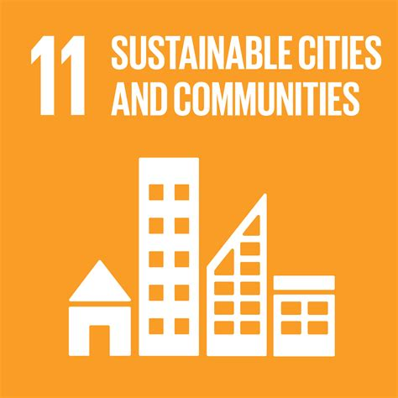
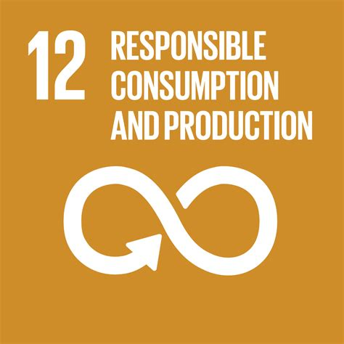

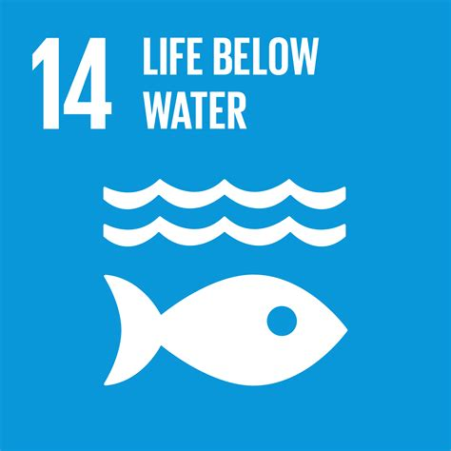
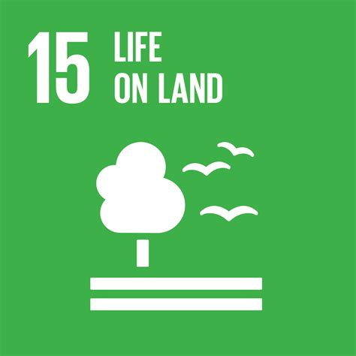
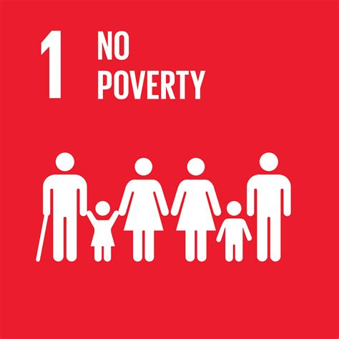
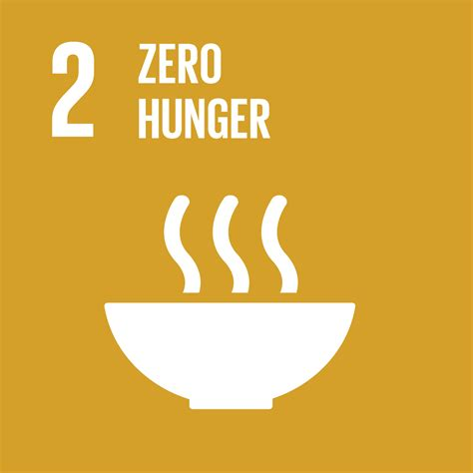
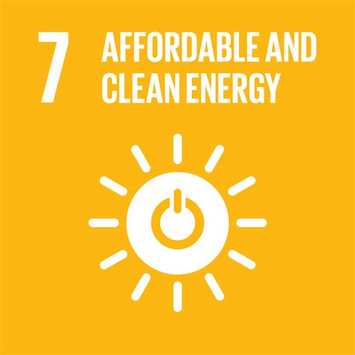








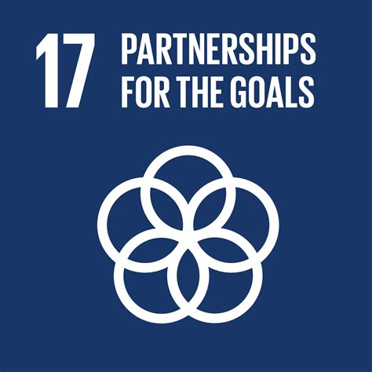
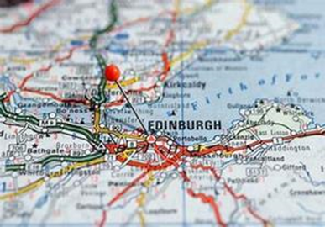
Sustainability – the “ultimate” wicked problem
Planet
Purpose
People
Prosperity
Peace
Partnership
Place
North Star Analogy, See Weaver et al., (2017)
Notes:
Miles

Slide 4
Reimaging Value(s): Connecting COR and Sustainability
Business
Communities
Ego
Individual
Relational
Community
Eco
Connecting & aligning business & societal goals
A purpose beyond profit
Bringing about wider impact in communities
Social
Environmental
Economic
Bringing about a ‘meaningful engagement’
with and between business and communities to co-create purposeful action
Notes:
Miles

Slide 5
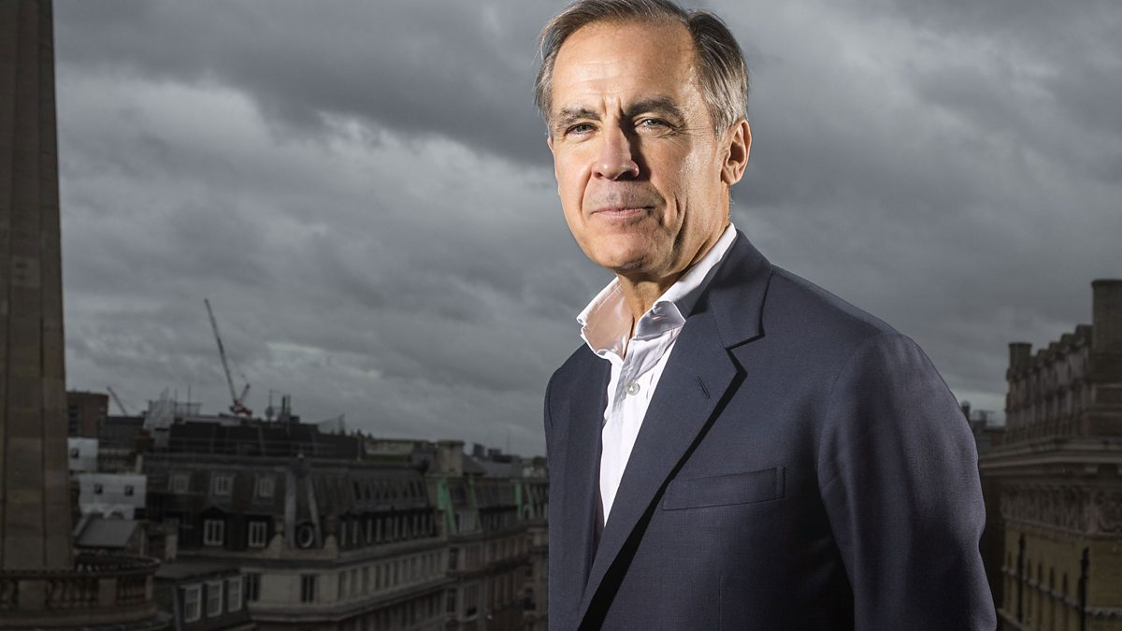
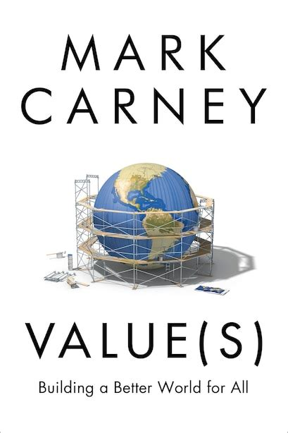
Mark Carney on Value(s)
Mark Carney asks:
  What is value?
  How does the way we assess value both shape our values and constrain our choices?
Carney argues that society has come to embody Oscar Wilde’s old aphorism: “knowing the price of everything but the value of nothing.”
Seven key values are: solidarity, fairness, responsibility, resilience, sustainability, dynamism and humility – all laced with compassion.

Slide 6
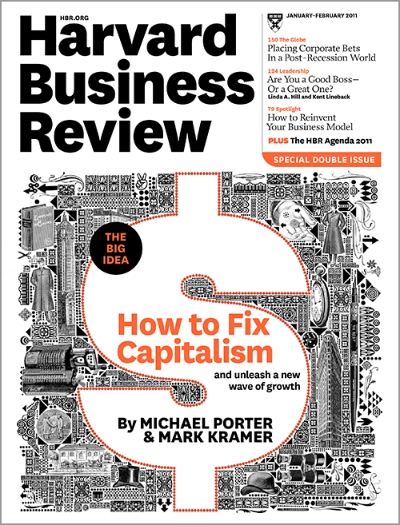
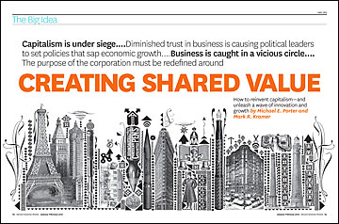
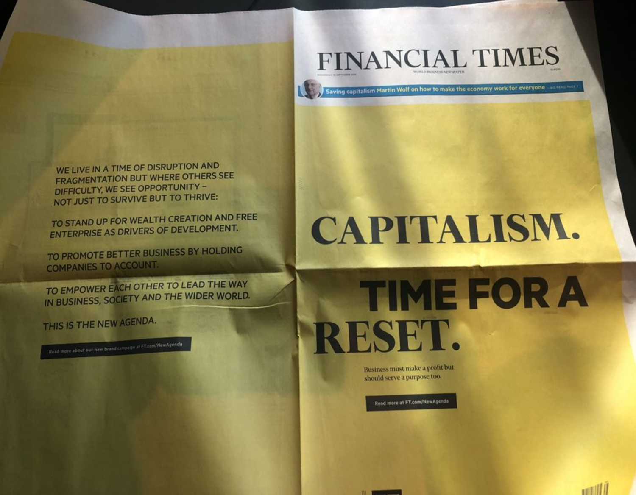
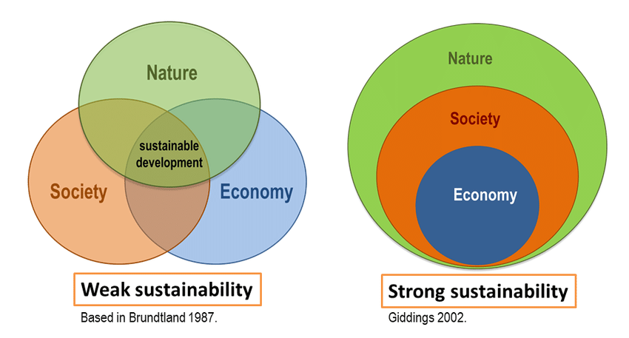
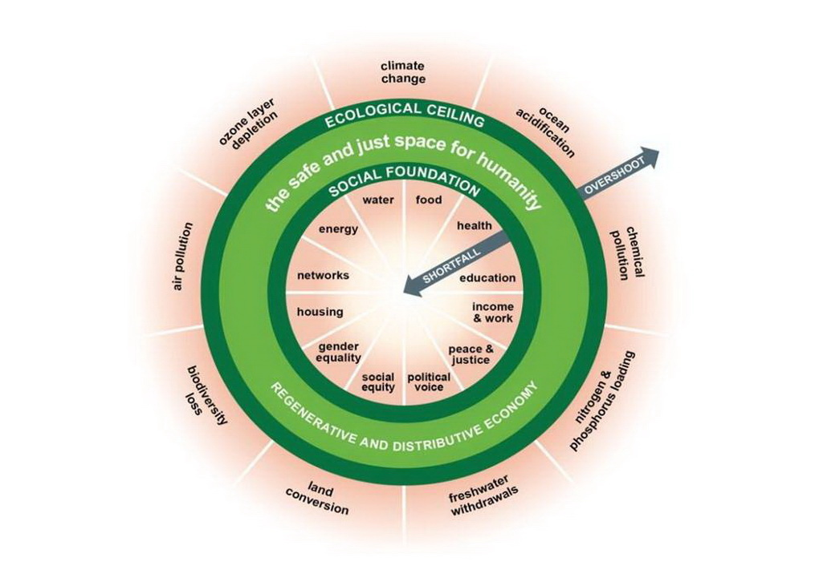
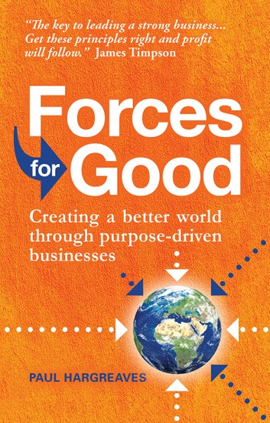
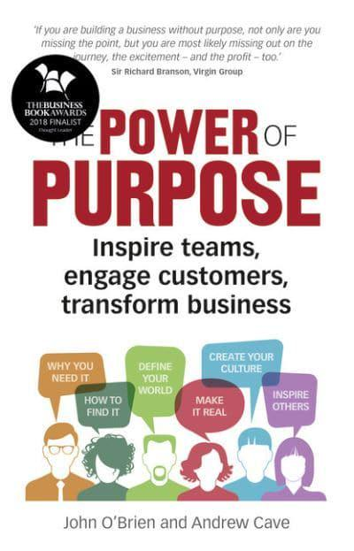
The notion of value(s) in an evolving business landscape
Doughnut economics, Raworth (2017)
Notes:
MW
Raworth Is our economic model working for us, that includes planet?
Doughnut economy
“visionary” companies — those guided by a purpose beyond making money — returned six times more to shareholders than explicitly profit-driven rivals” (Collins & Porras, 1994)
Purpose-driven Businesses, adopt:
a corporate purpose to create a material positive impact on society and the environment;
Expanded fiduciary duties of the directors requiring the consideration of non-financial interests;
an obligation for the corporation to report on its overall social and environmental performance”
(Hemphill and Cullari 2014, p. 520)
Catalysts: French Civil Code (2016), B Movement as well as UN Global Compact, SDGs & Net-zero

Slide 7

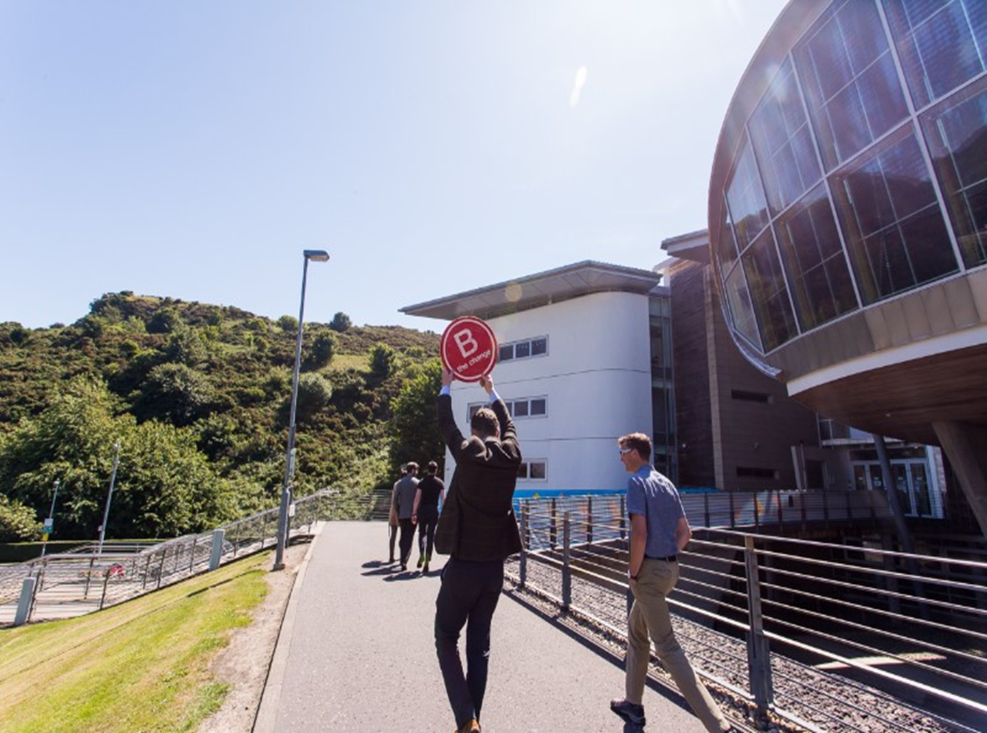
Purpose, meaning and value(s) in business (I)
Murray (2019) recognises the importance of meaning in work and a shared sense of social purpose is also crucial in businesses and the wider society.
Values articulate the desired culture and serves as a compass (preferences for behaviour or attitudes), includes:
  principles that help you to decide what is right and wrong
  how to act in various situations
  Values give meaning. Meaning is a sense of importance. Meaning touches the individual.
Value as “perceived and determined by the customer on the basis of value-in-use” (Vargo and Lusch 2004, p. 7).
Notes:
HT
Values - the principles that help you to decide what is right and wrong, and how to act in various situations
Values give meaning
Meaning is a sense of importance. Meaning touches individual.
Purpose – the reason for which something is done
Purpose externalises meaning (doing) to create value (worth, benefit, importance)

Slide 8
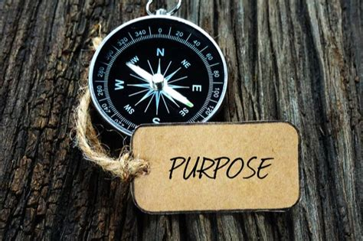
Purpose, meaning and value(s) in business (II)
Purpose answers the question ‘why it is worth doing what we are doing’ from various stakeholder perspectives. Provides motivation & inspiration (Mackey & Sisodia, 2013)
Purpose externalises meaning (doing) to create value
(worth, benefit, importance)
Meaning, values and purpose may seem personal, they are social/relational.
Despite the importance placed on ‘values’, there is very little understanding between human values and management practices (Florea, Cheung, & Herndon, 2013).
Notes:
HT

Slide 9
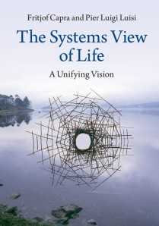
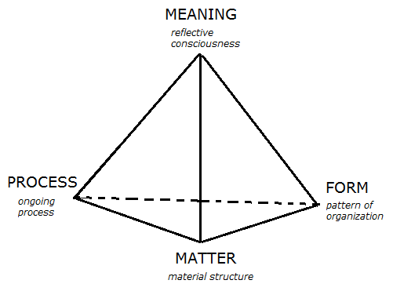
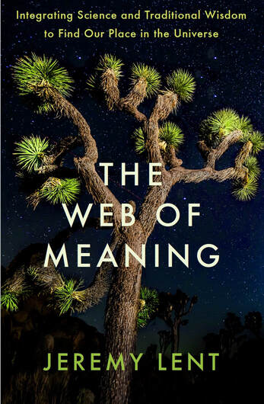
In search of ‘meaning’ in Systems Thinking
Value(s)
Our dominant worldview of disconnection, tells us we are:
split between mind and body
separate from each other, and
at odds with the natural world
Adapting Capra (2014) Four Perspectives of Life
Notes:
HT
A worldview of deep interconnectedness
As our civilization careens toward a precipice of climate breakdown, ecological destruction, and gaping inequality, people are losing their existential moorings.
Our dominant worldview of disconnection, tells us we are
— split between mind and body,
— separate from each other, and
— at odds with the natural world
This worldview has passed its expiration date
It's not just dangerous—it's based on a series of flawed assumptions that have been superseded by modern scientific findings

Slide 10
Purposeful Partnerships
Value | Benefit of co-creation to those involved & affected
Values | Connecting Weltanschauung – individual, shared
+ 1 SDG impact area
Climate action
Set direction
Build for purpose
Amplify Impact
(in partnerships)
Assess SDG baseline
Take action
Journey Making Lens
SDG Pillars | Planet; People; Prosperity; Peace
Schools of thought | B Leaders; Zero Waste; Leading Excellence (EFQM); SDG Impact
Sectors | SMEs; HCIs (funded)
Place | Local to global (Edinburgh & SE region funded)
Undertake an SDG Baseline
Deep dive into ‘SDG13 Climate Action’
Deep dive into + 1 SDG / pillar
Embody sense of purpose
Contextualised:
Tribes: B Leaders; Zero Waste; Excellence
Sectorial: Tourism, Education, Cycling etc.,
Place: Edinburgh and South East Region
Analysis
The Napier B4P Pathway
SDG baseline
SDG13 climate action
+ 1 SDG / pillar
Embody purpose
Impact = [SDG Baseline + (SDG13 + 1)]^{Purpose}
Pathways | SDG Action (mainstream) Net Zero; Leading Excellence; B Leaders
Trails | Sectoral & place-making
“the mess”
Sensemaking
Build for Purpose Pathway
Notes:
Not prescribed
We don’t have the answers – we on journey#
a body of people or pupils adhering to a certain set of principles, doctrines, or methods
Global Financing campaign – green guilt
Clean power – 4 times faster than present. Low carbon industrial sector. Renewable energy
EV corporate fleet
Build for Purpose (Climate Action)
BPCA
Excellence in Climate Action
ECA
Beyond
Act
Pay for the masterclass = £1500
C2K = 1K
Green ticks = 1K
= £3500 service package (say 4K)
Student placement = 3K
= £4 service. (with 50% voucher = £2K). You get:
Training, support, CoP, holistic view of improvement, climate action improvement, EMS
For additional 2K you get a placement student (50% towards the cost of a student)
So total cost = 4K investment
We could build this into a PG cert for an additional 4k (perhaps no voucher for this?)

Slide 11
Emphases of systems approaches for partnership working towards the goals
Main approaches reviewed by Weaver, Tan & Crossan (2020):
1) Systems Dynamics
2) The Viable Systems Model (VSM)
3) Strategic Options Development and Analysis (SODA)
4) Soft Systems Methodology (SSM)
5) Critical Systems Heuristics (CSH)
6) Theory U (Ego system to the eco system approach)
7) Systemic Intervention (incorporates boundary critique - vital relationship between boundary and value judgement created by agents, see Midgley (2015))
See Weaver, Tan & Crossan (2020), Adapted from Midgley (2014) citing Cabrera and Colosi (2008)
Notes:
MW
The theory of boundary critiques illustrates the vital relationship between boundary and value judgement created by agents.
Incorporating: Value(s) & meaning (worldview); autopoesis
Opportunity to combine some of the emphases of systems-based approaches to:
Accelerate progress towards attaining the SDGs including net-zero
… the “ultimate” wicked problem
To build partnerships towards the goals
… meaningful engagement between & with business and communities
Help business find their sense of purpose
… Embodying purpose by untangling Value(s)
… Bringing about a wider impact by connecting & aligning individual & shared Weltanschauung

Slide 12
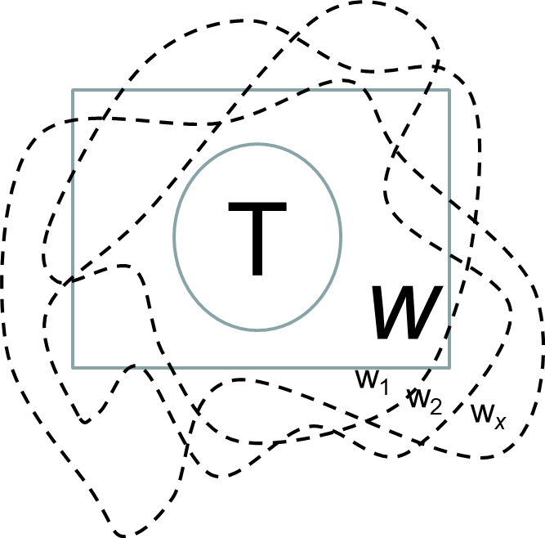
Reimaging Value(s) to bring about meaningful partnership for the goals
Stakeholder engagement: variety of purposes and values being pursued to create value
Purpose is made up of:-
  Interests and values (Ulrich, 1986)
  Ethical stance on values in purposeful action
  (T: transformation/intervention):
Boundary & value judgements are intimately linked (Ulrich, 1983)
Process of drawing boundaries constrains the ethical stance taken and values pursued (Midgely, 2010)
“WHY” does T matter (need to exist)?
“WHAT” W gives meaning to this “WHY”?
“WHO” is involved & affected by T?
“HOW” to bring about a meaningful engagement between and with the “WHO” in accord with W?
Notes:
Opportunity to combine some of the emphases of systems-based approaches to:
Accelerate progress towards attaining the SDGs including net-zero
… the “ultimate” wicked problem
To build partnerships towards the goals
… meaningful engagement between & with business and communities
Help business find their sense of purpose
… Embodying purpose by untangling Value(s)
… Bringing about a wider impact by connecting & aligning individual & shared Weltanschauung
“WHY” does the organisation exist?
“WHAT” gives meaning to this “WHY”?
North *
How VALUE is and ought to be created (T) in the context of W?
“WHY” does T matter?
“WHAT” W gives meaning to T?
“WHO” is involved in co-creating T & affected by the change?
“WHO” is
“WHY” does the organisation exist?
“WHAT” gives meaning to this “WHY”?

Slide 13
Implications for Systems/COR: Value(s) in partnership working for the goals
Accelerate progress towards attaining the SDGs including net-zero
Help business find their sense of purpose
To build partnerships towards the goals
… Embodying purpose by untangling Value(s) in purposeful action
… Bringing about a wider impact by connecting & aligning individual & shared Weltanschauung
(from ego to eco system)
… the “ultimate” wicked problem
… Deciding who is involved in co-creation & those affected (wider impact)
… Providing evaluation services to measure & track impact
Bringing about a ‘meaningful engagement’
with and between business and communities to
co-create purposeful action
Notes:
Implications for Systems/COR: Value(s) in partnership working for the goals
Thus, "systemic intervention is purposeful action by an agent to create change in relation to reflection on boundaries". The theory of boundary critiques illustrates the vital relationship between boundary and value judgement created by agents.^{[2]} This value judgement derived from the boundary, deciding on who is to be consulted and involved as well as what issues are comprised in the systemic intervention action.^{[3]} The most ethical systemic intervention groundwork practice is by expanding the boundary so that additional stakeholders beliefs and concerns would be accounted for.^{[1][4]}
The ecological divide: Disconnection between self and nature
The social divide: Disconnection between self and others
The spiritual divide: Disconnection of self from self
Help business find their sense of purpose
… Embodying purpose by untangling Value(s)
… Bringing about a wider impact by connecting & aligning individual & shared (relational, community) Weltanschauung

Slide 14
Thank you!
napier.ac.uk/tbs

