Slide 1

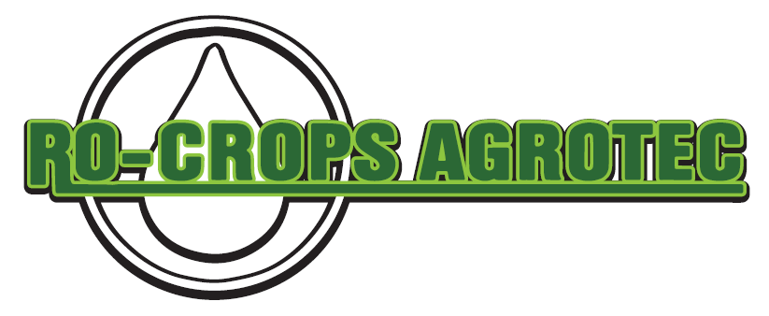
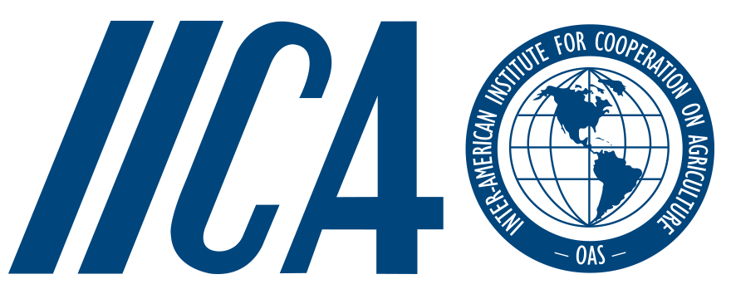

Integrated soil and water management on smallholder family-farms in building resilience to hydrometeorological hazards in Trinidad
Ramgopaul Roop¹*; Chaney C.G. St. Martin²; Miles Weaver³
Caribbean Science Symposium on Water
March 23rd – 25th, 2021

Slide 2
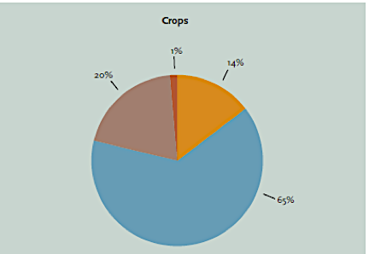
Introduction
Source: World Bank Group (2019)
Source: FAO (2018)
Notes:
77% - Hydrometeorological hazards

Slide 3
Caribbean Region: Comparative Production losses from Disasters as Percentage of Potential Production
Source: FAO, 2018

Slide 4
Agricultural Drought: “dry days”
Annual rainfall totals increase: 1960’s - 80’s, subsequent decrease onward to the 1990’s (TTMS 2021).
Decline in sugar production: El Nino of 1997/98 and associated drought conditions (TTMS 2021)
Projections:
  the average annual maximum number of consecutive dry days will increase for the higher emissions
  Drier mid-year, wetter end of year
Source: World Bank Group (2019)

Slide 5
Background: climate risk translated to on-farm challenges
Source: TTMO 2021
Climate risks>>>On-farm availability of water & heat stress: higher variations in moisture

Slide 6
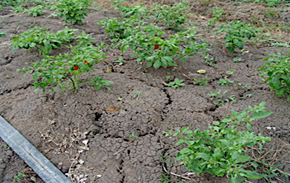
Water, soil and crop production challenges
Persad et al. (2007)

Slide 7
Research Question / Issue
Can the negative impact of climate variability on water availability be mitigated by integrated water and soil management practices?

Slide 8
(Persad and Wilson, 1998; Persad and Roop, 1998)
Methodology
Retrospective analysis using a deviant purposive case sampling method (Kuzell 1999): a small-holder (3-acre) farm development (Ro-CropsAgrotec).
  Identify key-turning points in the farm's development: 1994-1997 & Post 1997
  1994-1997:
    A review of published papers on-field trials Research Division, MOA:
      Persad and Wilson (1998)
      Persad and Roop (1998)
  Post 1997: Farmer’s account of Agroecological practices

Slide 9
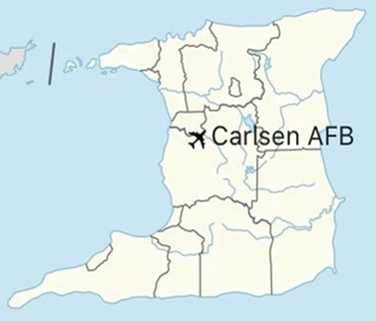
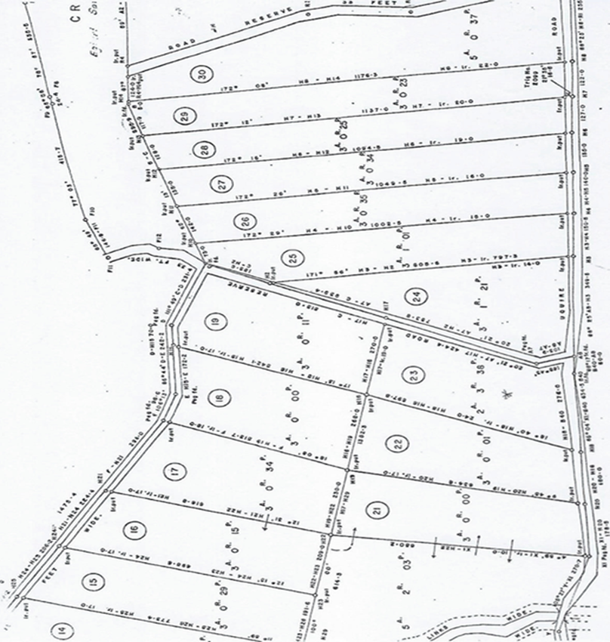
Study Area and Farm Profile
Location: Plot #23 Uquire Road, Carlsen Field, Caroni, Trinidad Former World War II (WWII) United States Army Air Forces (USAAF) airbase
The farm is one of 30 three acres plots in a 100-acre block

Slide 10
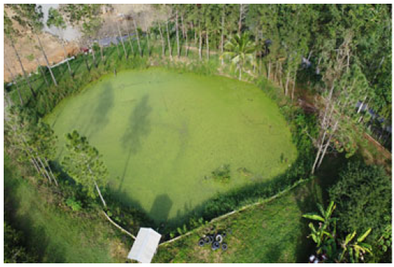
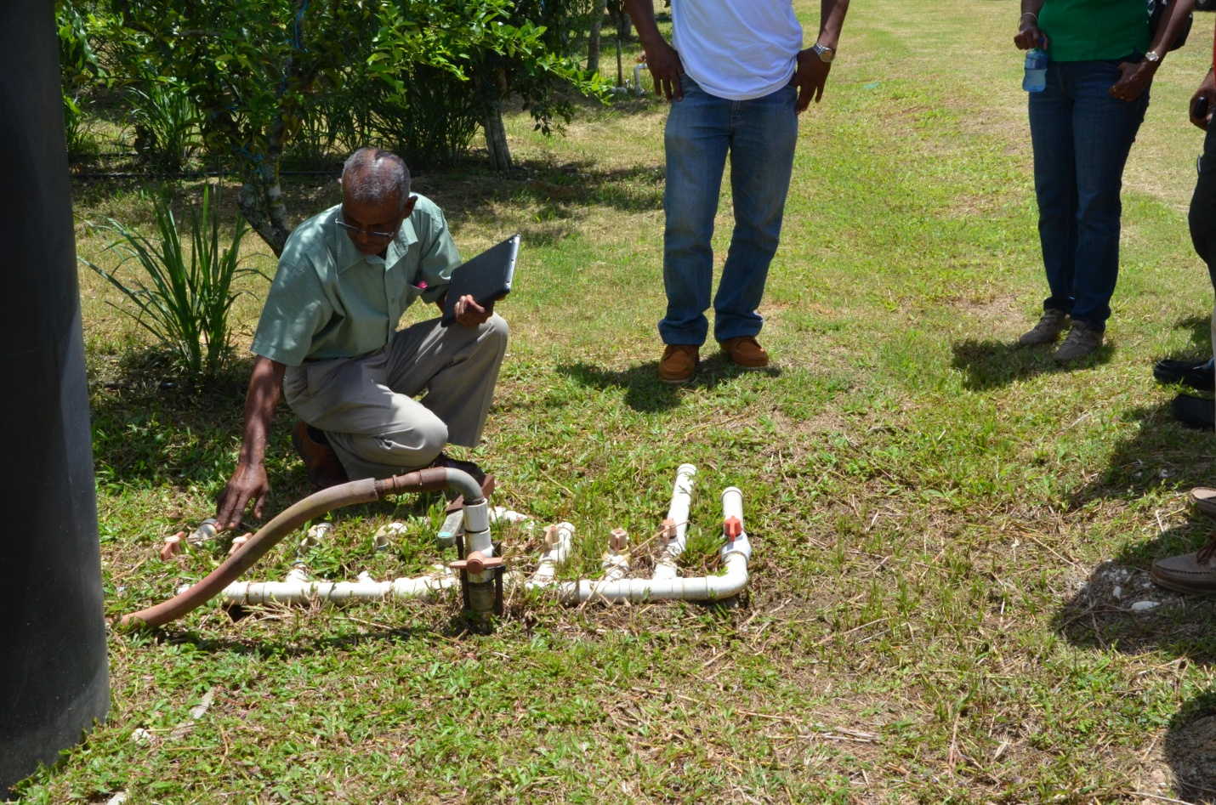
Interventions to address:
Water Challenges:
Construction of a by-pass farm pond (10,000 m³ of water)
Recycle field water into the irrigation pond
Installation of micro-low-pressure irrigation system: Layflat tubing vs. drip tapes with emitters
Soil Challenges:
Soil ploughing, chiseling & amelioration
Application of low-cost quarry overburden limestone from the Northern Range (Persad 1992)
Agronomic practices
Implemented Agroecology Systems: cropping patterns
Irrigation pond
Distribution system

Slide 11
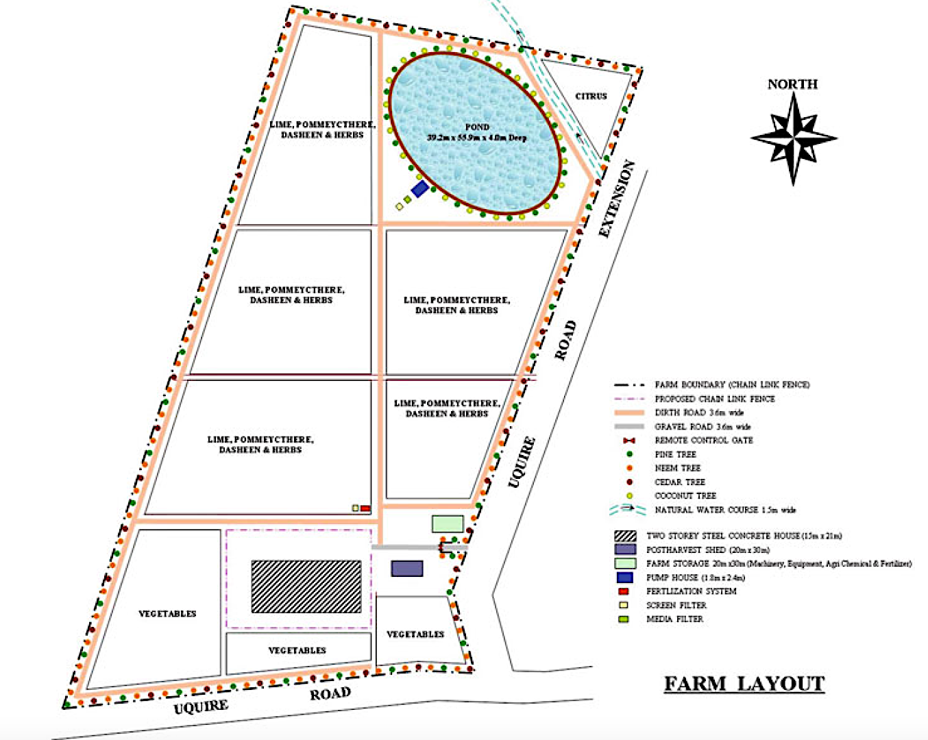
Intervention: Farm design & Layout
Subdivision of the plot into (8) irrigation blocks (7 for cultivation), with the farm pond as block 5 & internal access roads.

Slide 12
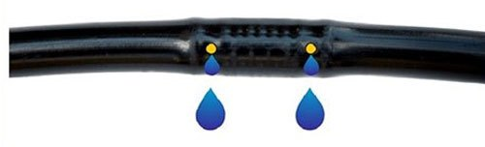
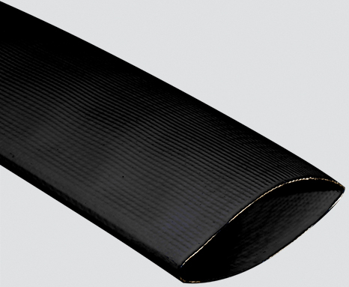
Results & Discussion: Water
Water capture, availability (10, 000 m³) & conservation:
  Increase surface area (drains) to capture and channel water
  lower risk of crop failure in dry season,
  Increase water conservation: soil cover
Water planning, management & distribution:
  Water auditing, timers, & control per block.
  Layflat tubing more effective: drip tape- clogged emitters reduced discharge rate (45%) and application uniformity (16%).
Overall impact:
  Increase water capture and use-efficiency: less run-off and erosion
  Salinity levels of water and soils remained low (26yrs)
.
Inline Drip Tape (emitter)
Layflat tubing

Slide 13
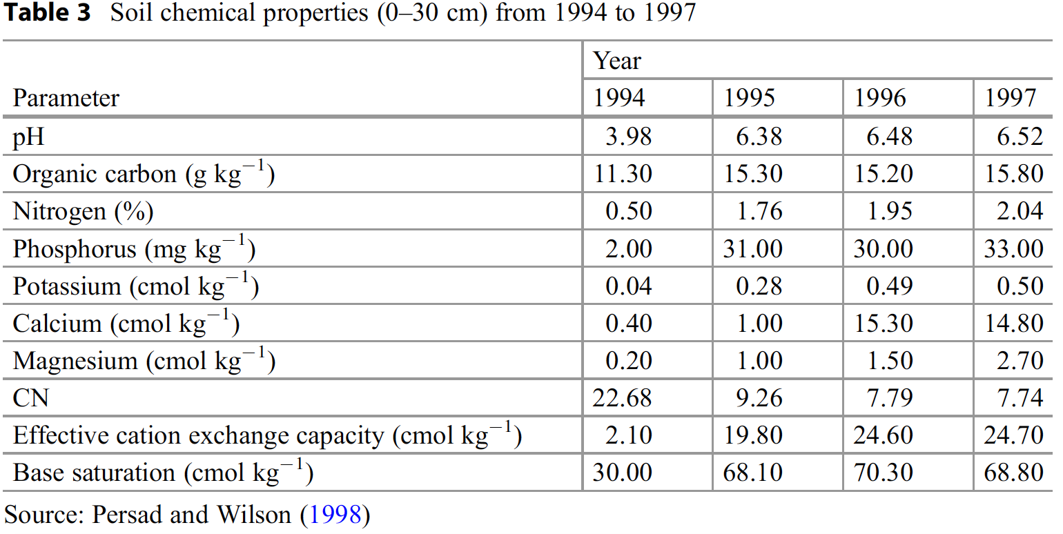
Results & Discussion: Soil
Table 1 Soil chemical properties (0-30cm) from 1994 to 1997)

Slide 14
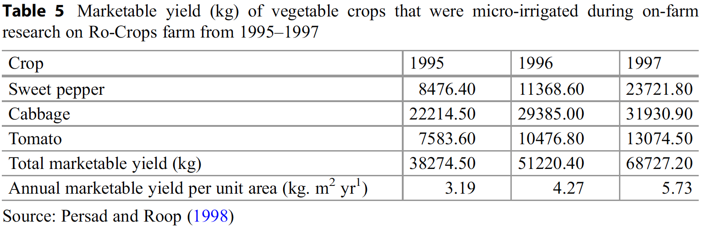
Results & Discussion: Yields
Table 2. Marketable yield (kg) of vegetable crops that were micro-irrigated during on-farm research on R0-Crops farm from 1995-1997
% Increase
180%
40%
70%

Slide 15
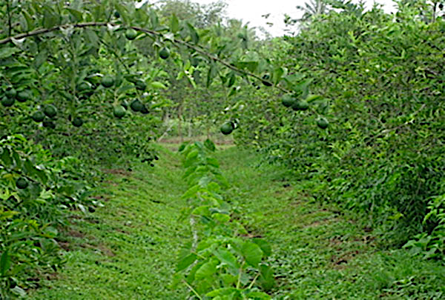
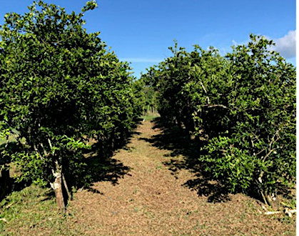
Agronomic practices: cropping patterns
Lime and Lime with dasheen

Slide 16
Conclusions
Farmers' integrated water and soil management practices can mitigate the negative impacts of climate variability and water availability on crop production.
Developing climate resilient farms by addressing water and soil challenges is not only a technical challenge but a long-term social process to preserve the traditional knowledge of farmers.
3. Implementing the measures requires a business acumen, lean management, and access to finance/resources.

Slide 17
Recommendations
Greater and more timely collaboration is needed among research-developmental type organization and farmers/other agricultural stakeholders to address the issues of water and soil challenges.
Embark on techniques to enhance the level of training provided to farmers.
Government must treat the SDG 2 as a national issue “to end hunger, achieve food security and improved nutrition and promote sustainable agriculture.”

Slide 18
Acknowledgements
Acknowledge the contribution of Soil Scientist Seunarine Persad and Research Team from the Soil and Land Capability Section, Research Division, Centeno.
Ministry of Agriculture, Land and Marine Resources.

Slide 19
References
Persad S, Roop R (1998) An evaluation of a micro-irrigation for vegetable production on heavy clay soils in Central Trinidad. C.E.S. Research paper. Ministry of Agriculture, Centeno.
Persad S, Wilson H (1998) Soil management of heavy clay soils on a vegetable farm in Central Trinidad. Central Experiment Station, Research Division, Ministry of Agriculture, Land and Marine Resources, Centeno
Kuzel, A. J. (1999). Sampling in qualitative inquiry. In B. F. Crabtree & M. B. Miles (Eds.), Doing qualitative research (2nd ed., pp. 33– 45). Thousand Oaks, CA: Sage
Persad S (1992) Reactivity of agricultural limestone from the northern range, Trinidad. Central Experiment Station (C.E.S.) Research Paper, Ministry of Agriculture, Centeno, Trinidad
FAO (2018) 2017: The Impact of Disasters and Crises on Agriculture and food Security. http://www.fao.org/emergencies/resources/documents/resources-detail/en/c/1106859/FAO (2015) Planning Communication for Agricultural Disaster Risk Management
Persad S (1996) Root-soil restrictions to crop production on selected clay soils of Central Trinidad. CES Research Paper. Ministry of Agriculture, Centeno
Persad S, Rampersad I, Wilson H (2007) Soil and water constraints to food crop production in Trinidad and Tobago – challenges and opportunities for small farms. In: Soil and land capability unit. Research Division, Ministry of Agriculture, Land and Marine Resources, Centeno
World Bank Group- Climate Change Knowledge Portal for Development Practitioners and Policy Makers https://climateknowledgeportal.worldbank.org/country/trinidad-and-tobago/impacts-agriculture

