Slide 1
The Bloody Big Project
DESIGN THINKING FOR SOCIAL CHANGE
Fast
Cheap
Crude
Disruptive
Impactful
Fun
Ruth Cochrane
Edinburgh Napier University
Notes:
Add a license-free picture (like from www.unsplash.com) in the background representative of the the theme of the lesson and make it 50% transparent.

Slide 2
SIMPLE DESIGN PROCESS
Research: Creative, user centred, visual methodology
Concept: Visual Ideation
Iterate: Fail & Fix
Communicate: Mixed media
Reflect: Evaluating Impact
Created by:
Ruth Cochrane & Richard Firth
Edinburgh Napier University
Product Design
Notes:
Please add the relevant information about your lesson. Don’t forget to add “Related Resources” links to help tutors and students learn more about the themes covered in this lesson.

Slide 3
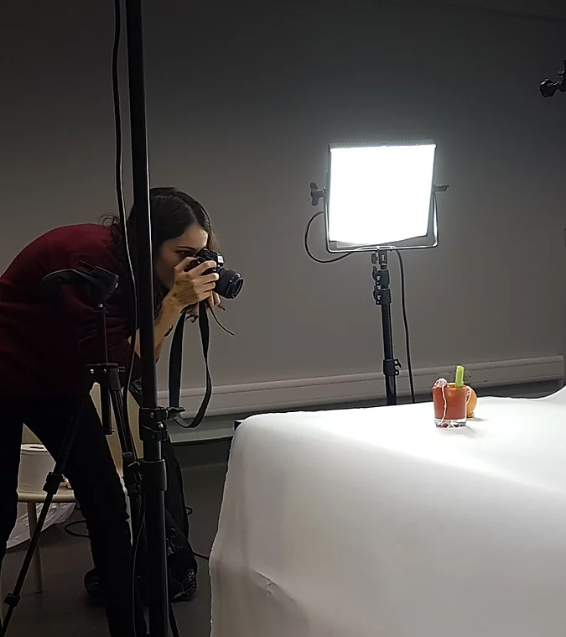
Research:
Visual Experimentation
Highlighted surprising responses in different demographics “shhhh….”
Created discourse in itself
Notes:
Please add the relevant information about your lesson. Don’t forget to add “Related Resources” links to help tutors and students learn more about the themes covered in this lesson.

Slide 4
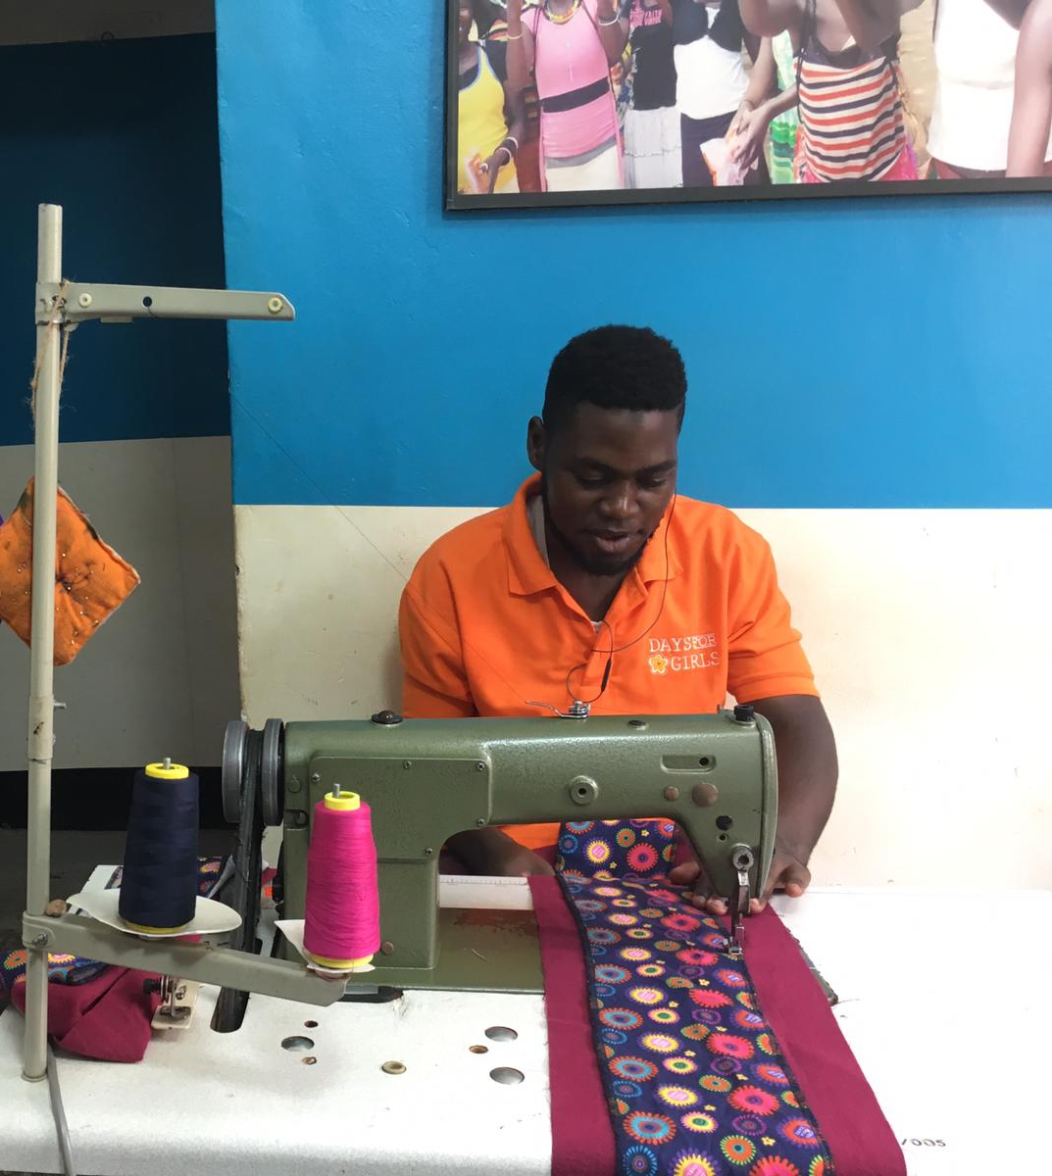
Research:
Uganda
Where resources are limited, progress is being made
Notes:
Please add the relevant information about your lesson. Don’t forget to add “Related Resources” links to help tutors and students learn more about the themes covered in this lesson.

Slide 5
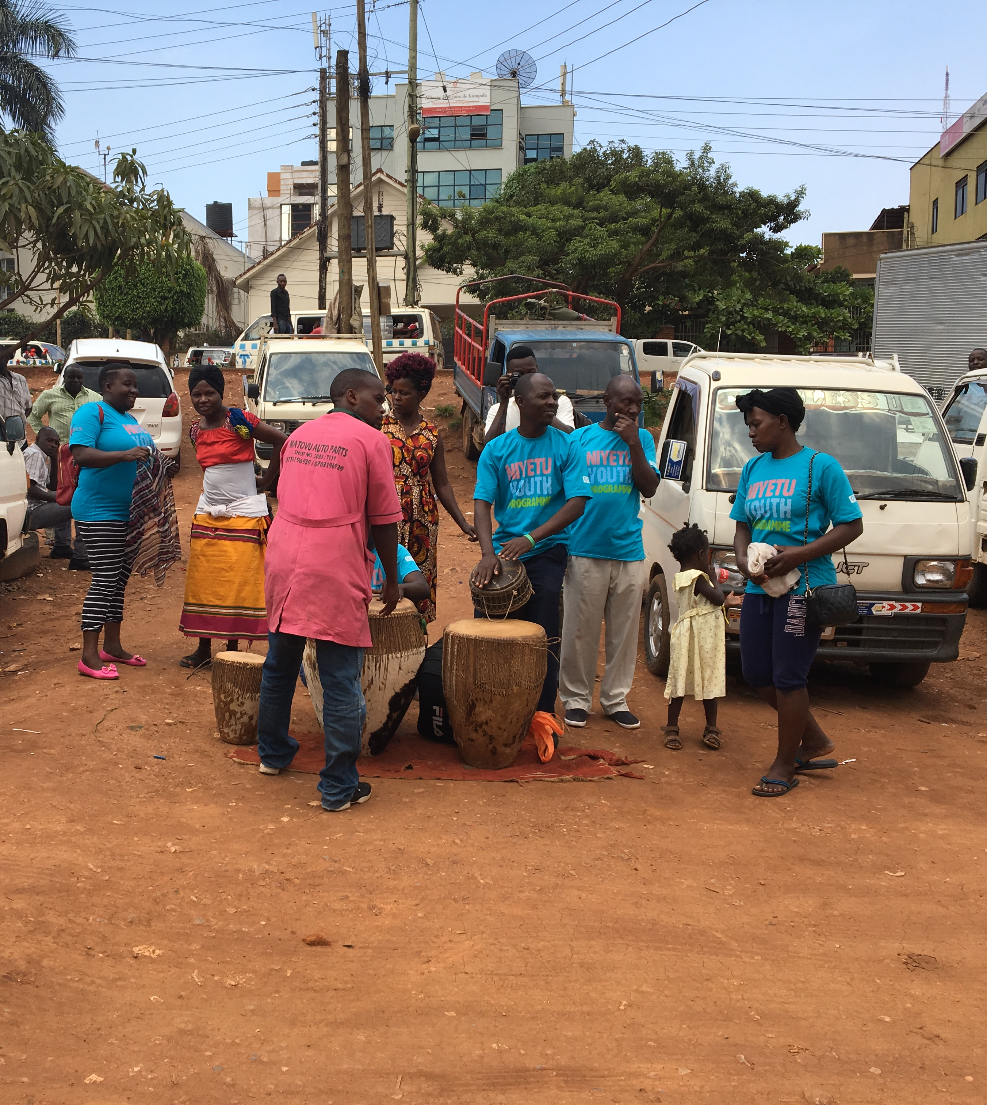
Research:
Uganda
Where resources are limited, progress is being made
Stories and communities can have a huge impact
Notes:
Please add the relevant information about your lesson. Don’t forget to add “Related Resources” links to help tutors and students learn more about the themes covered in this lesson.

Slide 6
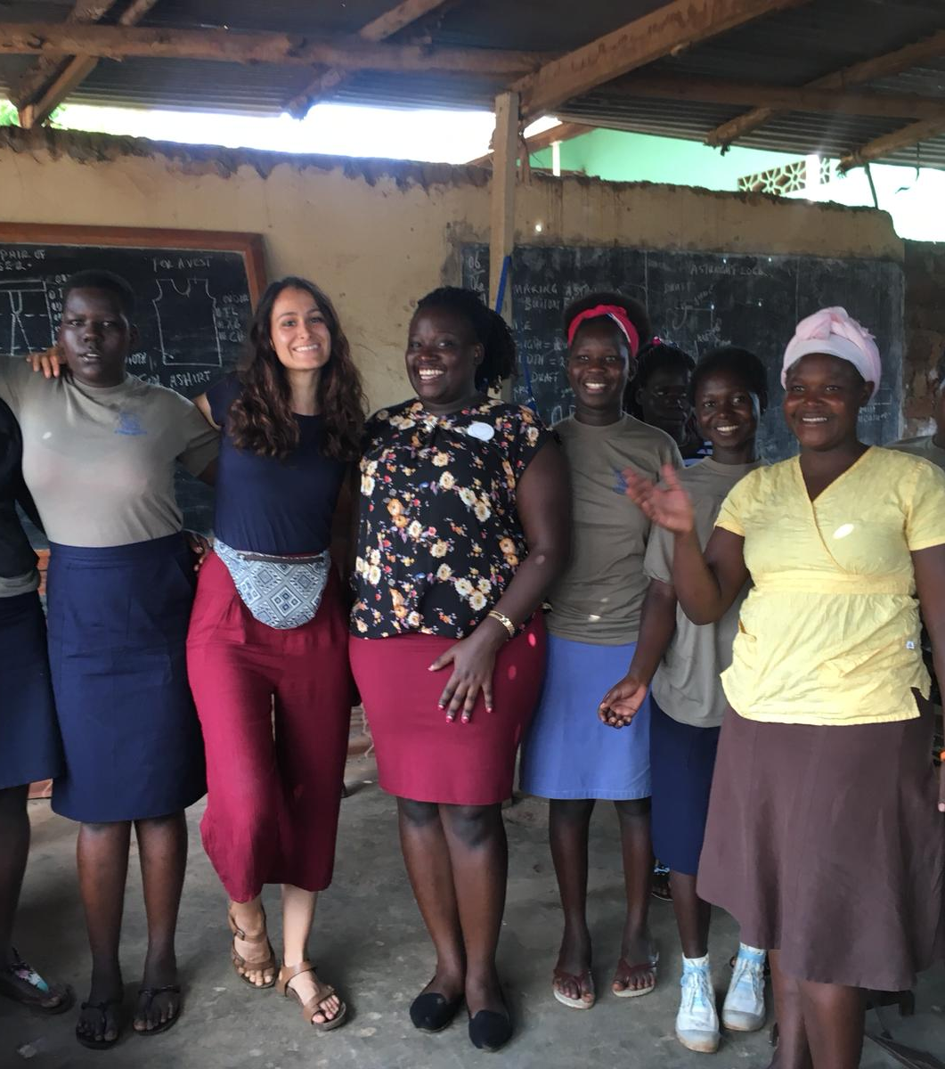
Research:
Uganda
Where resources are limited, progress is being made
Stories and communities can have a huge impact
Empowerment of women is exponentially effective
Notes:
Please add the relevant information about your lesson. Don’t forget to add “Related Resources” links to help tutors and students learn more about the themes covered in this lesson.

Slide 7
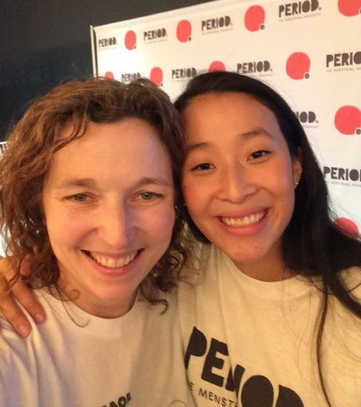
Research:
US academia and activism
Money isn’t the whole answer
Tampon Tax is a partisan issue
Notes:
Please add the relevant information about your lesson. Don’t forget to add “Related Resources” links to help tutors and students learn more about the themes covered in this lesson.

Slide 8
Research:
US academia and activism
Money isn’t the whole answer
Tampon Tax is a partisan issue
Stories change minds
Notes:
Please add the relevant information about your lesson. Don’t forget to add “Related Resources” links to help tutors and students learn more about the themes covered in this lesson.

Slide 9
Research:
US academia and activism
Money isn’t the whole answer
Tampon Tax is a partisan issue
Stories change minds
No sanitary bins at Columbia
We don’t know what works and what doesn’t because research isn’t funded
Notes:
Please add the relevant information about your lesson. Don’t forget to add “Related Resources” links to help tutors and students learn more about the themes covered in this lesson.

Slide 10
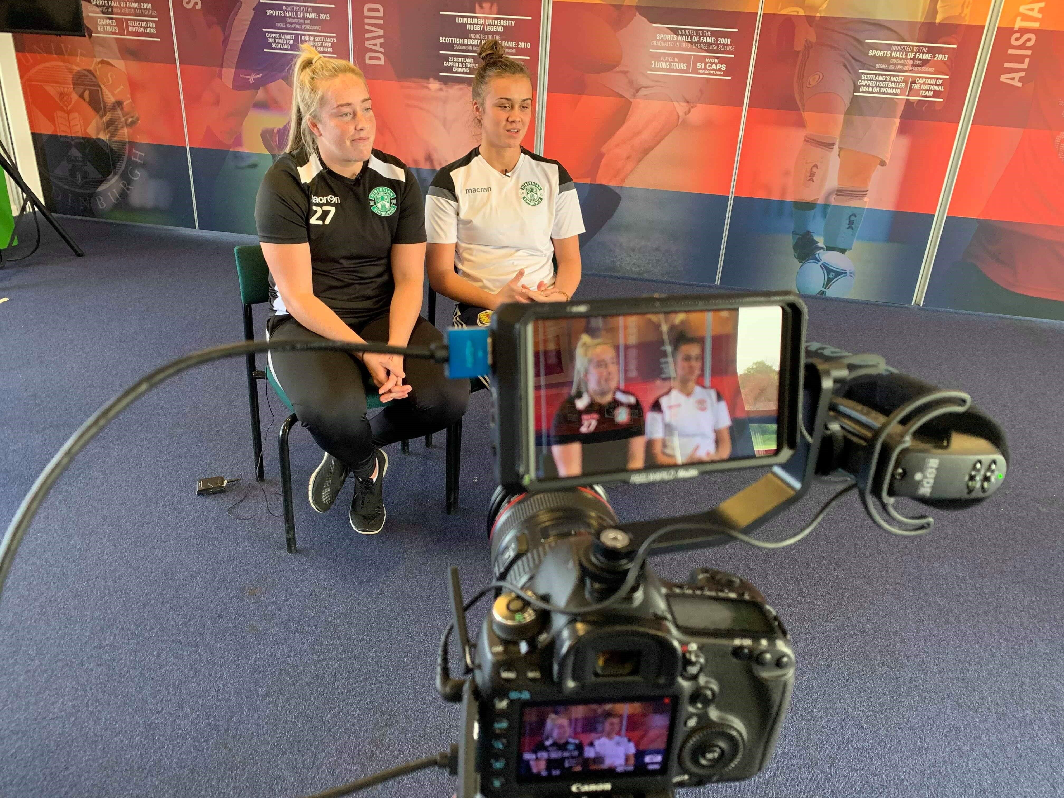
Research:
Women in Sport
Women in environments designed for men are further disadvantaged by menstruation
No toilets near pitches
White football shorts
Performance research not accounting for menstrual cycle
Notes:
Please add the relevant information about your lesson. Don’t forget to add “Related Resources” links to help tutors and students learn more about the themes covered in this lesson.

Slide 11
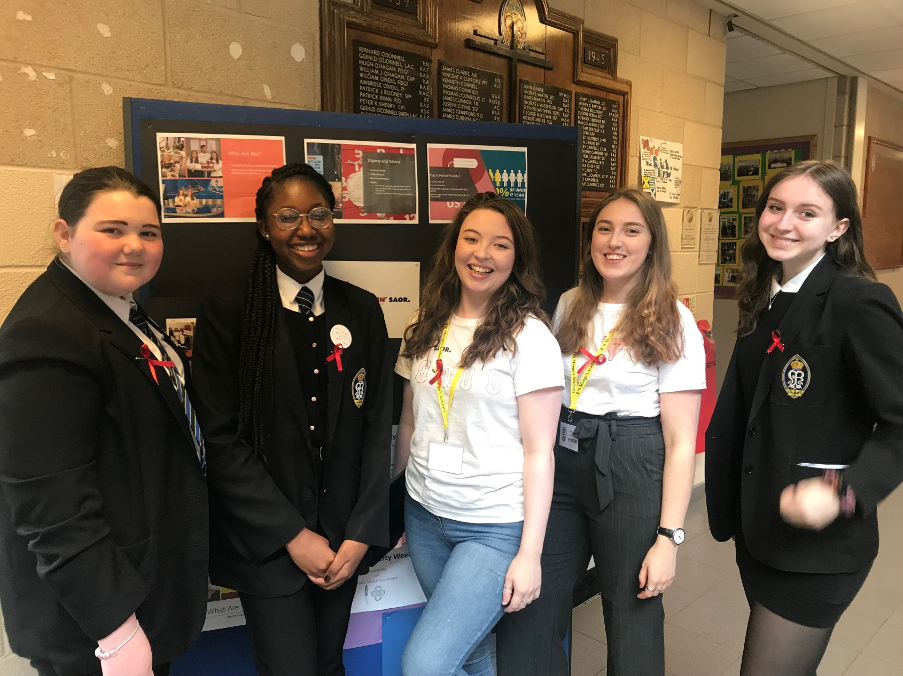
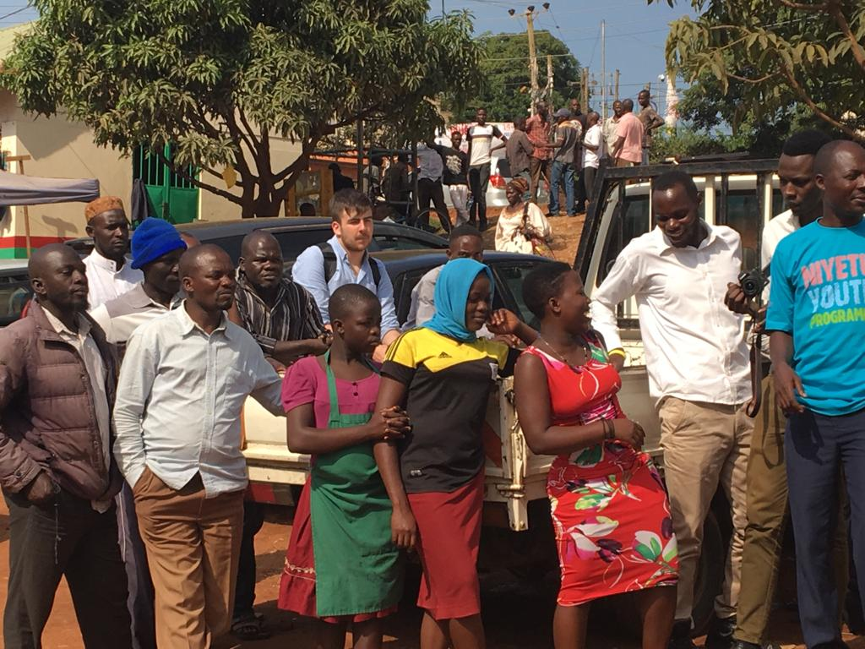
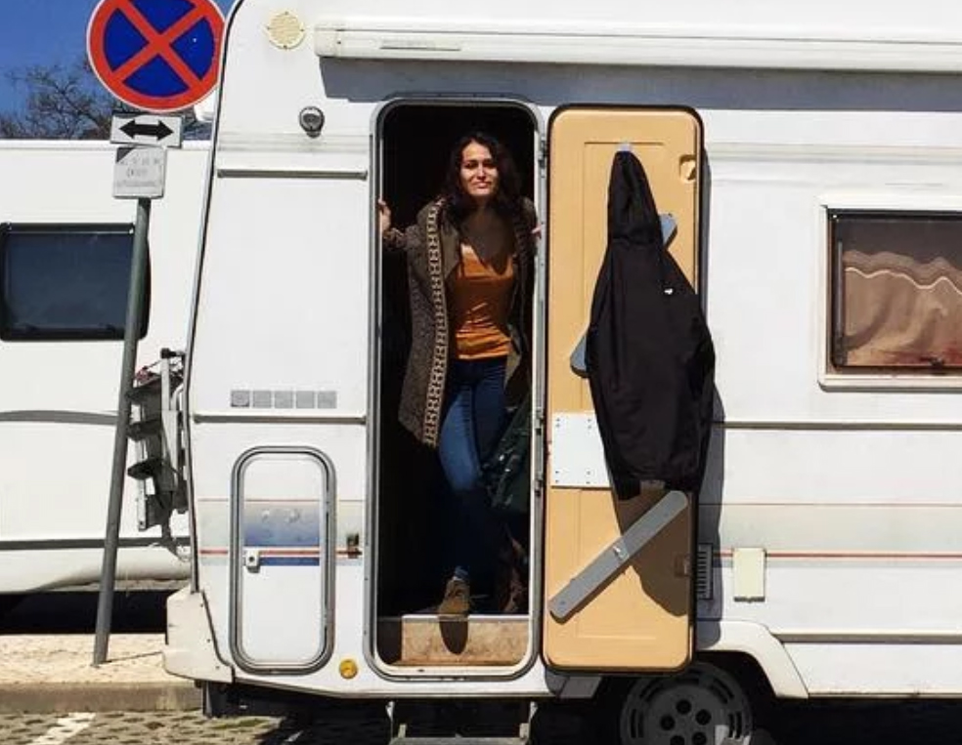
Research: Conclusions
Lack of products does lead to limited opportunities (Products)
The silence around menstruation causes a multitude of problems (Awareness)
Medical
Financial
Social
Educational
Where poverty and menstruation intersect, effects are amplified, but stories and communities can affect change (Stories)
Notes:
Please add the relevant information about your lesson. Don’t forget to add “Related Resources” links to help tutors and students learn more about the themes covered in this lesson.

Slide 12
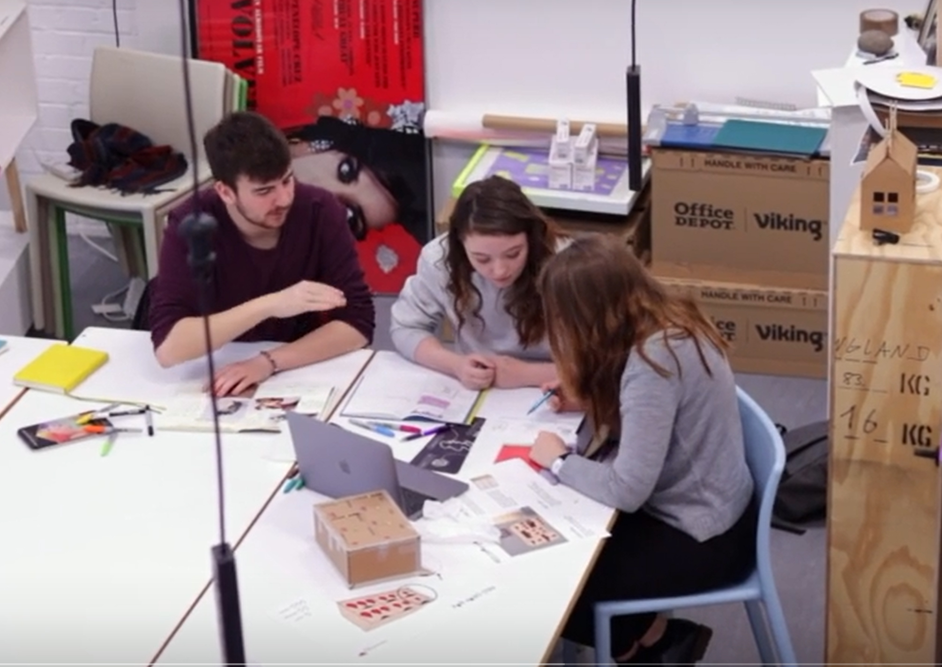
Concept
Sketchbookery – responding to research with a range of visual ideation techniques
Quantity over quality
Notes:
Please add the relevant information about your lesson. Don’t forget to add “Related Resources” links to help tutors and students learn more about the themes covered in this lesson.

Slide 13
Concept – Ideas selected
Products – Hey Girls & Napier Dispensers
Stories – Period Blether
Awareness – Bloody Big Brunch
Notes:
Please add the relevant information about your lesson. Don’t forget to add “Related Resources” links to help tutors and students learn more about the themes covered in this lesson.

Slide 14
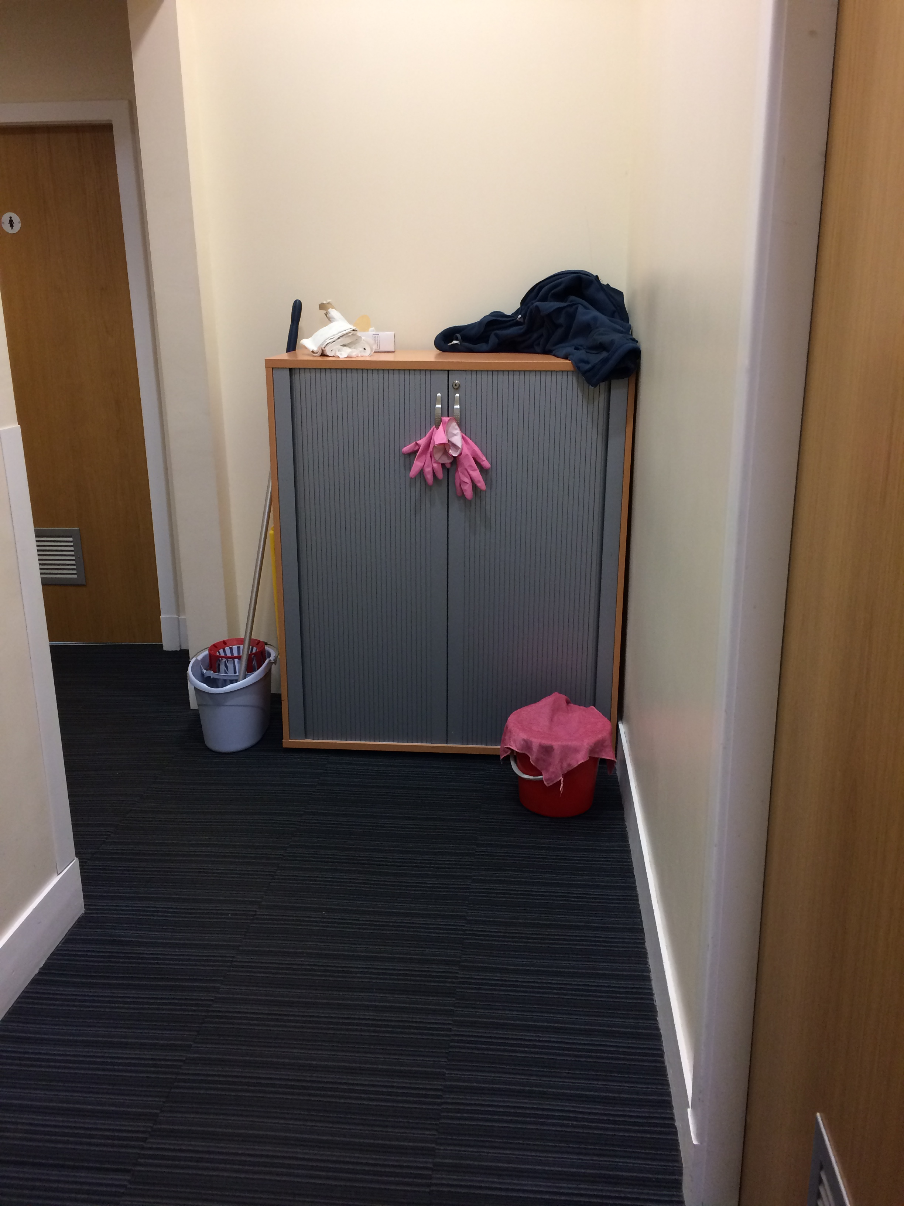
Iterate – Fail & Fix (Product)
Hey Girls & Napier Dispensers
Iterative design process – from closets....
Notes:
Please add the relevant information about your lesson. Don’t forget to add “Related Resources” links to help tutors and students learn more about the themes covered in this lesson.

Slide 15
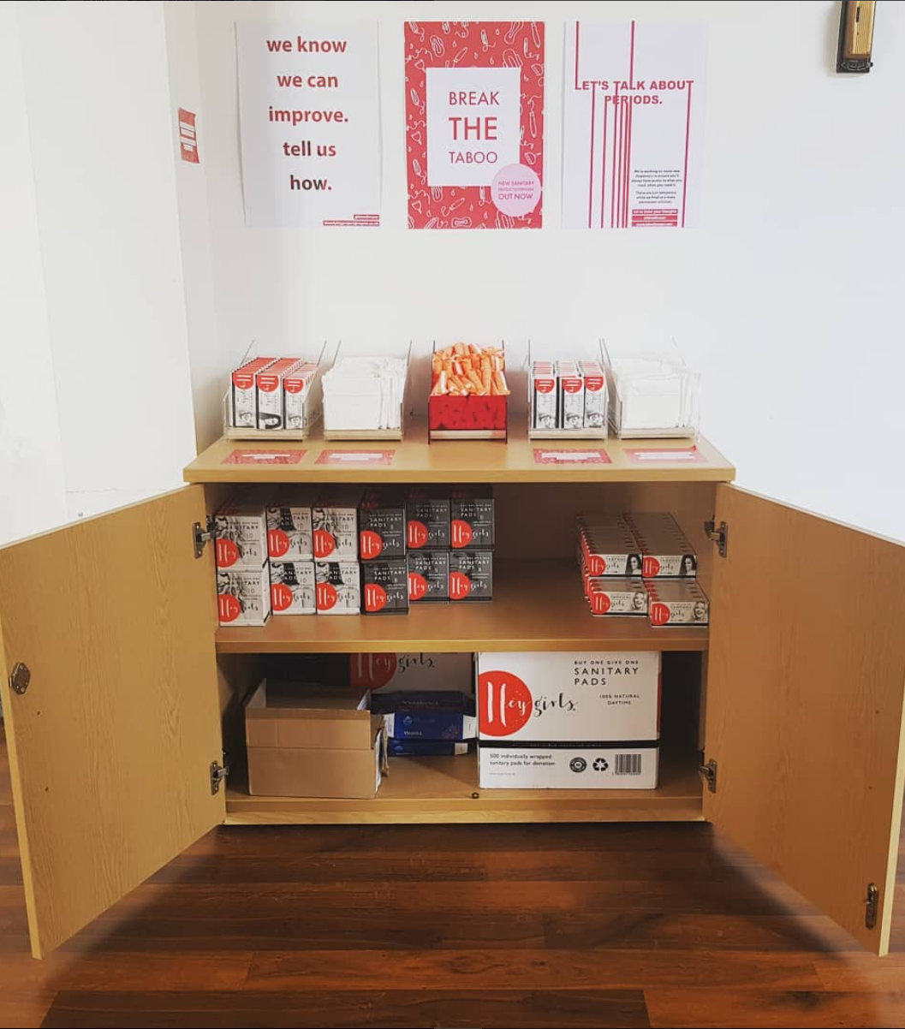
Iterate – Fail & Fix (Product)
Hey Girls & Napier Dispensers
Iterative design process – from closets....to cupboards….
Notes:
Please add the relevant information about your lesson. Don’t forget to add “Related Resources” links to help tutors and students learn more about the themes covered in this lesson.

Slide 16
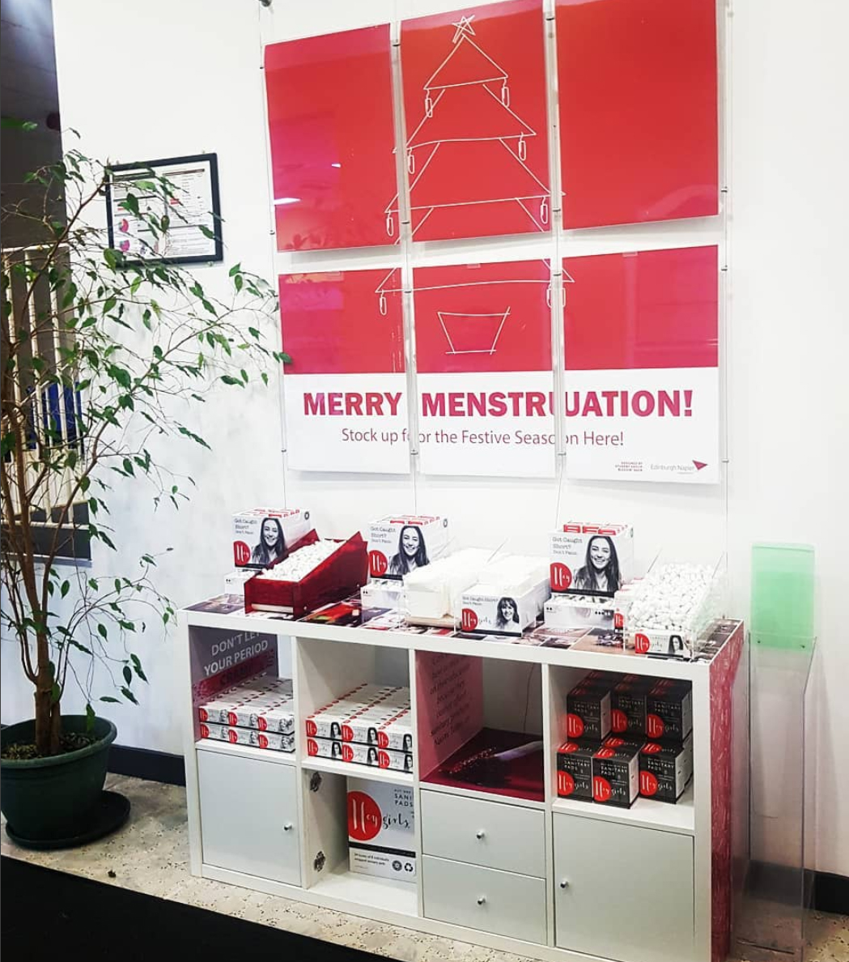
Iterate – Fail & Fix (Product)
Hey Girls & Napier Dispensers
Iterative design process – from closets....to cupboards….to celebrations
Notes:
Please add the relevant information about your lesson. Don’t forget to add “Related Resources” links to help tutors and students learn more about the themes covered in this lesson.

Slide 17
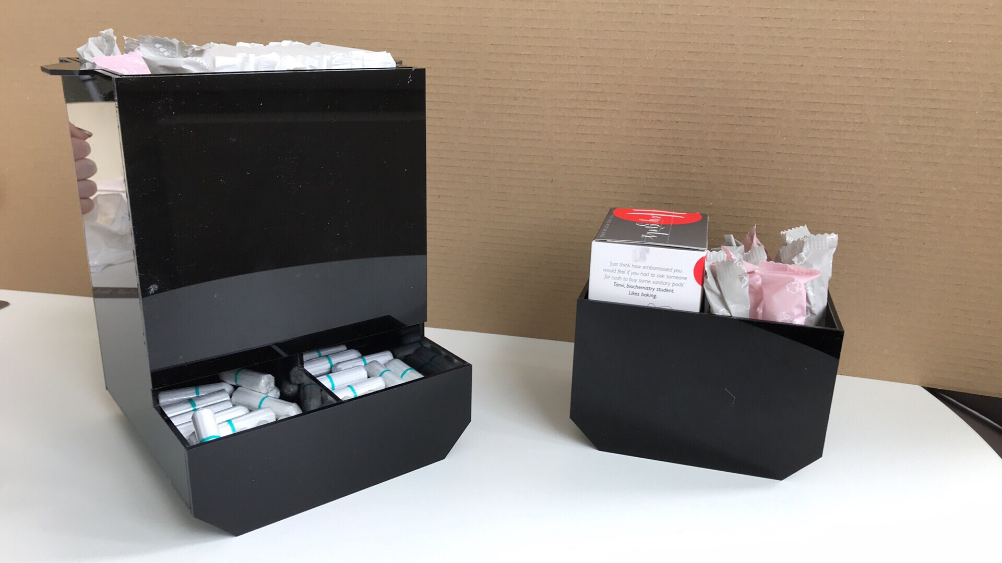
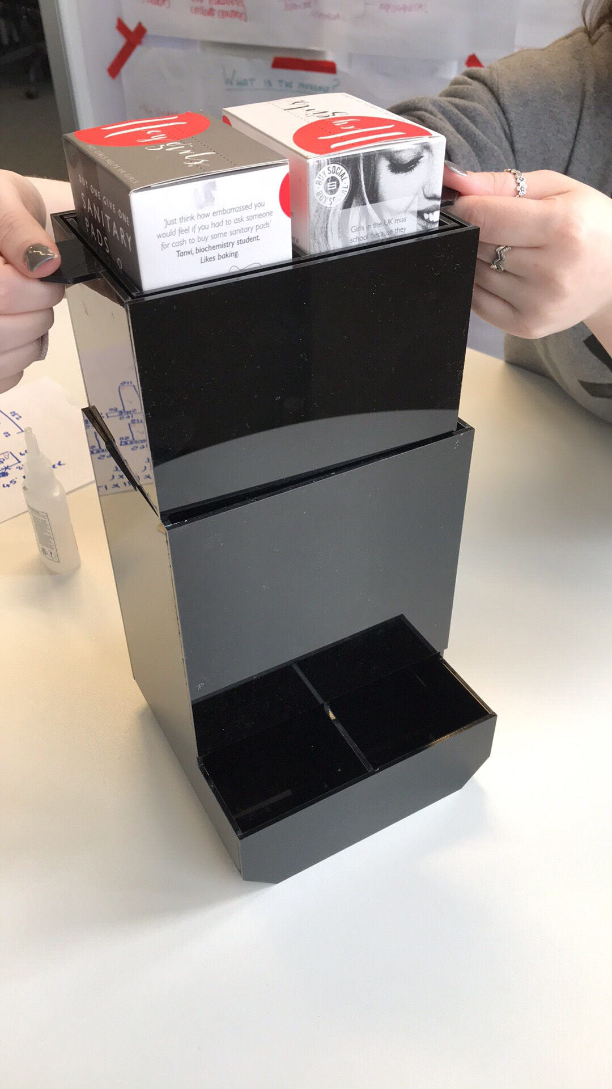
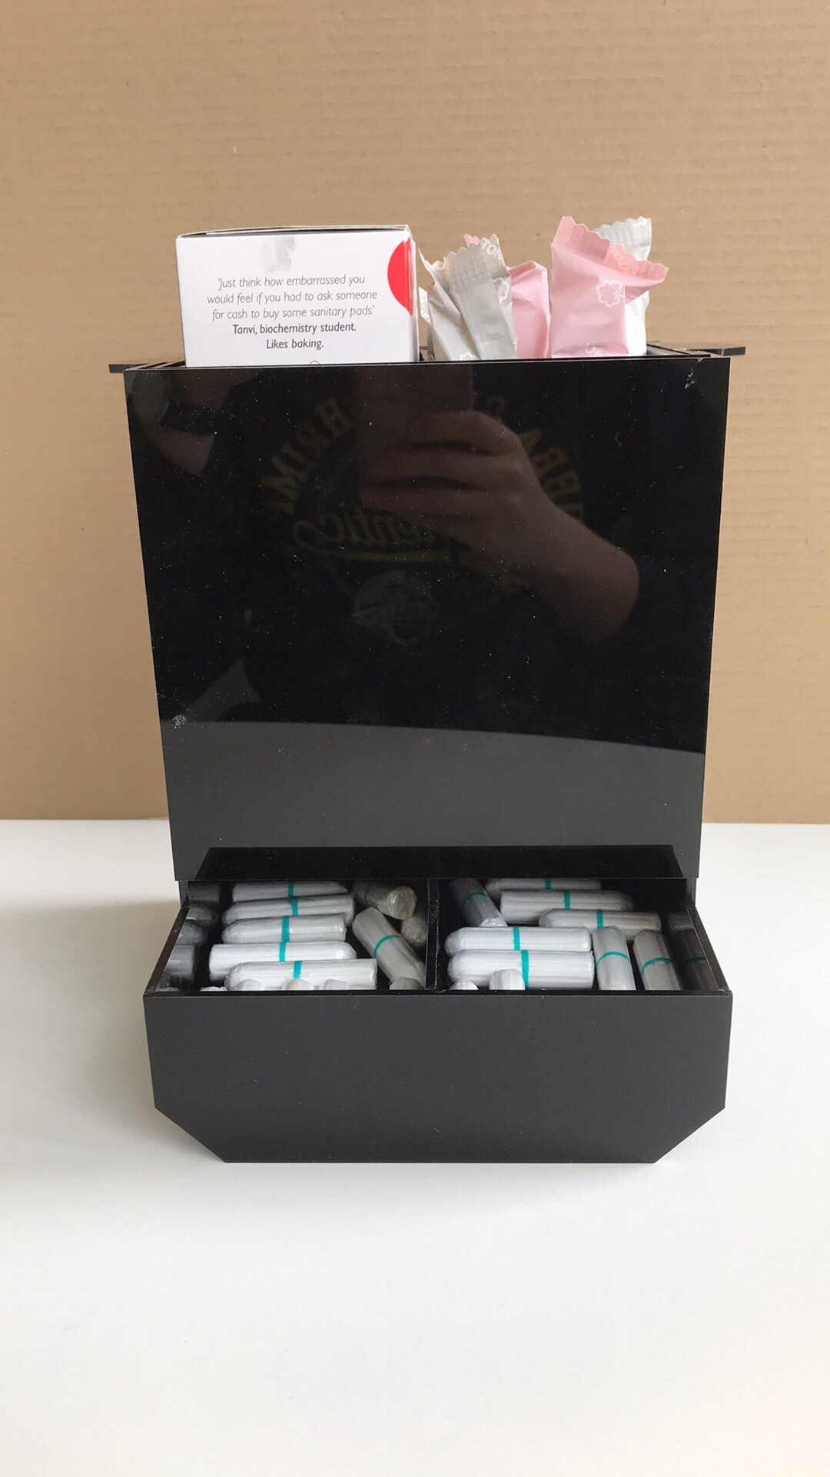
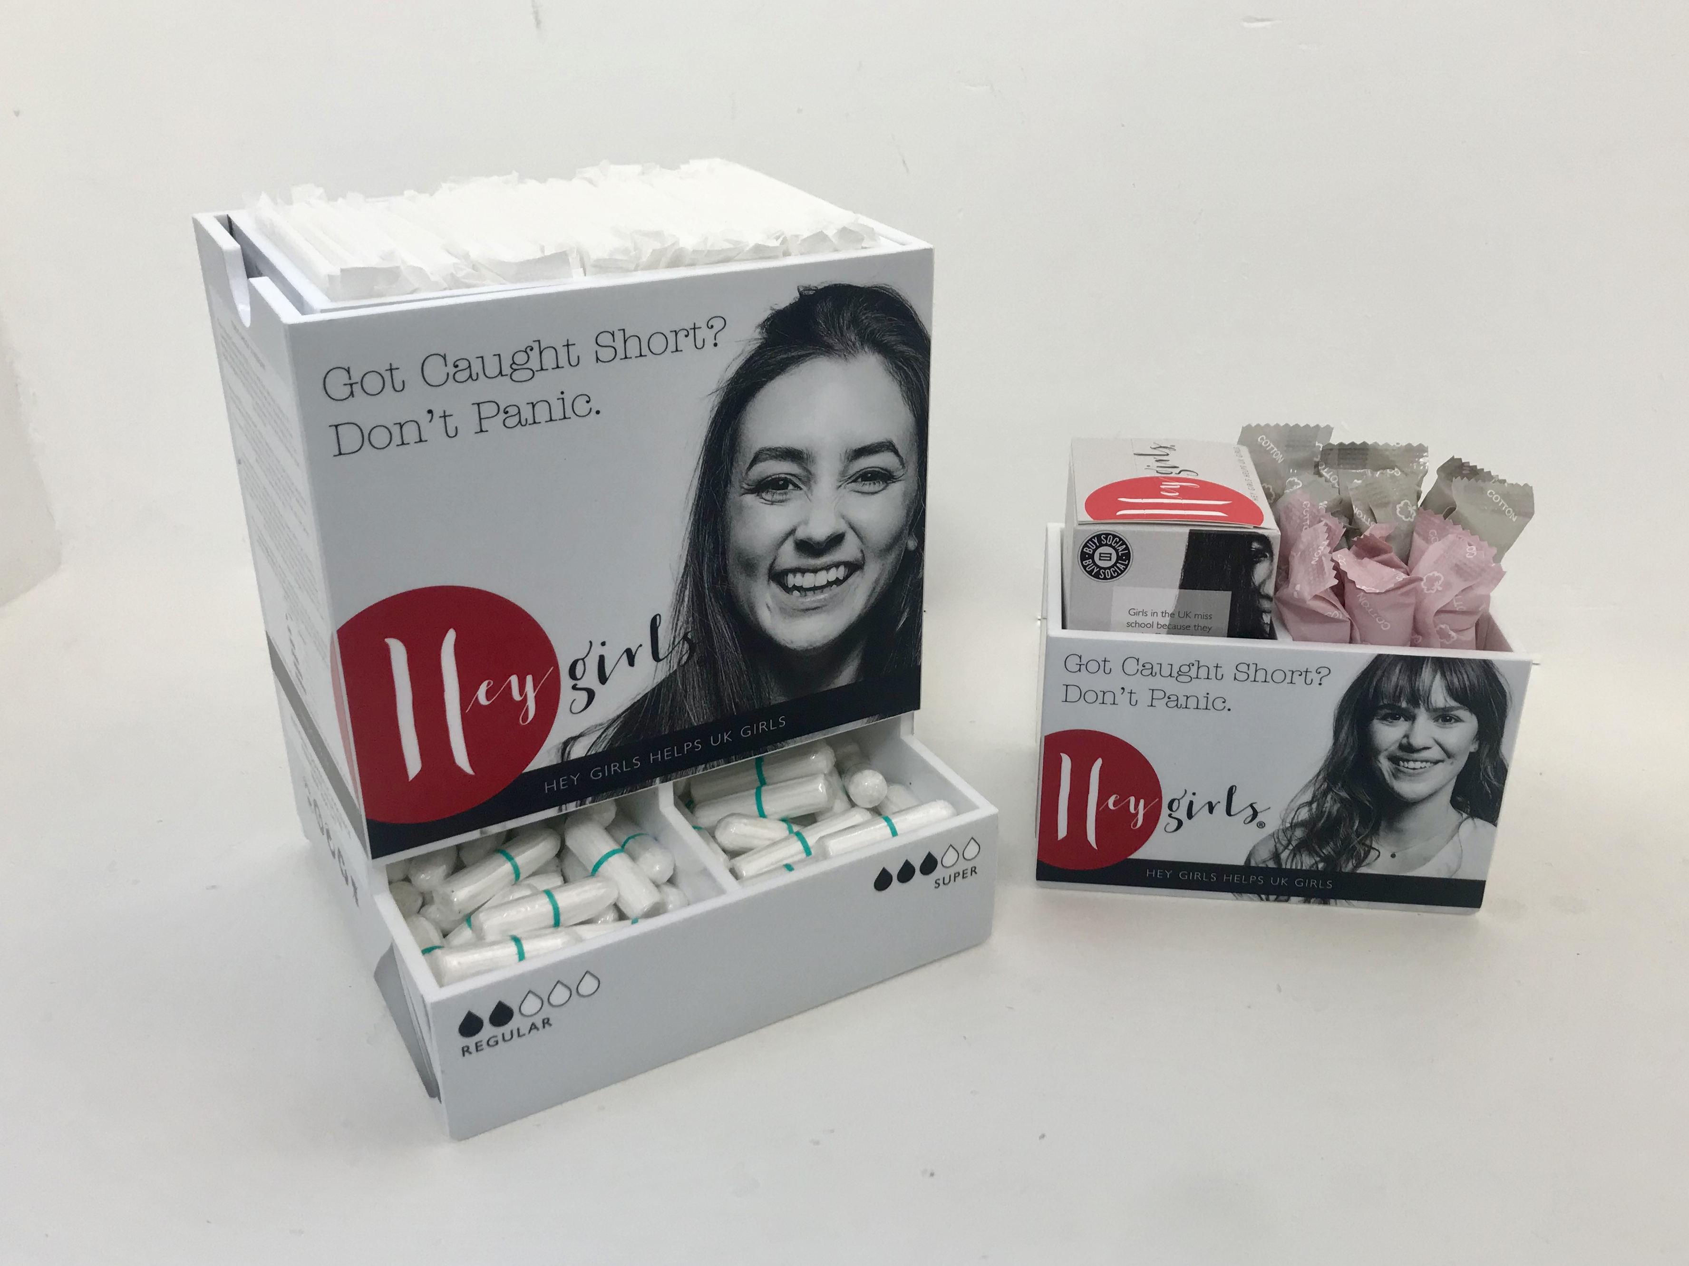
Iterate – Fail & Fix (Product)
Hey Girls & Napier Dispensers
Iterative design process – from closets....to cupboards….to celebrations
Dispenser Design
Notes:
Please add the relevant information about your lesson. Don’t forget to add “Related Resources” links to help tutors and students learn more about the themes covered in this lesson.

Slide 18
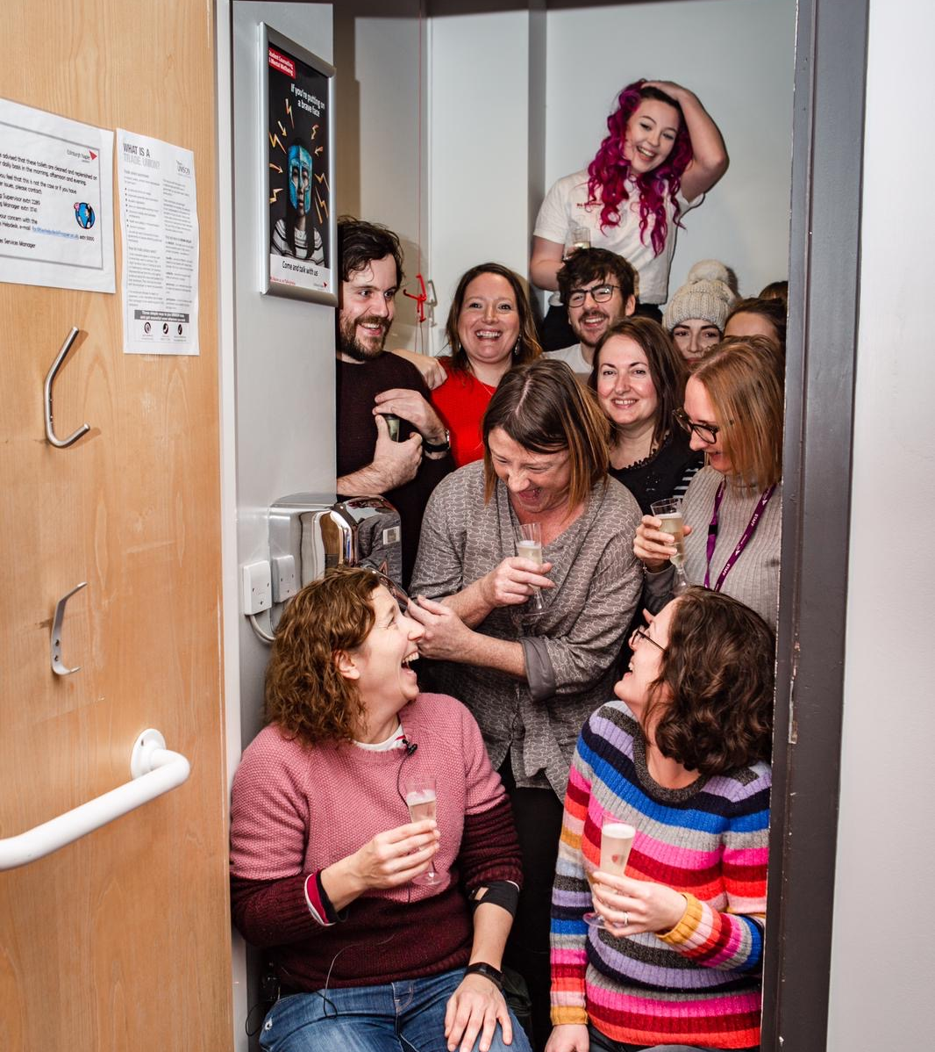
Iterate – Fail & Fix (Product)
Hey Girls & Napier Dispensers
Iterative design process – from closets....to cupboards….to celebrations
Dispenser Design
Bringing stakeholders together to have dispensers in every toilet
Notes:
Please add the relevant information about your lesson. Don’t forget to add “Related Resources” links to help tutors and students learn more about the themes covered in this lesson.

Slide 19
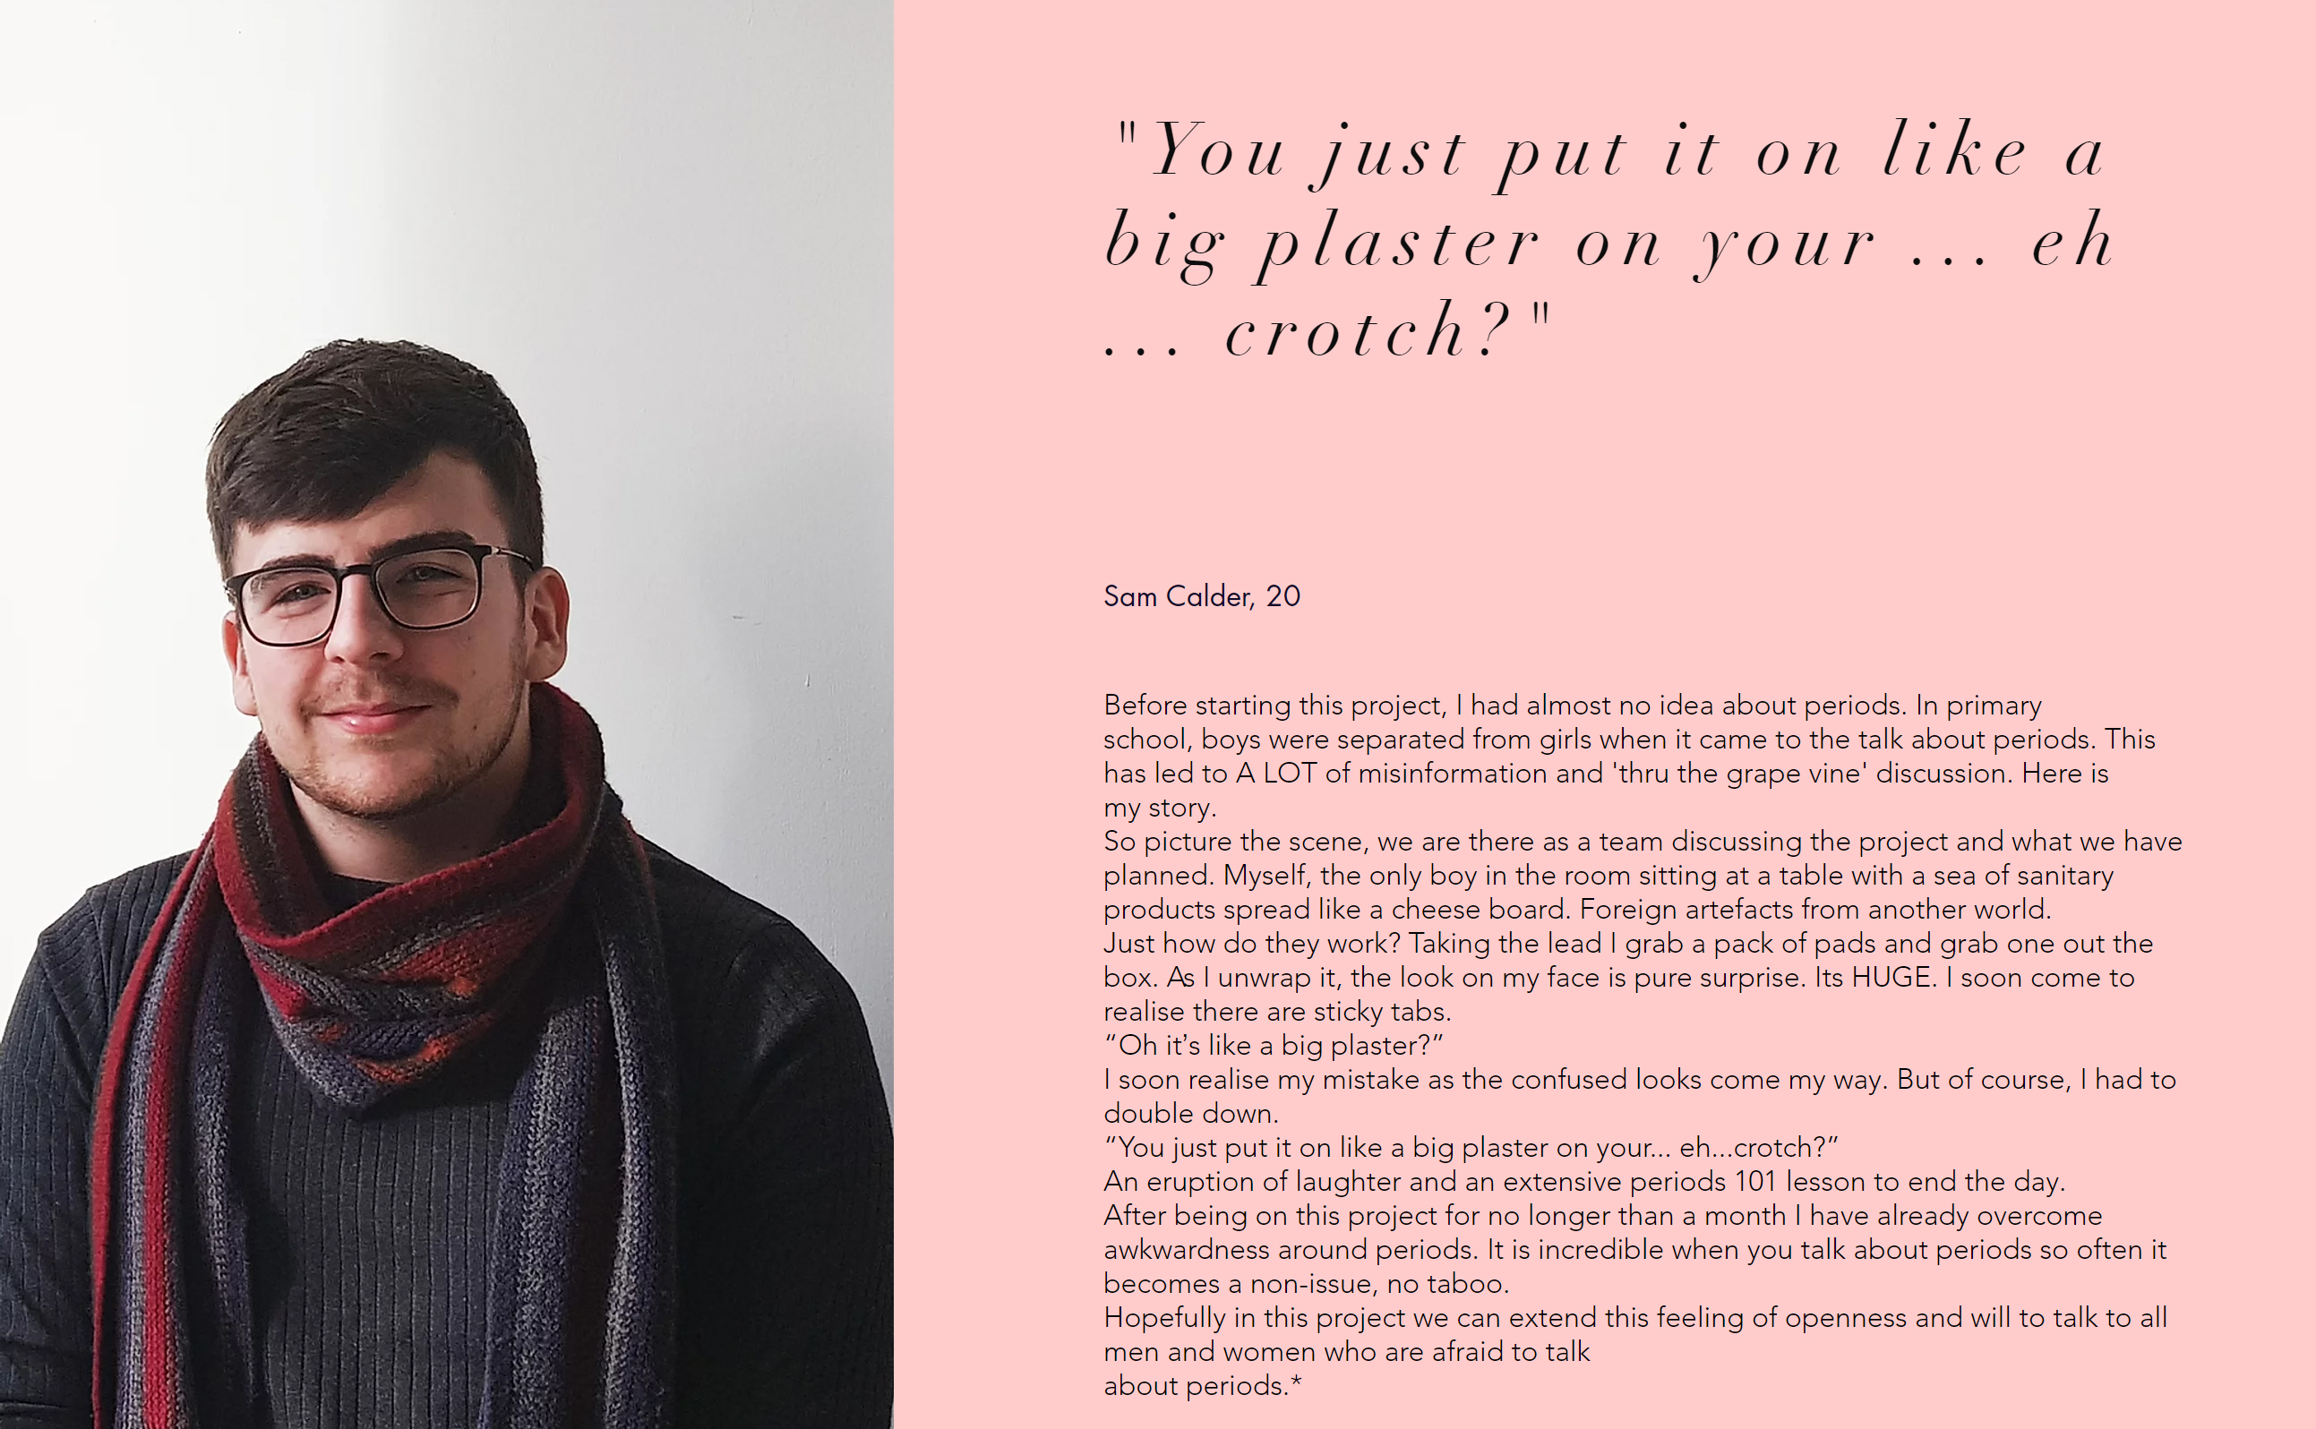
Iterate – Fail & Fix (Stories)
Period Blether
Stories empower communities
Notes:
Please add the relevant information about your lesson. Don’t forget to add “Related Resources” links to help tutors and students learn more about the themes covered in this lesson.

Slide 20
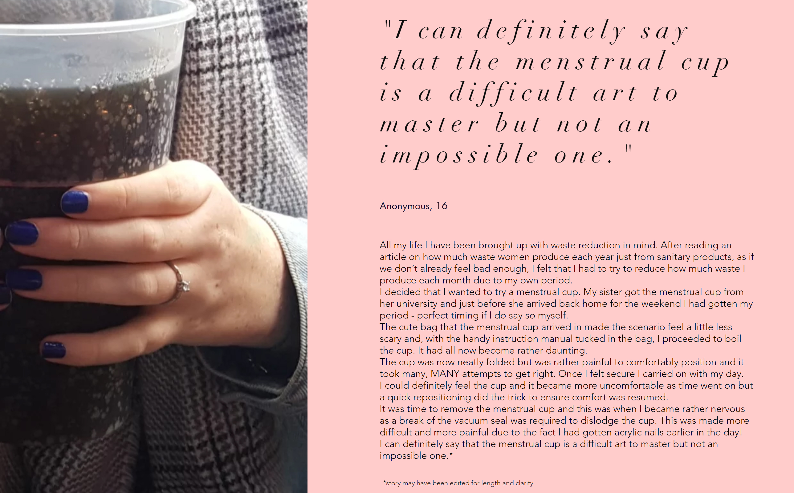
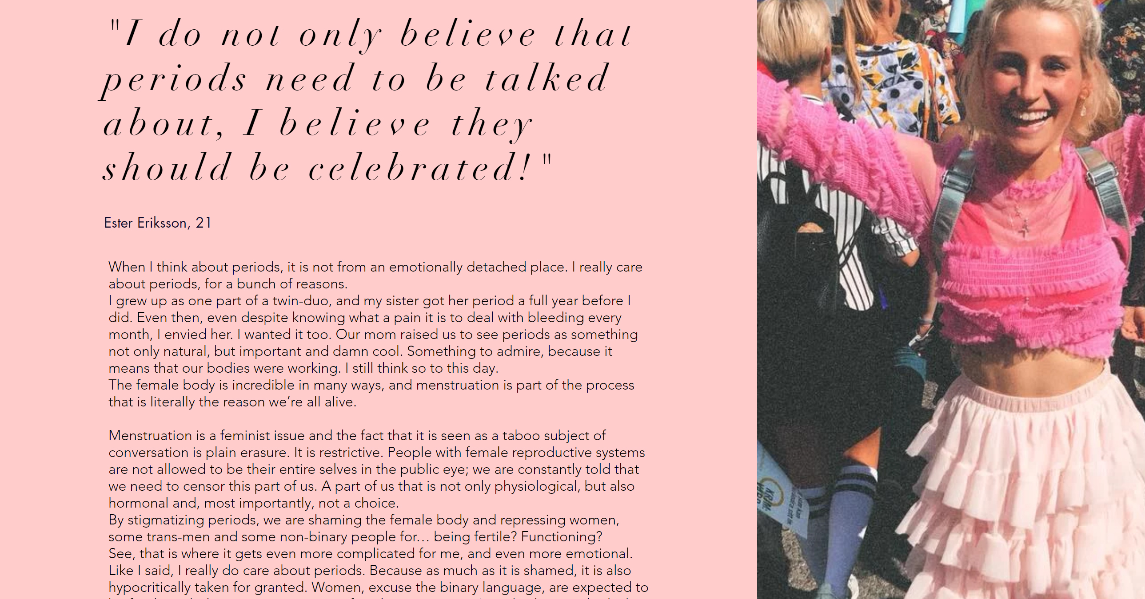
Iterate – Fail & Fix (Stories)
Period Blether
Stories empower communities
Simplest interventions can create the most impact
Notes:
Please add the relevant information about your lesson. Don’t forget to add “Related Resources” links to help tutors and students learn more about the themes covered in this lesson.

Slide 21
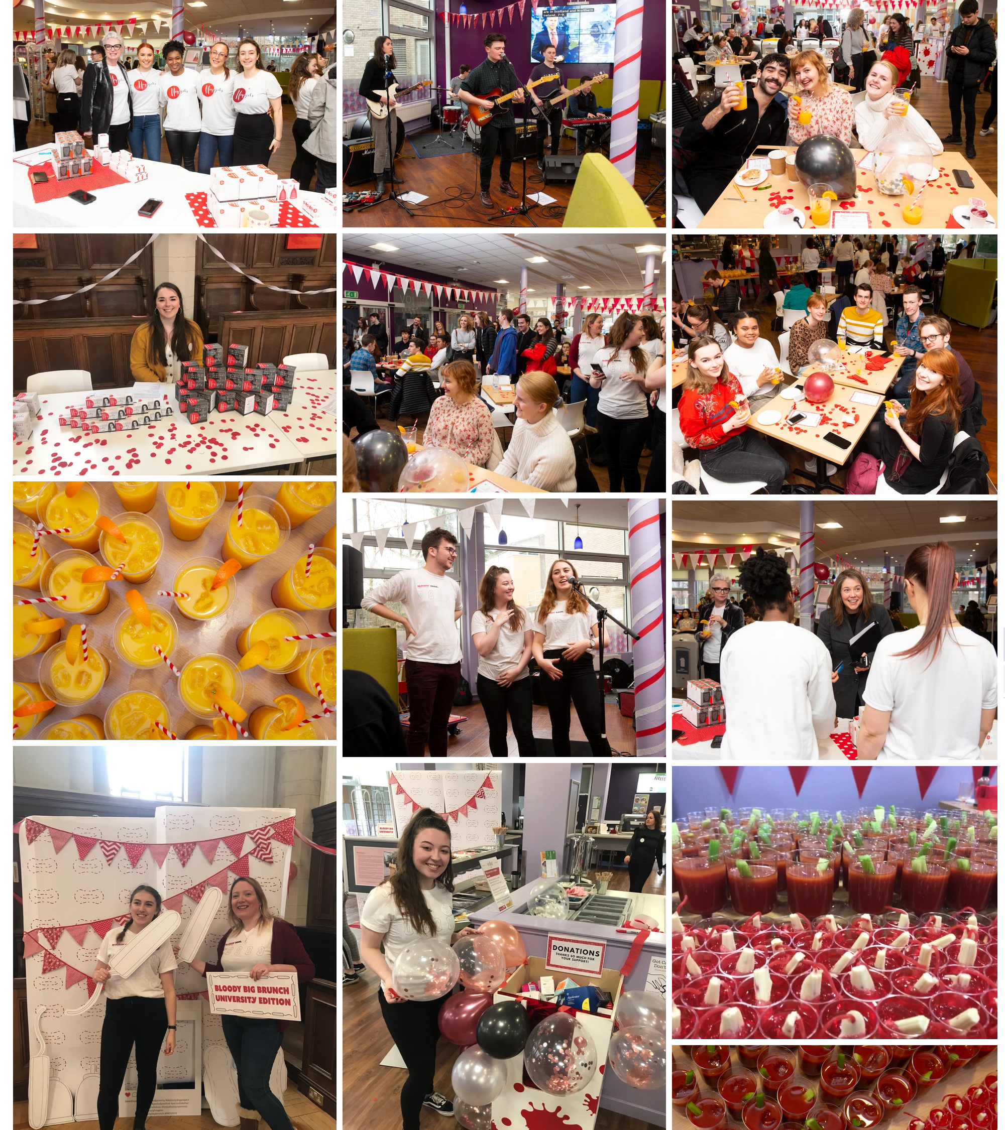
Iterate – Fail & Fix (Awareness)
Bloody Big Brunch
Events create communities
Notes:
Please add the relevant information about your lesson. Don’t forget to add “Related Resources” links to help tutors and students learn more about the themes covered in this lesson.

Slide 22
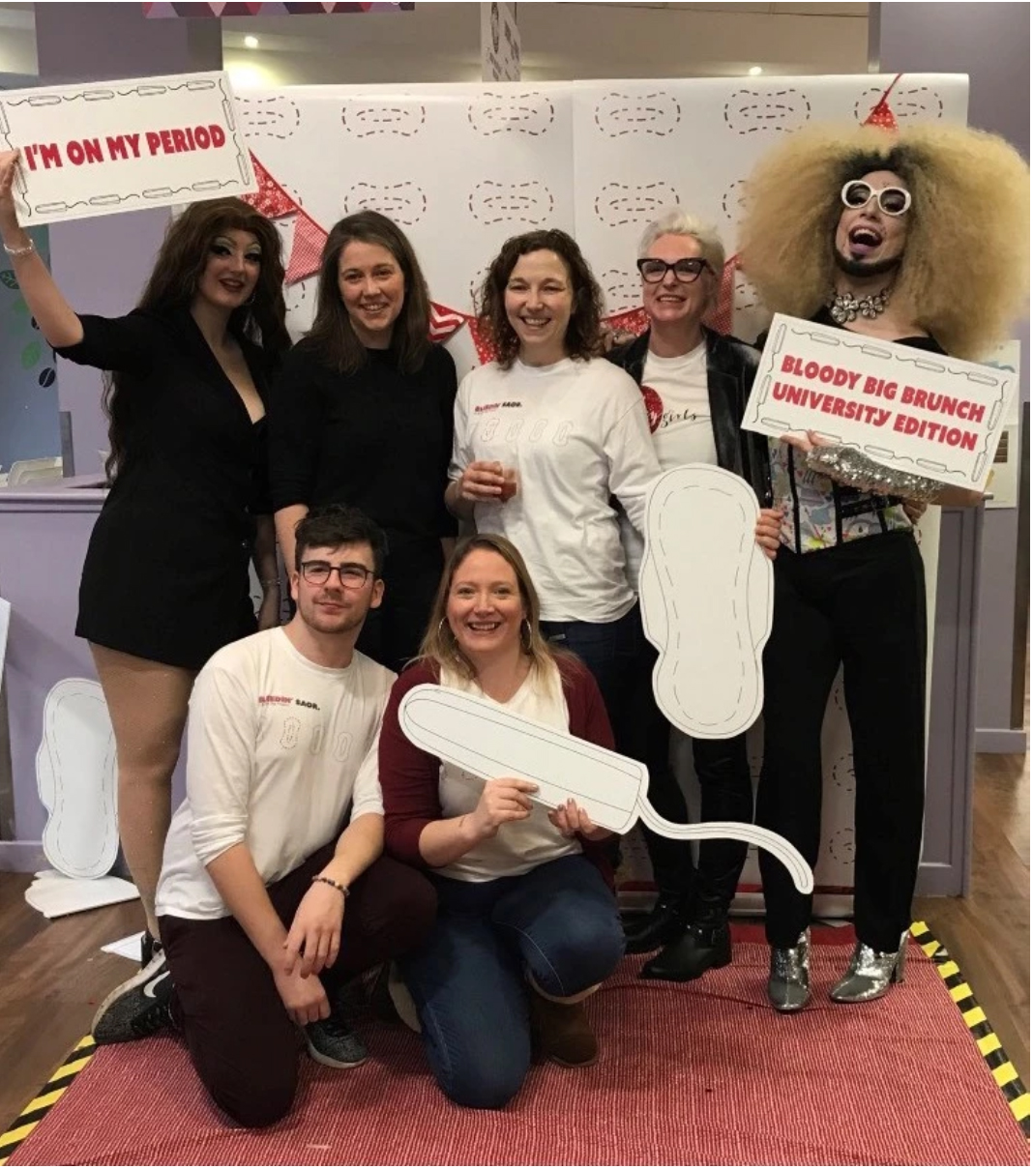
Iterate – Fail & Fix (Awareness)
Bloody Big Brunch
Events create communities
Raising awareness gives people permission to have dialogue
Notes:
Please add the relevant information about your lesson. Don’t forget to add “Related Resources” links to help tutors and students learn more about the themes covered in this lesson.

Slide 23
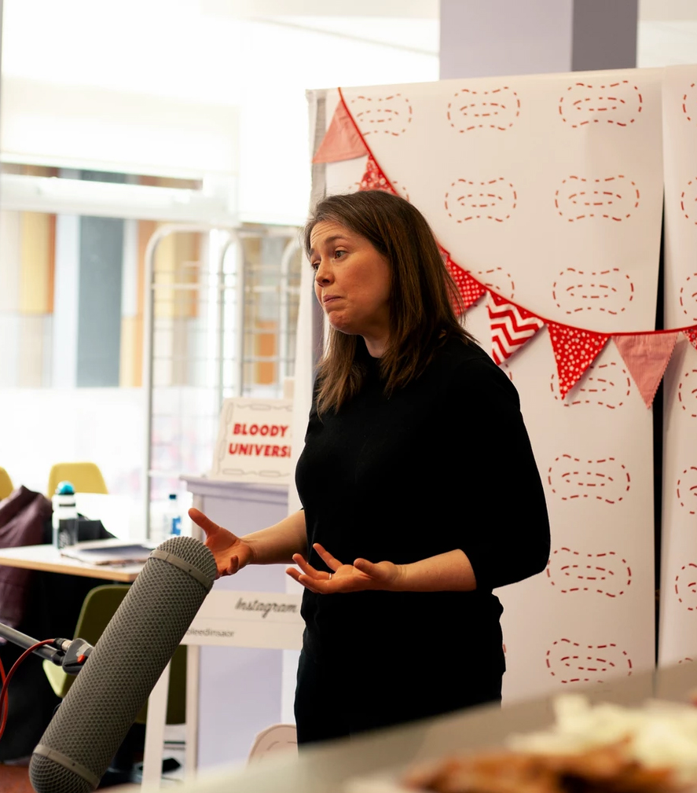
Iterate – Fail & Fix (Awareness)
Bloody Big Brunch
Events create communities
Raising awareness gives people permission to have dialogue
Dialogue creates change
Notes:
Please add the relevant information about your lesson. Don’t forget to add “Related Resources” links to help tutors and students learn more about the themes covered in this lesson.

Slide 24
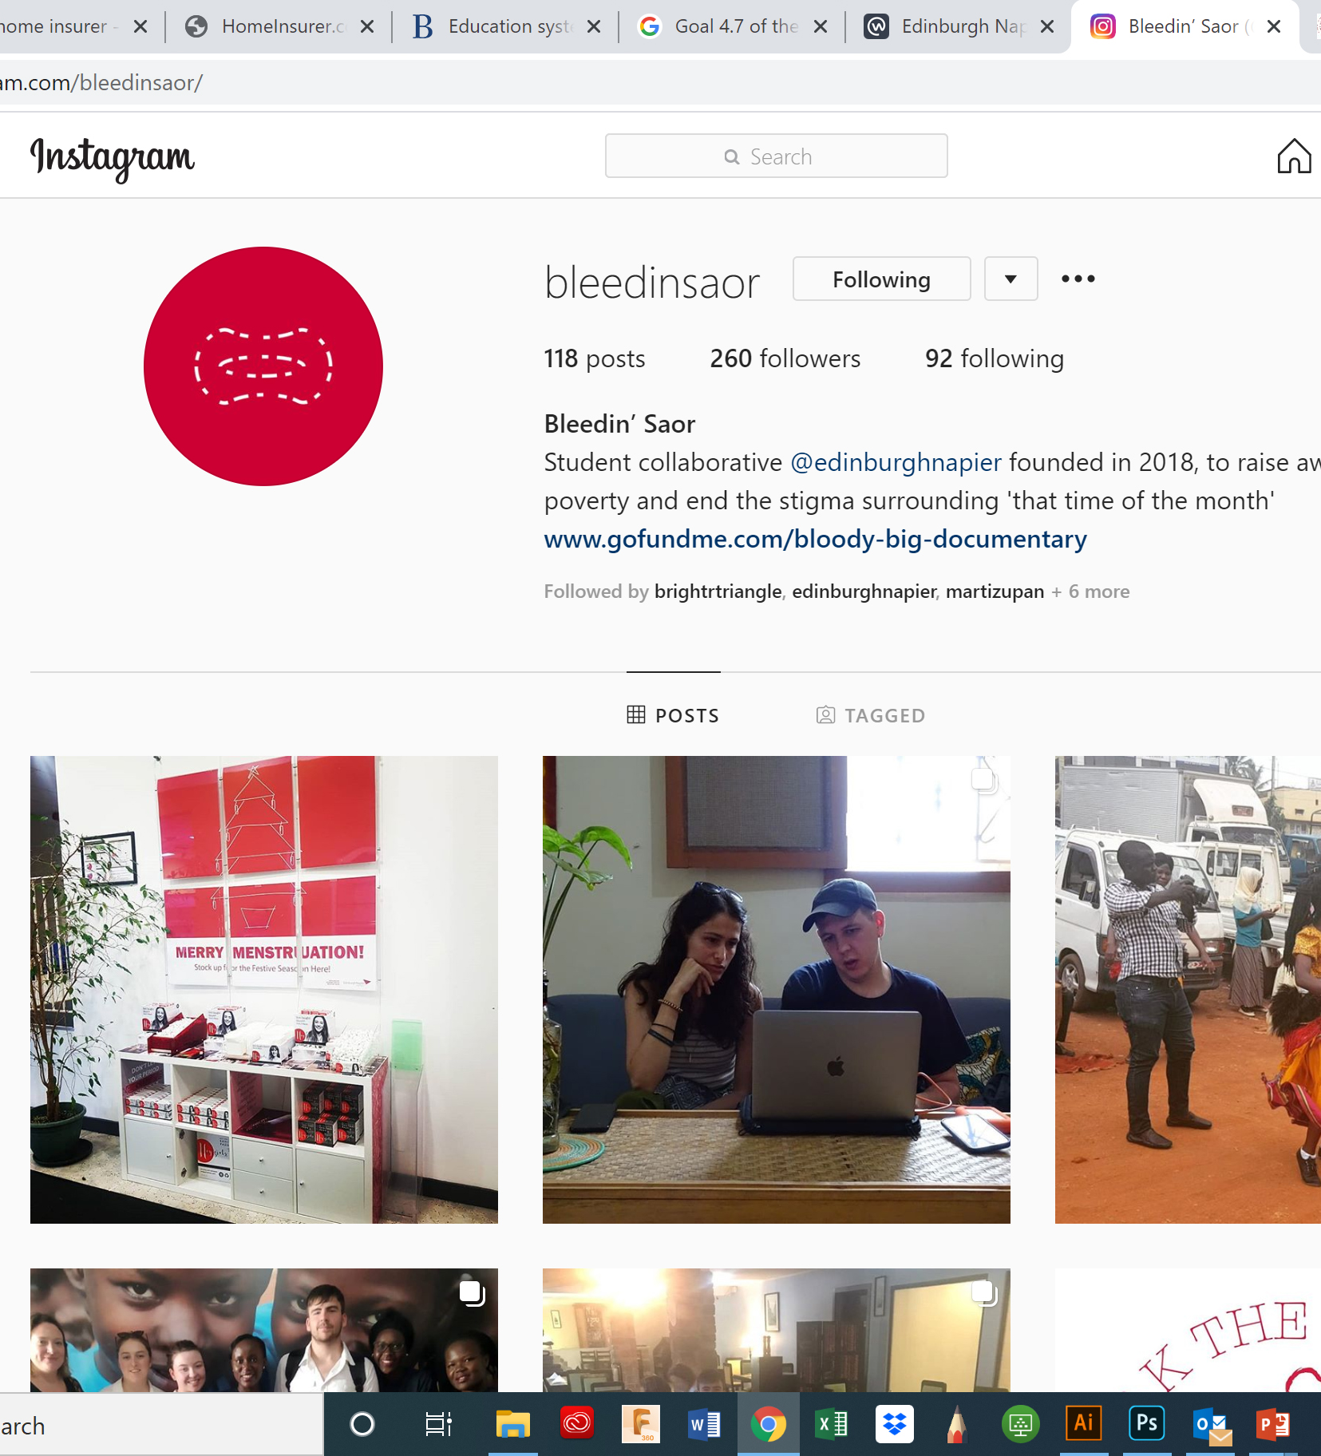
Communicate – Mixed Media
Media – Social and Conventional
Notes:
Please add the relevant information about your lesson. Don’t forget to add “Related Resources” links to help tutors and students learn more about the themes covered in this lesson.

Slide 25
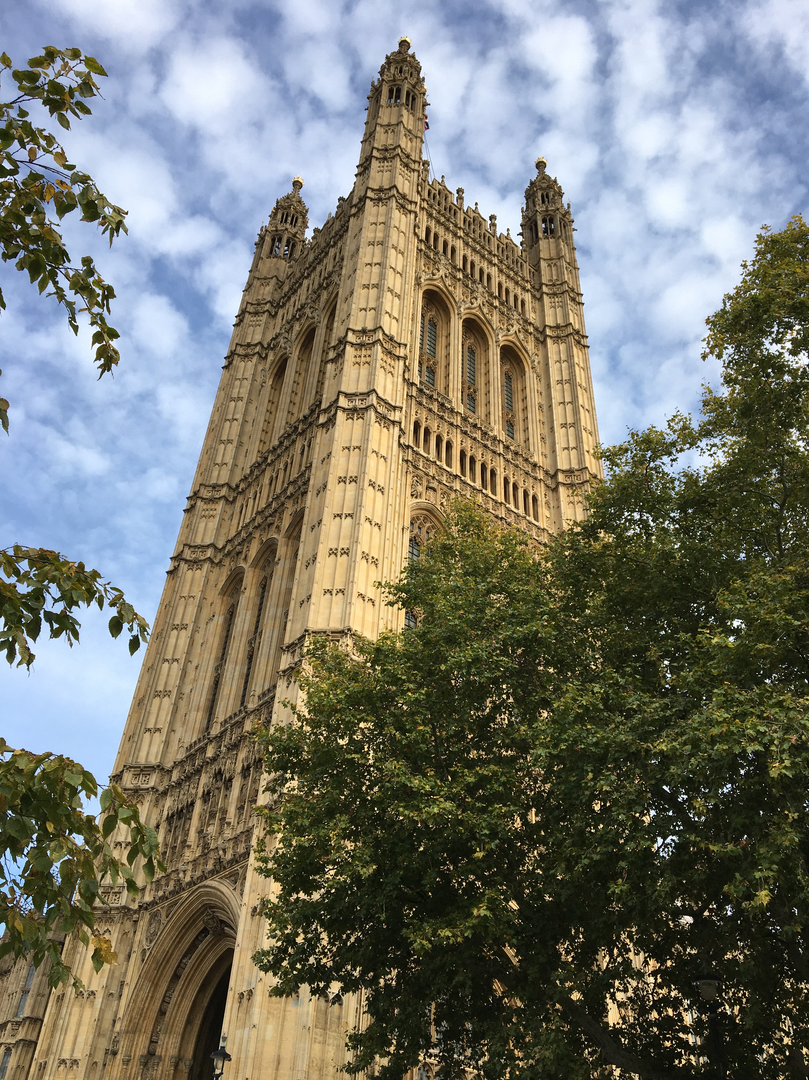
Communicate – Mixed Media
Media – Social and Conventional
Policy consultation
Notes:
Please add the relevant information about your lesson. Don’t forget to add “Related Resources” links to help tutors and students learn more about the themes covered in this lesson.

Slide 26
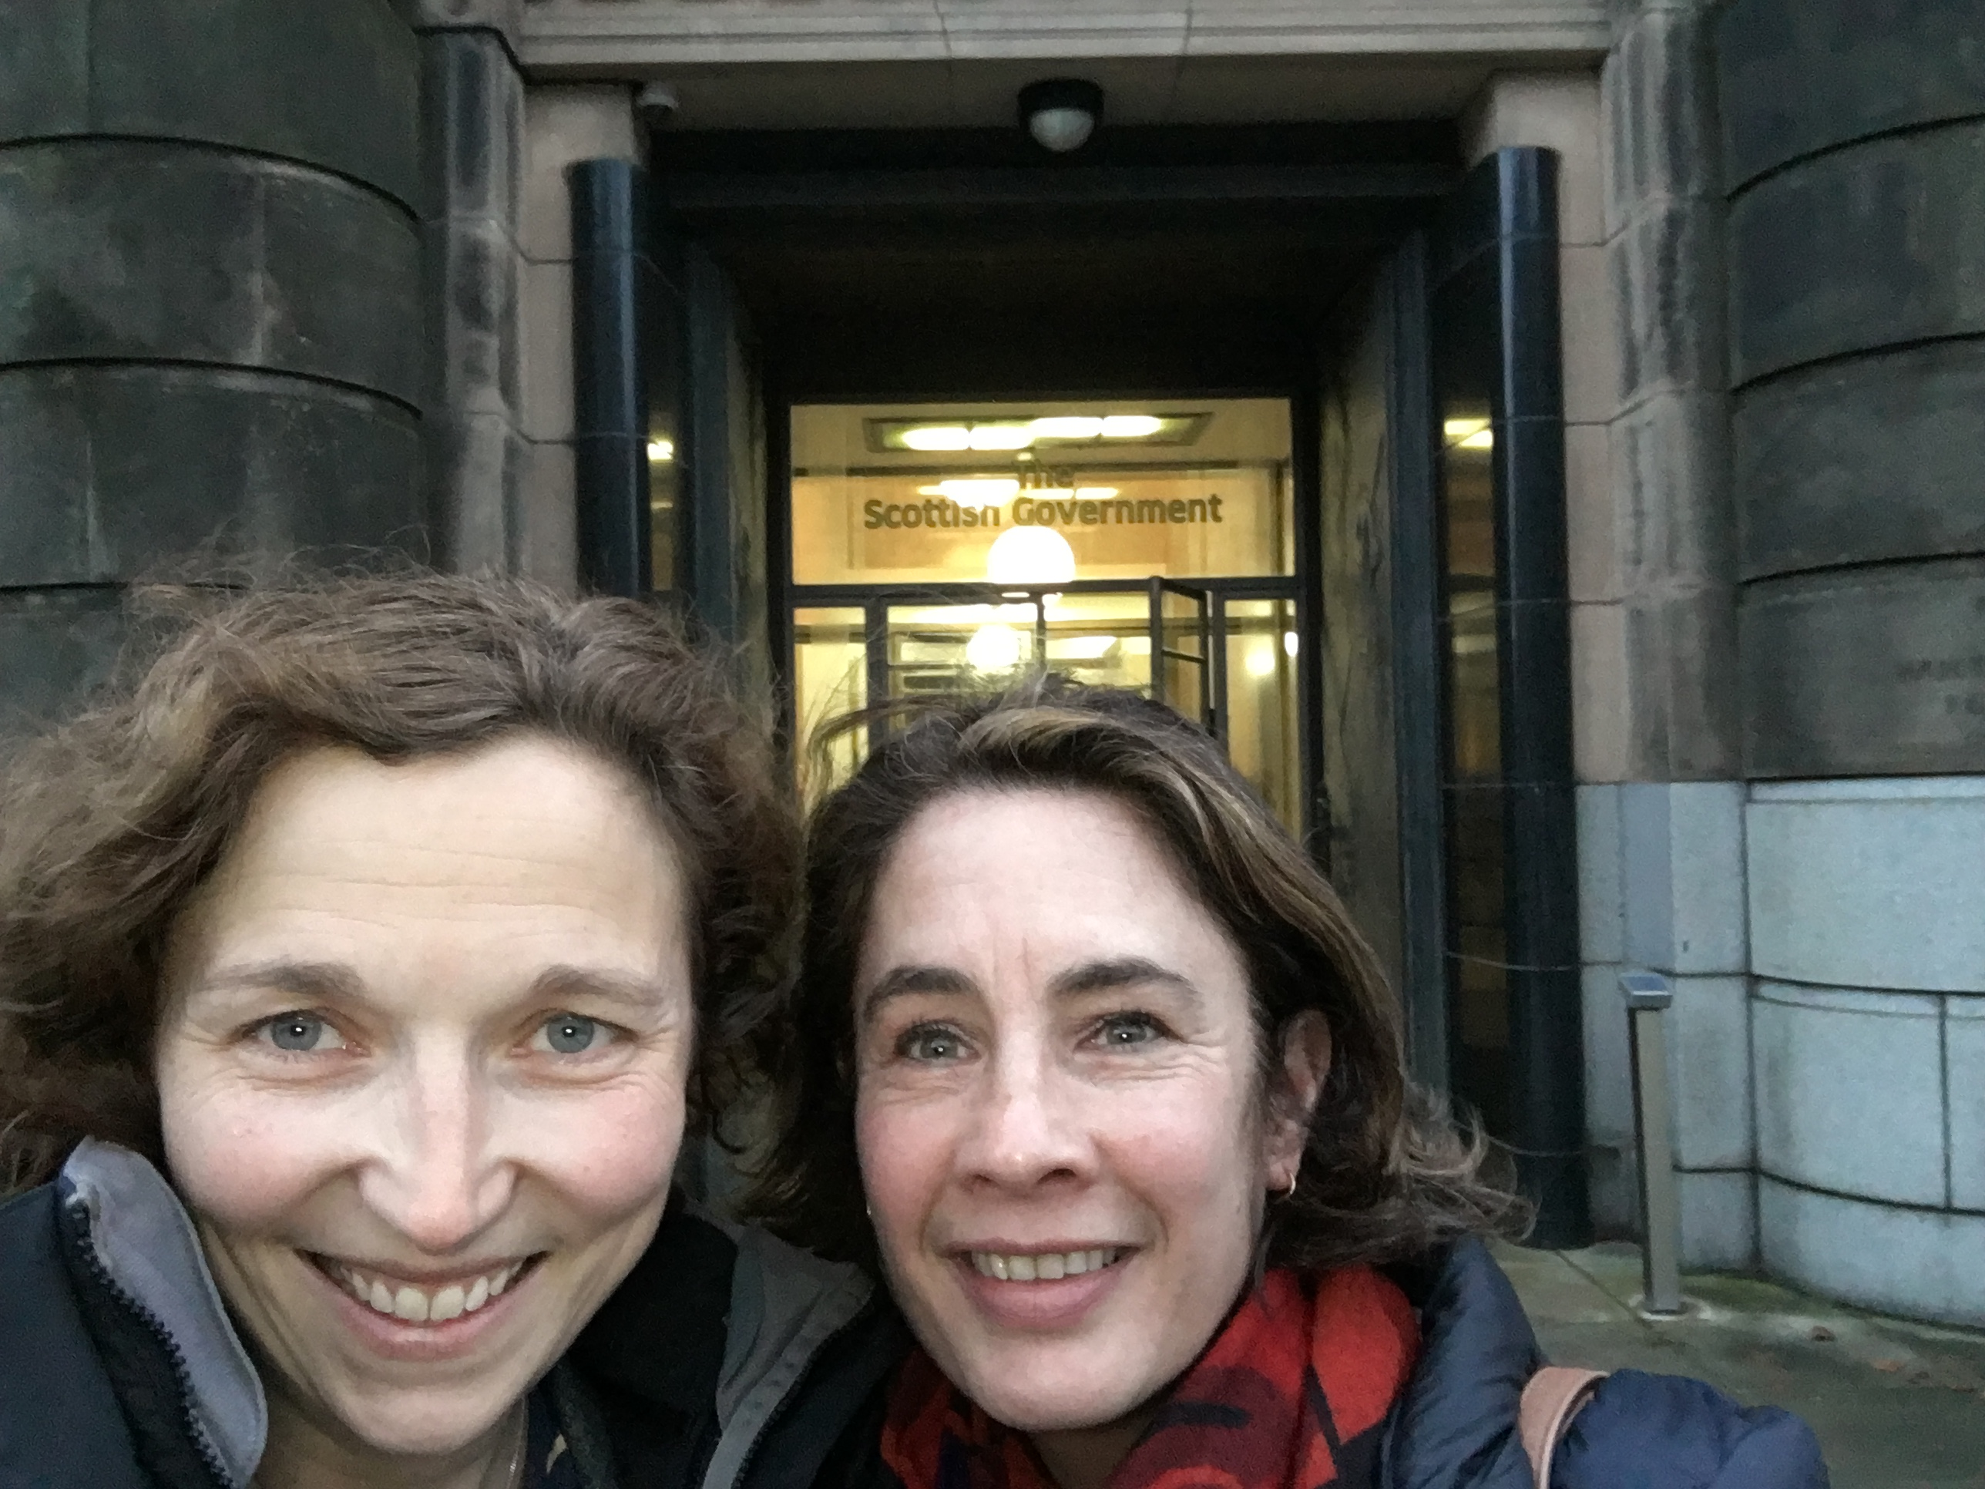
Communicate – Mixed Media
Media – Social and Conventional
Policy consultation
Notes:
Please add the relevant information about your lesson. Don’t forget to add “Related Resources” links to help tutors and students learn more about the themes covered in this lesson.

Slide 27
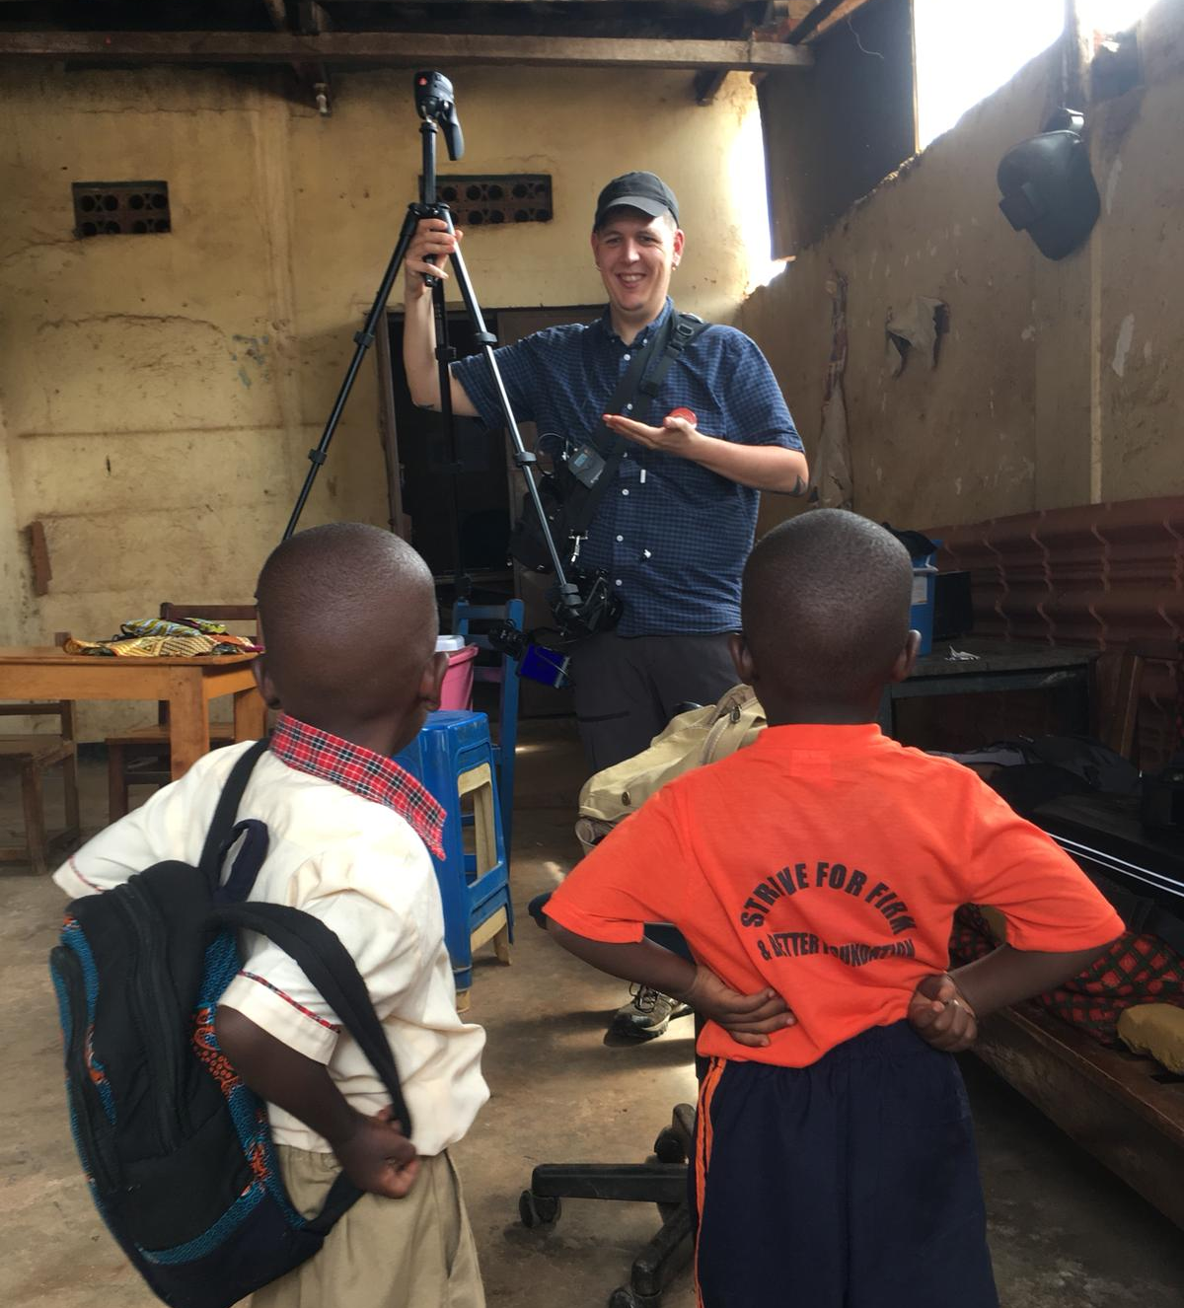
Communicate – Mixed Media
Media – Social and Conventional
Policy consultation
Documentary Film
Notes:
Please add the relevant information about your lesson. Don’t forget to add “Related Resources” links to help tutors and students learn more about the themes covered in this lesson.

Slide 28
Communicate – Mixed Media
Media – Social and Conventional
Policy consultation
Documentary Film
Academic Conference
Notes:
Please add the relevant information about your lesson. Don’t forget to add “Related Resources” links to help tutors and students learn more about the themes covered in this lesson.

Slide 29
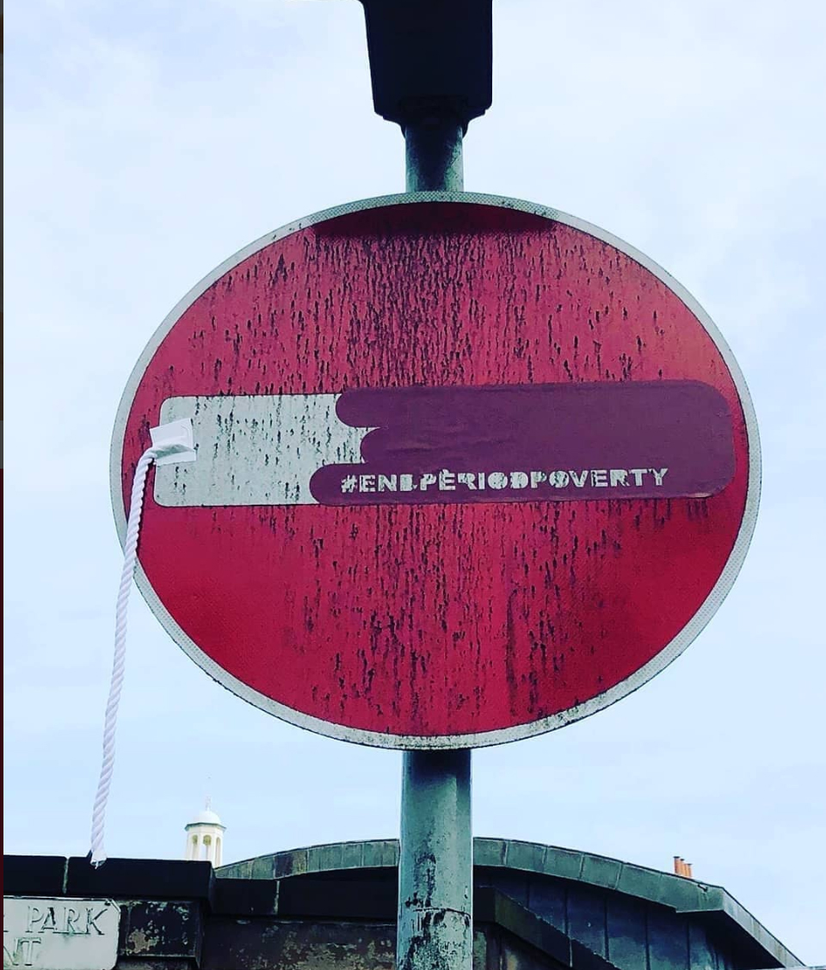
Communicate – Mixed Media
Media – Social and Conventional
Policy consultation
Documentary Film
Academic Conference
Artistic Interventions
Notes:
Please add the relevant information about your lesson. Don’t forget to add “Related Resources” links to help tutors and students learn more about the themes covered in this lesson.

Slide 30
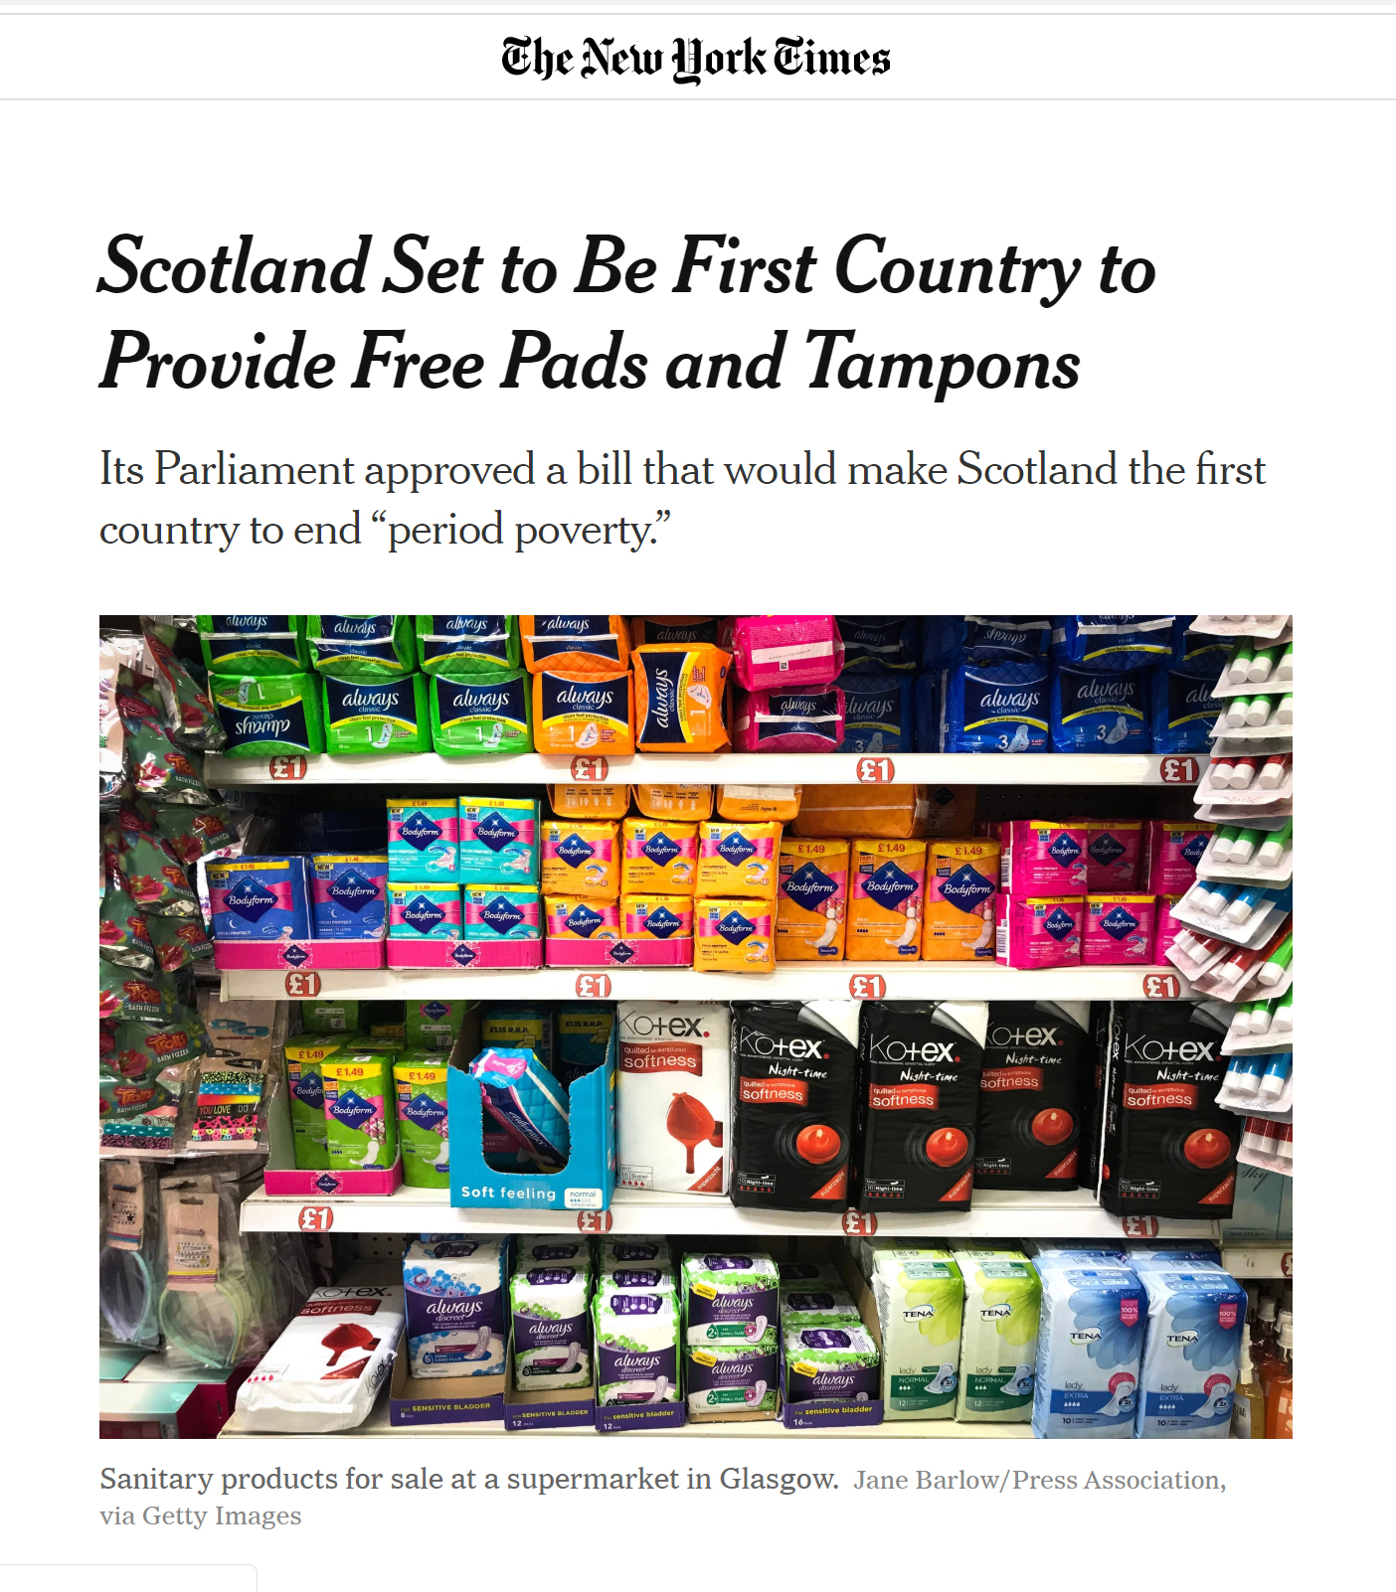
Reflect
Impact
Changed National Policy
Notes:
Please add the relevant information about your lesson. Don’t forget to add “Related Resources” links to help tutors and students learn more about the themes covered in this lesson.

Slide 31
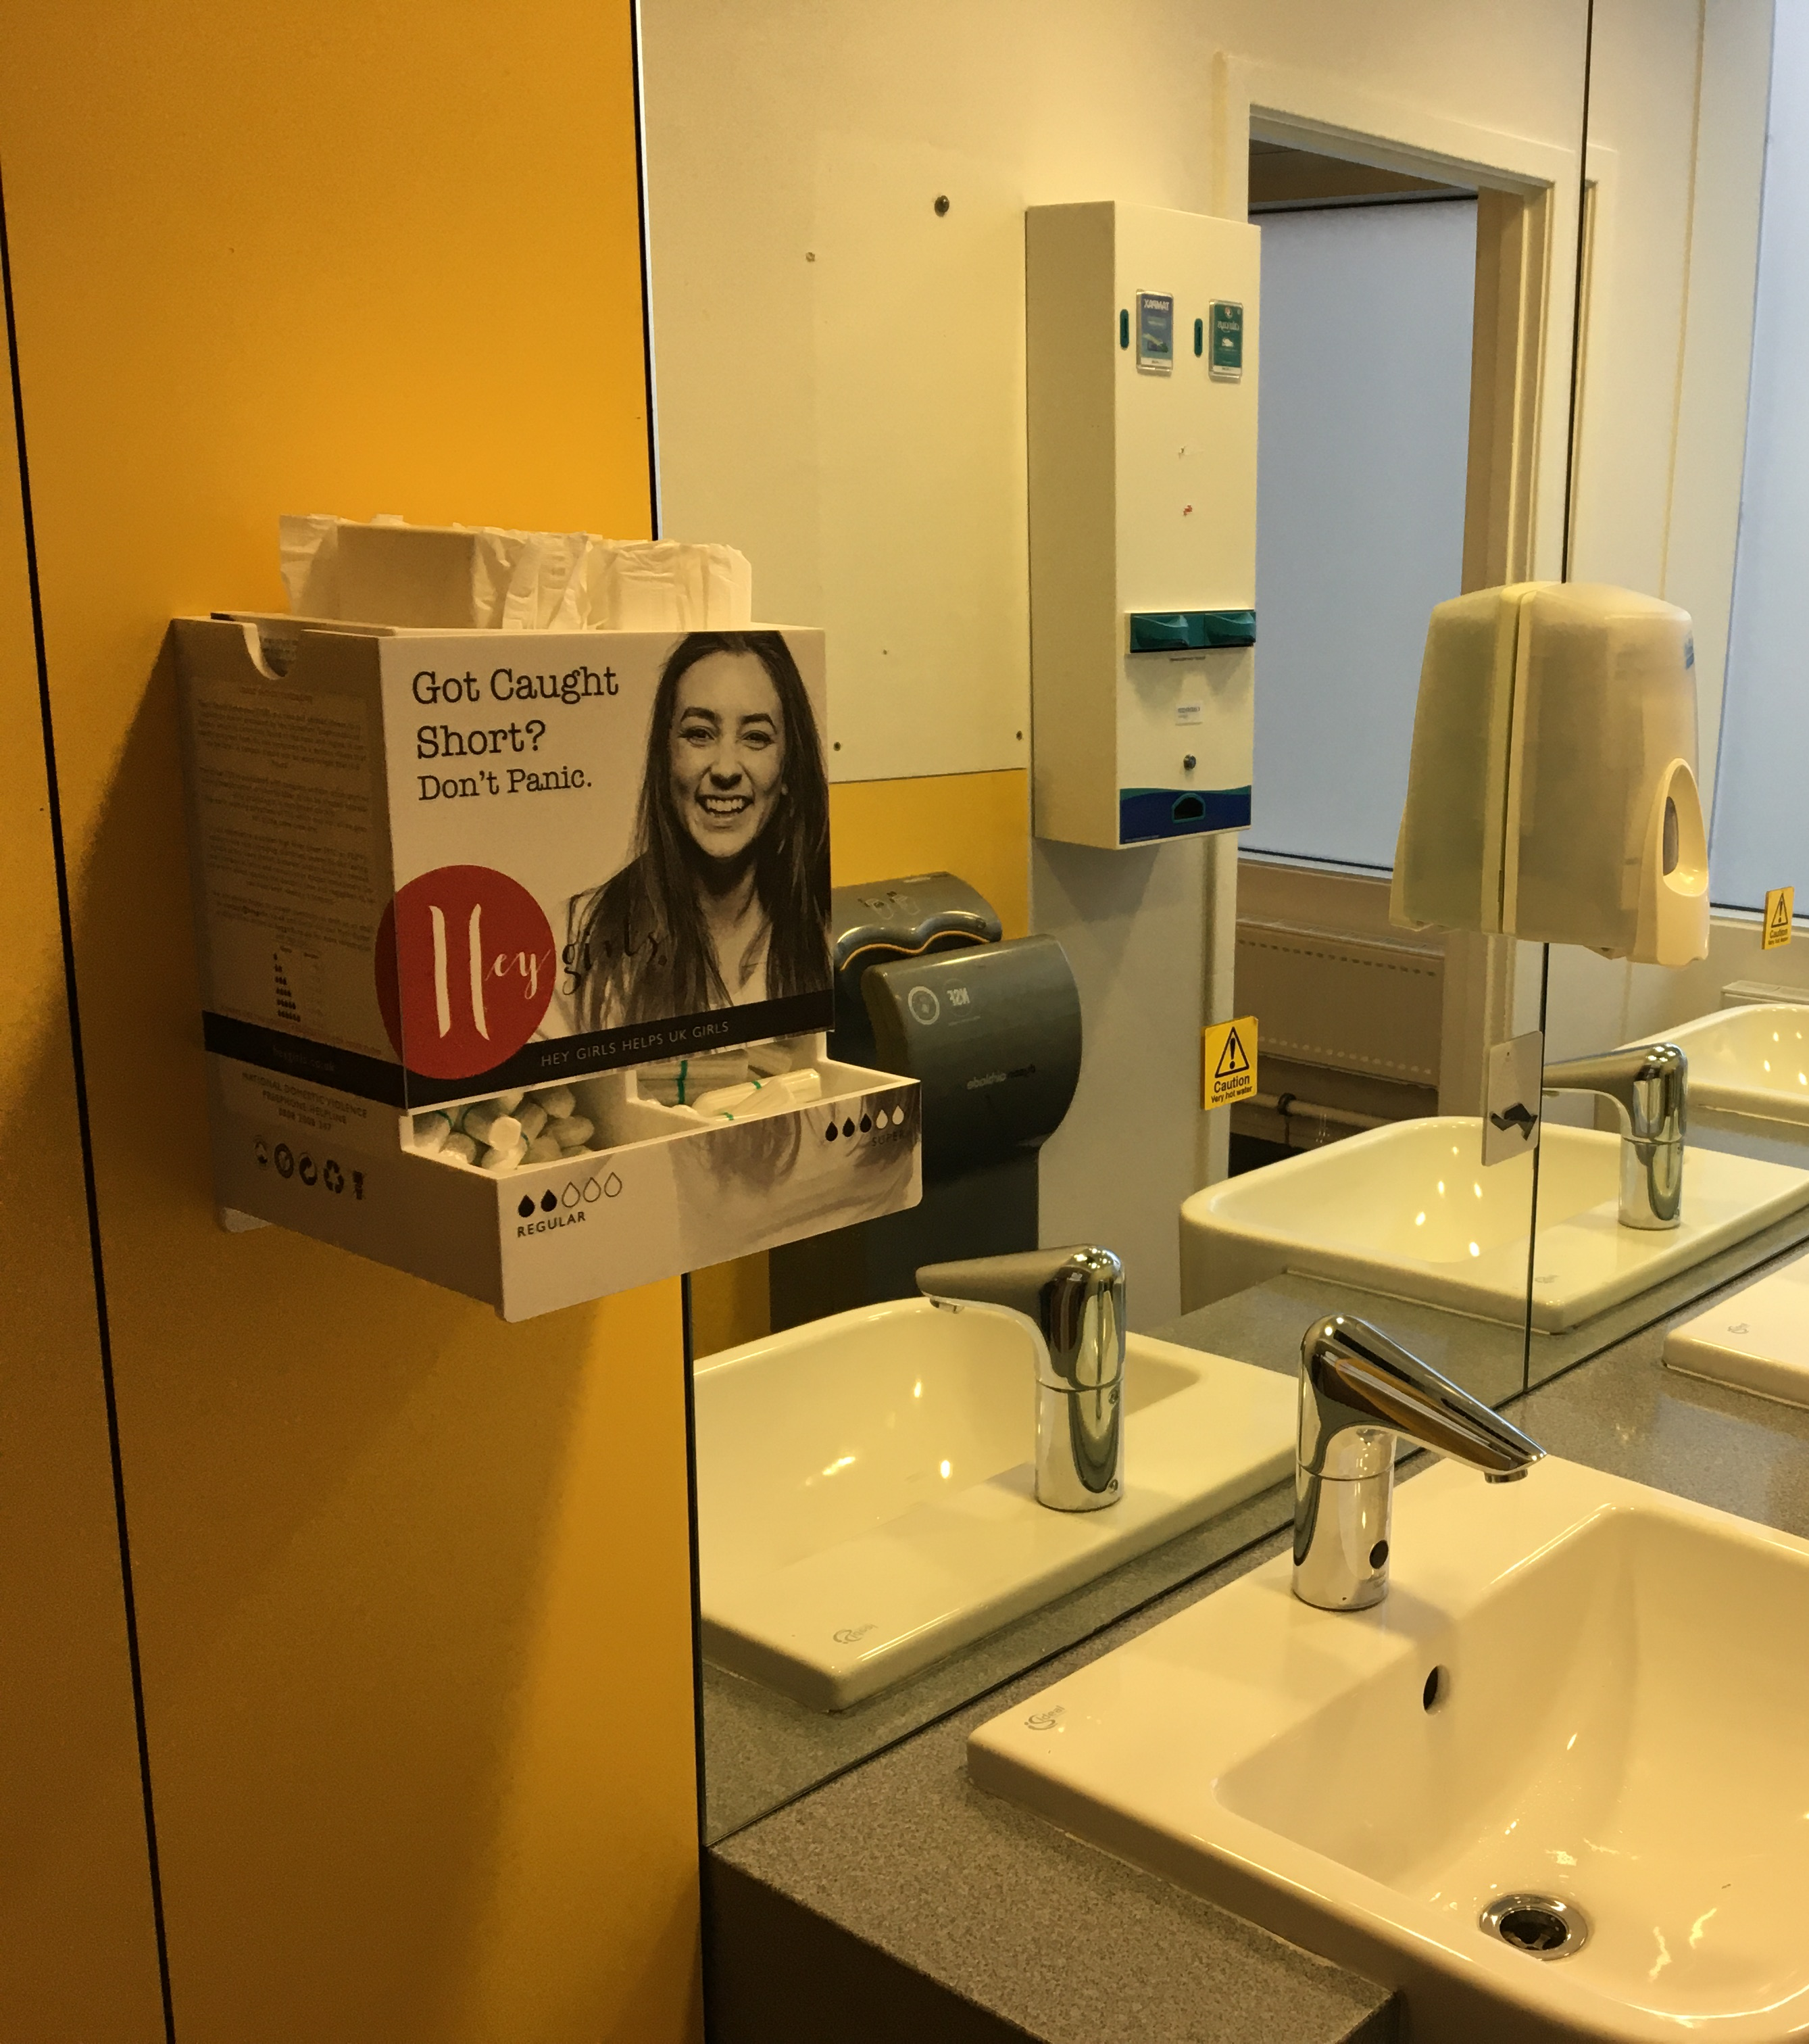
Reflect
Impact
Changed National Policy
All Edinburgh Napier University facilities have free products
Notes:
Please add the relevant information about your lesson. Don’t forget to add “Related Resources” links to help tutors and students learn more about the themes covered in this lesson.

Slide 32
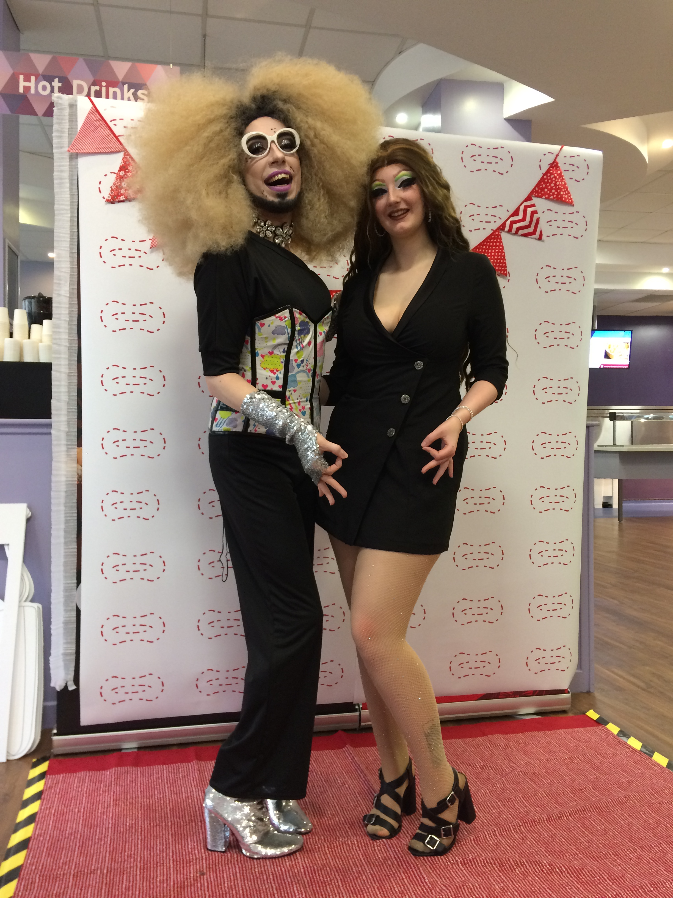
Reflect
Impact
Changed National Policy
All Edinburgh Napier University facilities have free products
Fostered an environment for activism
Notes:
Please add the relevant information about your lesson. Don’t forget to add “Related Resources” links to help tutors and students learn more about the themes covered in this lesson.

Slide 33
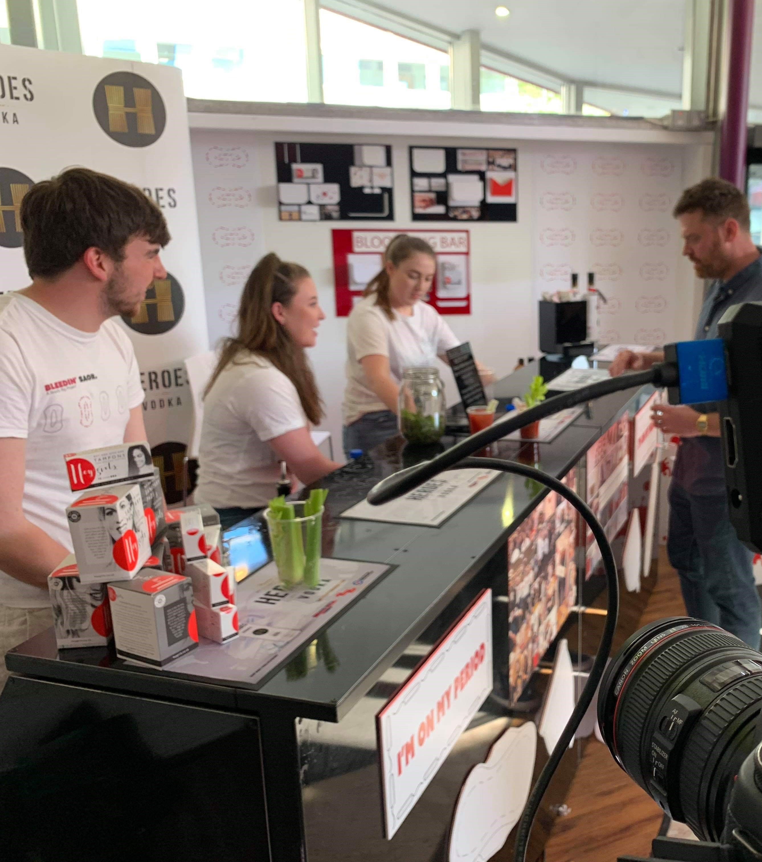
Reflect
Impact
Changed National Policy
All Edinburgh Napier University facilities have free products
Fostered an environment for activism
Enhanced the University community
Notes:
Please add the relevant information about your lesson. Don’t forget to add “Related Resources” links to help tutors and students learn more about the themes covered in this lesson.

Slide 34
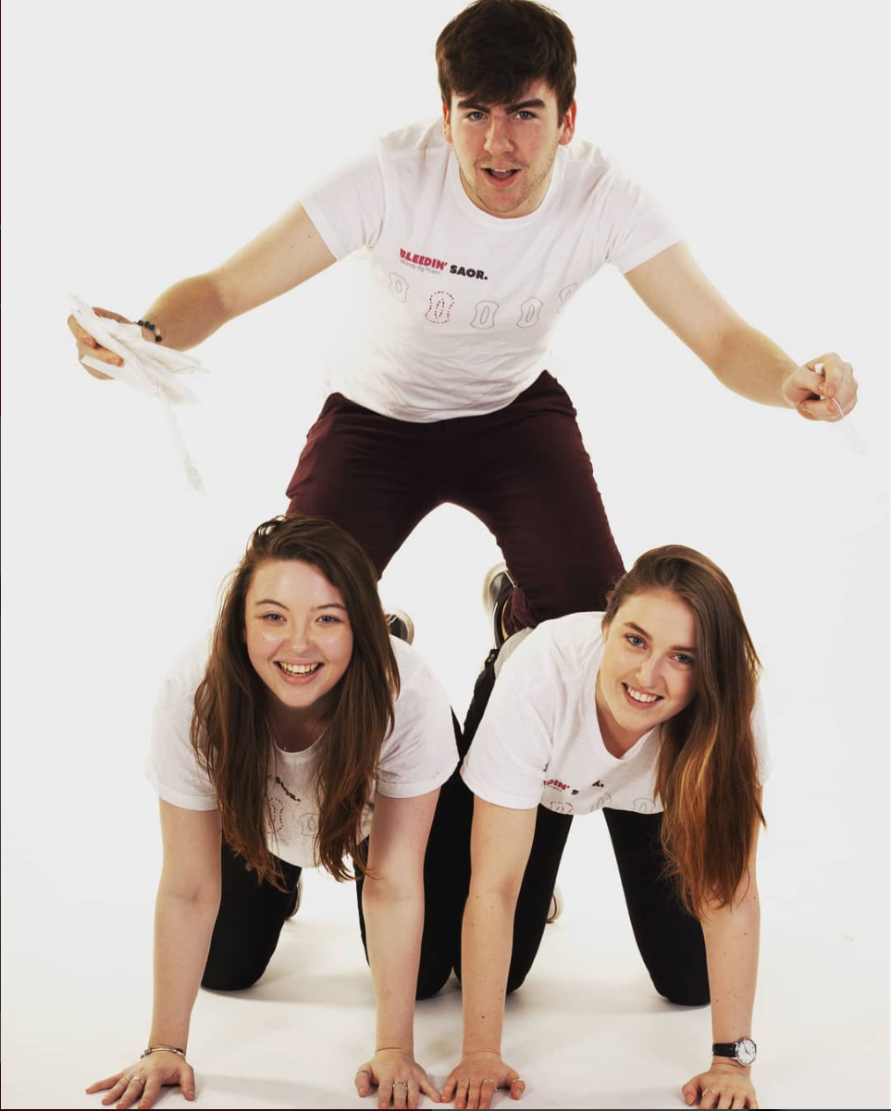
Reflect
Impact
Changed National Policy
All Edinburgh Napier University facilities have free products
Fostered an environment for activism
Enhanced the University community
Provided excellent teaching and learning
Notes:
Please add the relevant information about your lesson. Don’t forget to add “Related Resources” links to help tutors and students learn more about the themes covered in this lesson.

Slide 35
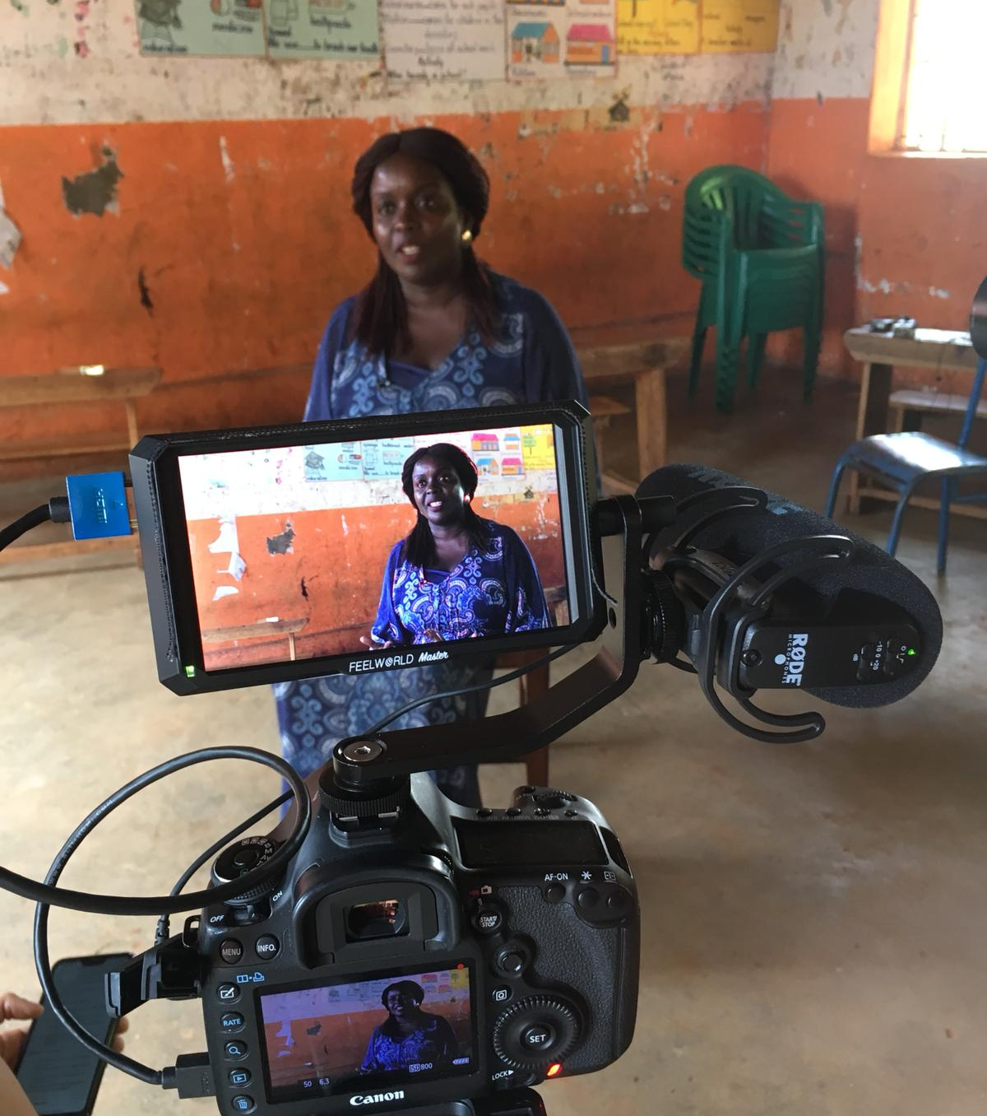
Reflect
Improvements
Align with academic research
Missed opportunities to collect data
Design Thinking is action without consideration “Fail Fast to Succeed Sooner”
Difficult to evaluate the consequences of this
Notes:
Please add the relevant information about your lesson. Don’t forget to add “Related Resources” links to help tutors and students learn more about the themes covered in this lesson.

Slide 36
The Bloody Big Project
DESIGN THINKING FOR SOCIAL CHANGE
We changed the world in a year
For the better….we think?!
Design Thinking doesn’t replace academic research
Design Thinking can create impact where research isn’t funded
Design Thinking more often highlights where more research is needed
Ruth Cochrane
Edinburgh Napier University
Notes:
Add a license-free picture (like from www.unsplash.com) in the background representative of the the theme of the lesson and make it 50% transparent.

