Slide 1
The ‘Working For Families Fund’ programme database
Ronald McQuaid and Robert Raeside
Employment Research Institute,
Napier University, Edinburgh
Presentation to the Scottish Social Survey Network network, Edinburgh, 20 November 2008

Slide 2
Structure of the presentation
Background and aims of Working for Families Fund
The evaluation
Data collection
Some examples of the analysis, Regression, Panel data, Propensity Score Matching
Conclusions

Slide 3
ERI Team
Many people were involved in the evaluation team over the 4 years (2004-08). These include:
Ronald McQuaid
Sue Bond
Vanesa Fuertes
Cathy Craig
Robert Raeside
Plus Colin Lindsay
Jesus Canduela etc.

Slide 4
The Scottish Government’s Working for Families Fund

Slide 5
Aims of Working for Families Fund (WFF)
Funding and strategic management/objectives set by Scottish government; delivery by local authorities
Improve employability of lone parents and parents with barriers to work/labour market participation
Targeting lone parents, ‘households in poverty’, ‘households with stresses’ (drugs, mental health, etc.)
All participation voluntary

Slide 6
How to achieve aims of WFF
Improve awareness of and access to childcare
Improve knowledge of employability/training services
Offer limited new childcare/employability services
Engage and support parents through mentoring, advice, counselling, personalised support (Key worker model)
Help both inactive and those in work (breaking the low pay-no pay cycle)

Slide 7
Funding and geography of WFF
£50M (€72M) budget 2004-08
20 (initially 10) of Scotland’s 32 local authorities
2004-06: 10 local authorities (2 rural areas with greatest economic inactivity, 8 areas with more than 3,000 children in benefit-dependent households)
2006-08: further 10 local authorities
Local authorities’ populations ranging from 82,000 to 578,000; unemployment from 3% to 8%
Workless family households: 31% Glasgow; 12% Highland
Lone parent households: 42% Glasgow; 19% Dumfries

Slide 8
WFF Evaluation

Slide 9
Evaluation research challenges
Detailed baseline of objective and perceived barriers to work – allows us to place outcomes in context and explain differences between individuals’ progress
Identify key issues that can affect employability
Identify aims and aspirations – compare outcome with what client wanted as well as policy aims
Changing aspirations may be positive ‘soft’ outcome
Consistent measure of changes in confidence

Slide 10
Evaluation research challenges (2)
Emphasis on FORMATIVE as well as SUMMATIVE evaluation – regular reporting
Formative evaluation – commitment (and data!) from practitioners in return for timely, useful analysis to inform policy development during the process
Developed system to provide – client monitoring data for WFF staff; evaluation data for researchers
Mixed methods – qualitative research on HOW and WHY the programme worked/did not work

Slide 11
Overview of Evaluation
Communication: Regular meetings and feedback to LAs and Scottish Government, events
Consistent data collection: Quarterly updates of data on registration, follow-up etc., Quality checking data
Case Studies
Triangulation
Control group
Analysis and recommendations

Slide 12
Evaluation research methods
Extensive interviews with clients at start (baseline)
Focus on employability: individual factors (skills, qualifications, experience); personal circumstances (childcare responsibilities, ‘household stresses’ such as drugs); external barriers (transport, benefits, jobs)
Income and employment status of self and spouse
Perceived barriers to work
Aim of participation; aspirations for the future
10 point scales to measure confidence

Slide 13
Evaluation research methods
Extensive follow-up interviews with clients…after ‘major transition’ (got a job, got a better job, lost a job, started training); 6 months; on-going
Details of outcome: occupation, pay, hours, type of training, level of qualification
Impact of WFF? How could WFF be improved?
Follow up interviews to assess sustainability

Slide 14
TYPES OF OUTCOMES
‘Hard’ Outcomes
(Key Transition)
Outcomes
Intermediate
Activities
‘Soft’ Outcomes
Employability
Measures
14

Slide 15
Some findings…

Slide 16
Numbers of New Clients Registered by Month to 31 December 2008
Total: 25,508 clients
16

Slide 17
Type of Latest KEY Transitions to 31 December 07
47%
31%
Total Number of Transitions = 13,095 by March 2008
17

Slide 18
Intermediate Activity Outcomes (w/o Key Transition) to 31 March 07
Total IA outcomes without Key Transition = 850
18

Slide 19
Distance travelled: Change on Employability Measures – Change in Average Score between Registration and at Six-Month Review
19
Notes:
19

Slide 20
All Client Outcomes to 31 March 2007 to 31 March 2008
No significant
Outcome
28%
(7,202)
Key transition
Registered in
51%
(13,095)
previous 6 month
(no outcome
expected)
7%
(1,666)
Valid Six Month
monitoring
Intermediate Activity
4%
(906)
Outcome
10%
(2,576)
20

Slide 21
Measuring ‘distance travelled’
Among those still not working after six months:
Childcare now less of a barrier
Low self-esteem now less of a barrier, but….
Scales demonstrated moderate progress in confidence-building, especially on childcare
Little progress on ‘external’ barriers such as access to transport, lack of social capital
Intractable problems around health/disability

Slide 22
Insights from policy case studies
10 Phase One local authorities; 15 case studies
Overview of management, programme content
We were able to focus on individual local projects, e.g.:
  access to transport in rural areas
  money/debt advice
  Work experience placements with employers
  Financial support for childcare and training clients in childcare
We were able to regularly report on HOW projects operated, WHY they worked well – formative evaluation to share good practice and inform the continuing development of policy

Slide 23
Variation by Area (illustrative – not final results)
Reference: West Lothian

Slide 24
Variables (illustrative – not final results)
Percentage Correct = 85.5%
Pseudo R Square = 24.7%

Slide 25
Draft Findings
Promoters
Qualifications
Age
Lone parent
Area – Glasgow or North Ayrshire
Inhibitors
Identifiable barriers
Under 20
Having been out of work for any period
Being pregnant
Phase 2 Local Authority

Slide 26
Propensity Model
Match to cases in “Control Group” – 198 from control and 668 from WFF
Transition rate of 18% in control group and 52% n WFF and improvement of
188% - but!
Cases in British Household Panel
1st September 2004 to 1st September 2005 BHPS = 40.6% WFF = 58.3% an improvement of 43.5%
( Matched on housing tenure own or rent -1202 matches from BHPS and 2115 from WFF)

Slide 27
Multi Level Model (illustrative – not final results)
Individuals live in local authorities

Slide 28
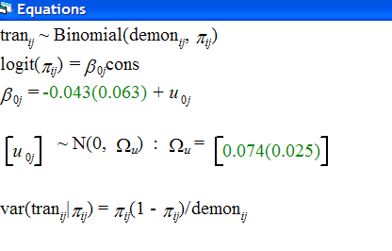
Equations (illustrative – not final results)

Slide 29
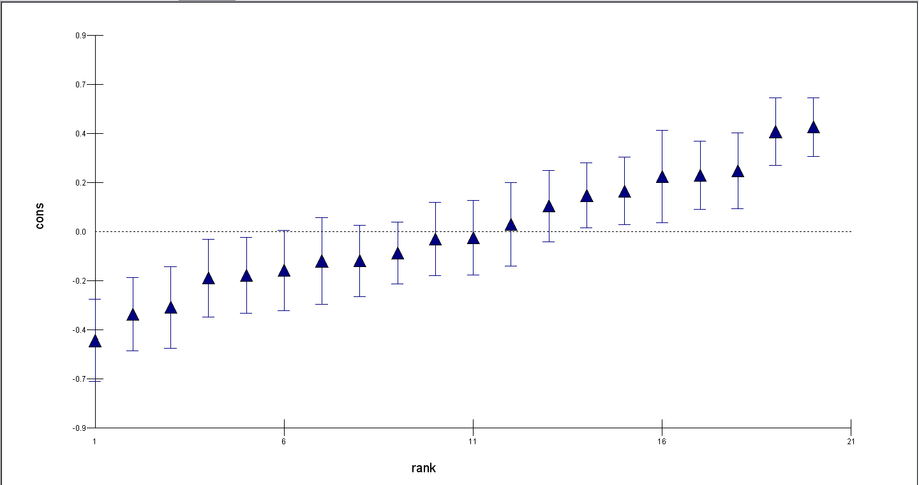
Variation with Local Authority (illustrative – not final results)
Glasgow City
North Ayrshire
Aberdeen City & Aberdeenshire
Dundee

Slide 30
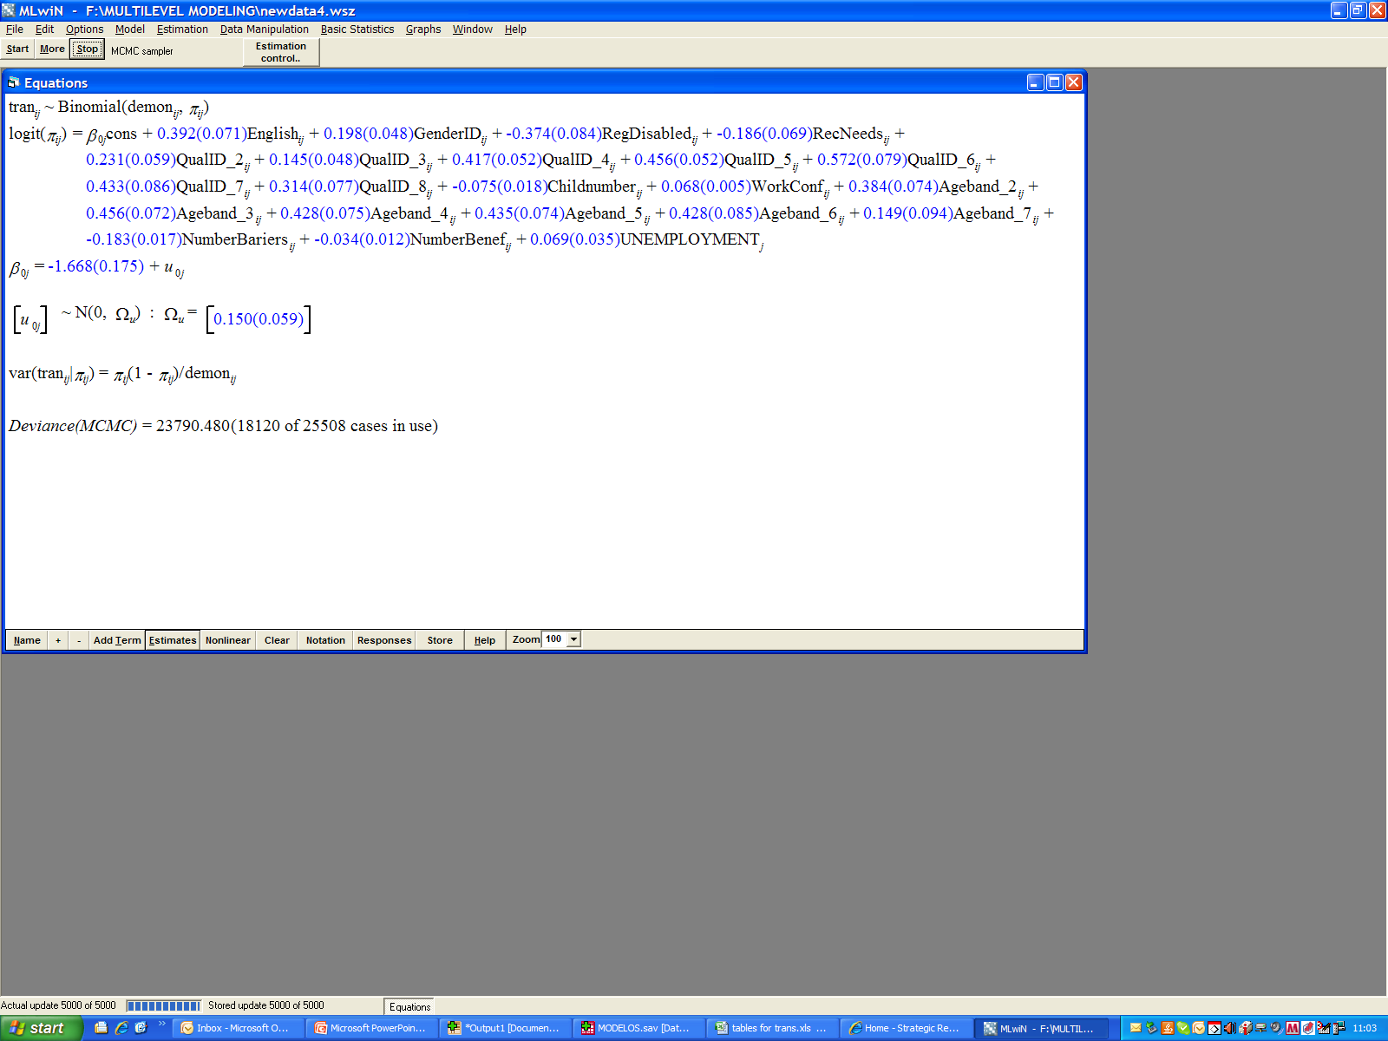
Fixed Effects Model (illustrative – not final results)

Slide 31
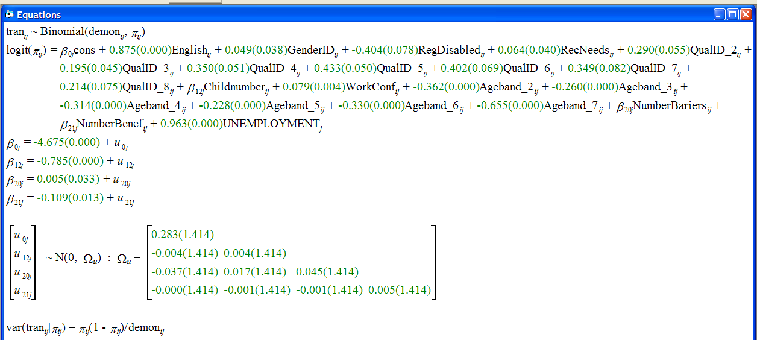
Random Effects Model (illustrative – not final results)

Slide 32
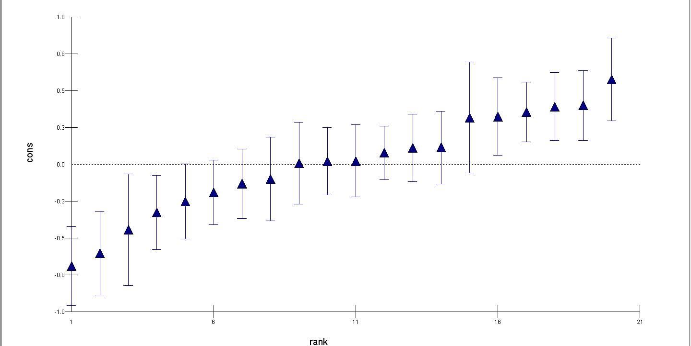
Residuals by Area (illustrative – not final results)
South Lanarkshire
Dundee
Aberdeen city
Aberdeenshire

Slide 33
Conclusions

Slide 34
Evaluating Working for Families Fund
Effectively targeted low-skilled lone parents with multiple barriers to work, limiting deadweight
Improved chances of finding work
Improved access to and knowledge of childcare
Sustained people in work through crisis
Confidence gains may lead to progress later
More help needed for those with fewer skills, those with severe household/skills problems

Slide 35
Reflecting on the evaluation
Avoiding simplistic ‘league table’ comparisons – in-depth, qualitative policy research and baseline data about clients allowed us to place results in context and explain differences across local authorities
In-depth, qualitative work = depth of understanding of HOW and WHY outcomes were achieved by different approaches
Case studies on policy help practitioners and policy makers to understand ‘what works’ and take action.
Formative evaluation of value to policy makers and service providers – sharing of good practice and informing policy development in process

Slide 36
The end
For more information see the Scottish Government Website:
www.scotland.gov.uk/
and the ERI website:
www.napier.ac.uk/eri
www.napier.ac.uk/randkt/rktcentres/eri/projects/Pages/WorkingforFamilies.aspx

