Slide 1
Moodle on the Move
Mobile VLE Access – why bother?
Do your students access Moodle this way?
What does that mean for page design?

Slide 2
Moodle on the Move
Question: If you left home without your phone what would the impact be?
I wouldn’t notice
Breathe sigh of relief
A Minor inconvenience
A Major problem
Would struggle to function

Slide 3
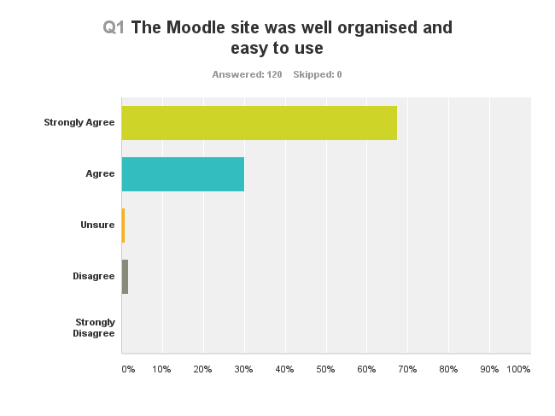
Moodle on the Move

Slide 4
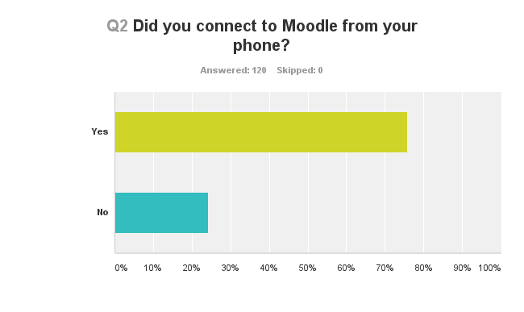
Moodle on the Move

Slide 5
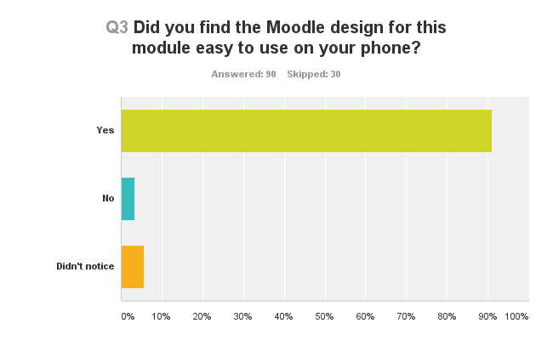
Moodle on the Move

Slide 6
Moodle on the Move
Could download lecture on to phone to view when on the go which is handy for traveling to and from work/uni
Really found it useful when i needed to access moodle and didn't have access to a computer, was a really good and beneficial idea
Was easy to use from any medium
Worked very well and easy to use on phone. This was great as I do lots of work from my phone!
Yes the moodle page worked just as well on a phone as it didn't on a pc.
It works really well. I use my phone more than I probably should so it was good for me to look at
It was simple, perfectly designed for the phone
Platform is not easy to access.
Better but could improve

Slide 7
Moodle on the Move
Design considerations
Last year
http://moodle.napier.ac.uk/course/view.php?id=8200
Current
http://moodle.napier.ac.uk/course/view.php?id=11672

Slide 8
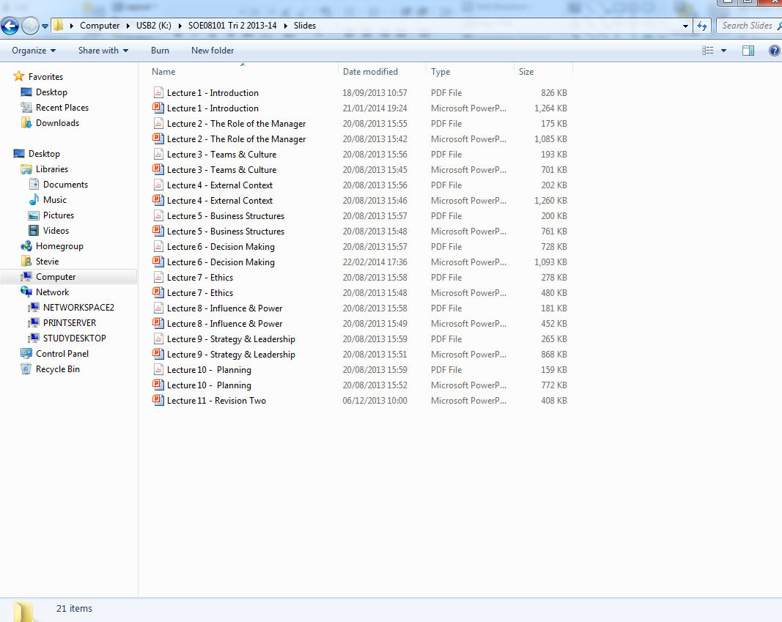
Moodle on the Move
Content considerations
File type – PPT v PDF
File sizes – download times

Slide 9
Moodle on the Move
Future considerations
Easier access
Site content
‘Unknown unknowns’

Slide 10
Moodle on the Move
Question, observations or suggestions?

